Slide 1
PACT4SKILLS 2021-1-CY01-KA220-HED-000031113 TRAINING PROGRAM
TUTORIAL 2
Digital Products and Services

Slide 2
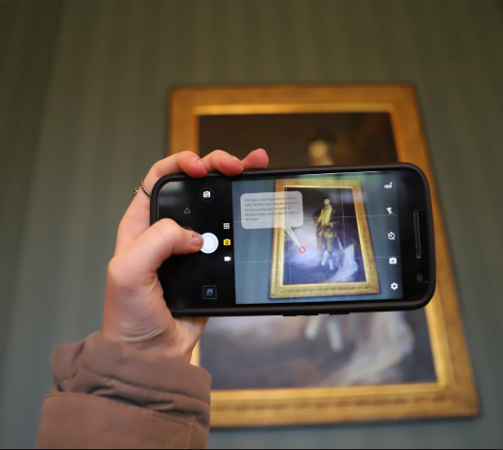
2. DIGITAL CULTURAL HERITAGE
2.1 Definitions
2.2 The Digital revolution / Participatory Culture
2.3 Digital Culture
2.4 Digitization
2.5 The Digital Media & Digital Experiences
2.6 Digital Tools
2.6.1 Virtual Reality
2.6.2 Augmented Reality
2.6.3 Serious Games
2.6.4 Multivision Technologies
2.6.5 iBooks and eBooks

Slide 3
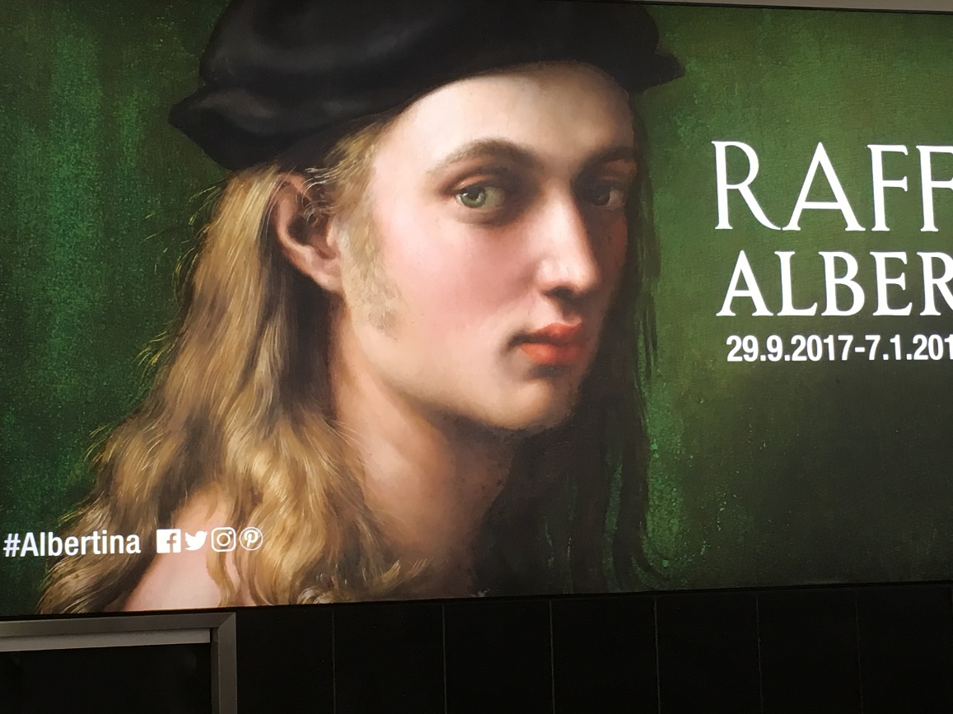
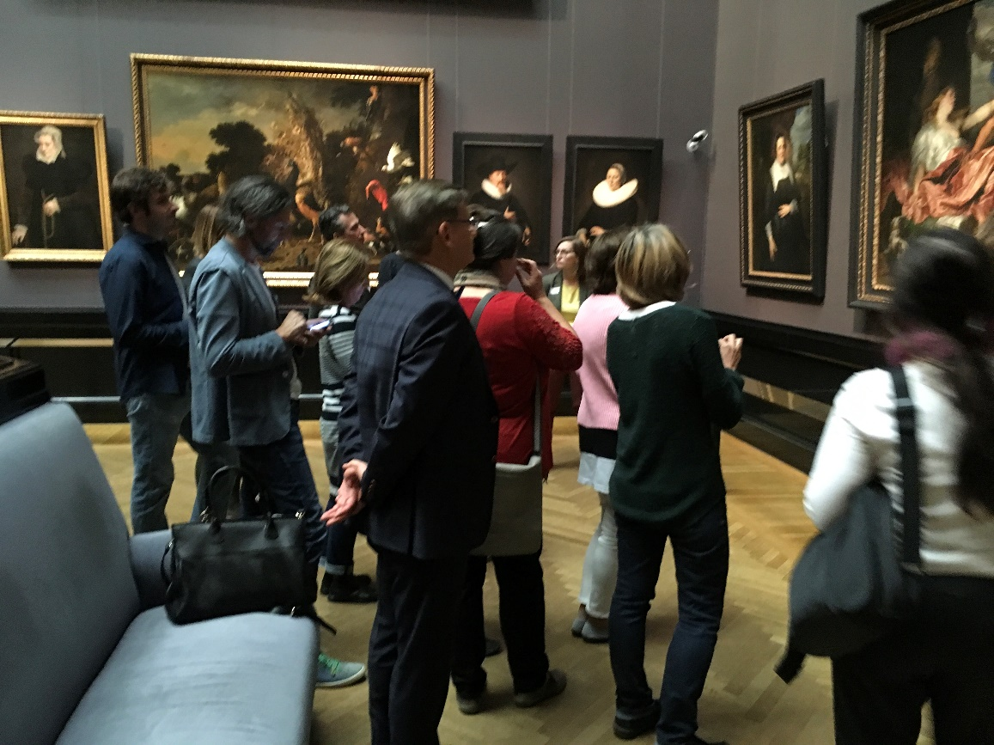
2.1 Definitions
EXPERIENCES
interactions with time-space, people, and tangible –intangible product and services

Slide 4
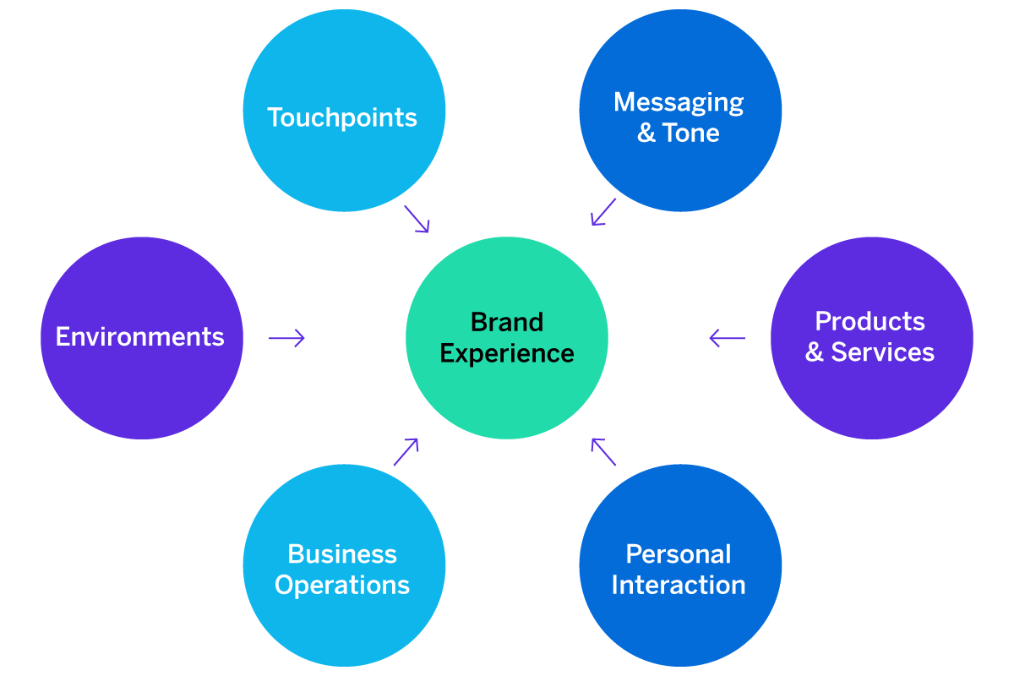
2.1 Definitions
Physical
Cognitive
Emotional
Digital
Economic
Social

Slide 5
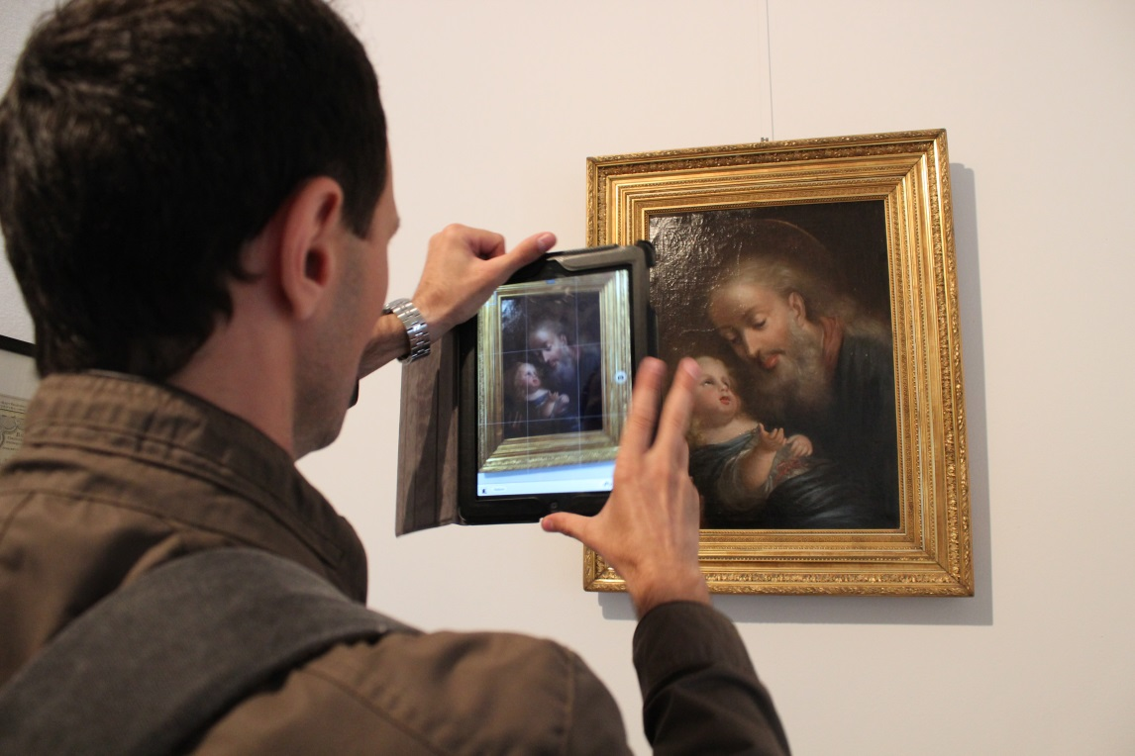
2.2 Participatory Culture
Information Search/Evaluation/Trashing
Viral Information Distribution
Loss of Cultural Capital
killing - rewarding the producer

Slide 6
2.2 The Digital Revolution
The digital revolution provides means to our ability to use symbols, which allows the audience set out on the path to a work of art, to history, to culture to appropriate a degree of knowledge he did not have before.
Knowledge is always a traumatic process, caused by the condition of thaumazein, the existential upheaval of which Aristotle spoke.
It means generating an imbalance and moving from a consequent imbalance to a new, more advanced and solid balance, reconfiguring the old information with the new in a new scheme.

Slide 7
2.2 The Digital Revolution
to manipulate static data creating a visual concept starting from any image from the real world, from archives, or from an imaginary vision we have in mind;
to produce drafts as part of the final project, so “digital” changes the plan procedures reducing the production time making texting more efficient and results more accurate;
to introduce the possibility to browse through a vast set of contents under the condition to have enough knowledge to be clear about the objectives
to eliminate any distance and any distribution cost changing business model and social approach;
to disseminate through a new management and marketing for cultural sector creative events in a vast and connected social environment.

Slide 8
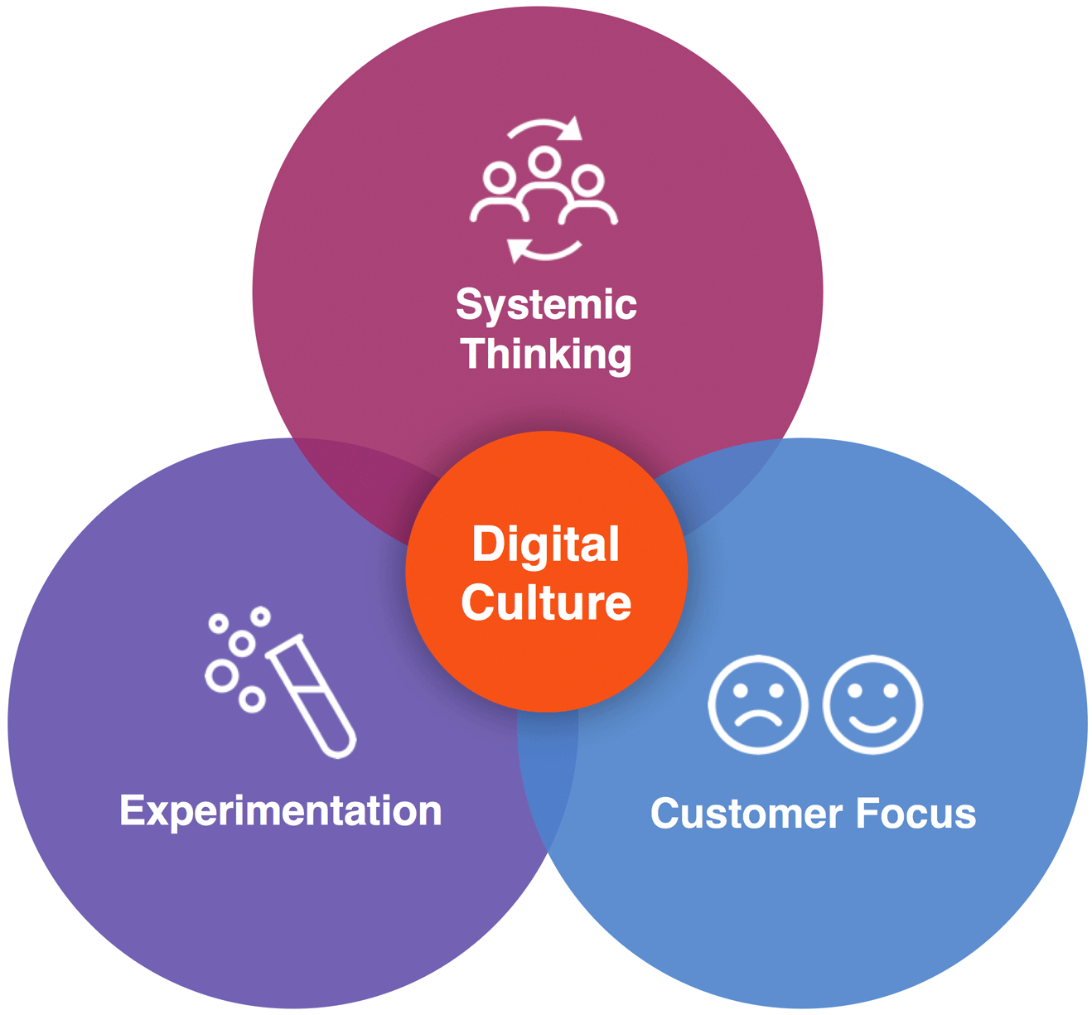
2.3 Digital Culture
THE LEGACY
DIGITISATION AND PRESERVATION
CULTURE ONLINE
CULTURAL COMMUNICATION
THE CULTURAL INVESTMENT
THE EXPERIENCE DESIGN
THE CULTURAL CAPITAL
Notes:
As Jean Monnet said, if ‘Europe were to be reconstructed, I would begin with culture rather than the economy’. The cultural heritage of the old continent nourished the education, the formation, the spirit of the generations which preceded us and we feel the responsibility to transmit this rich (indeed, one of the richest in the world) heritage to future generations and to make sure it will be preserved, enriched and shared.
It is legacy of the past, but is a body of knowledge, imagination and creativity which is constantly evolving and growing every day. Today’s wealth of cultural expressions and knowledge will be our common cultural heritage tomorrow. Therefore, although the recommendations focus on digitisation and the cultural heritage from the past, they always include what is added in the present because the past and the present must be available to future generations.
One of our core missions is to ensure full access to cultural expressions and knowledge of the past, the present and the future.
2. Second, digitisation is more than a technical option, it is a moral obligation. In a time when more and more cultural goods are consumed online, when screens and digital devices are becoming ubiquitous, it is crucial to bring culture online (and, in fact, a large part of it is already there).
If we don’t pursue this task, we run the risk of progressively eroding and losing what has been the foundation of European countries and civilization in the last centuries. It must be clearly understood that if access is the final objective, a tall order, it can only be achieved through preservation of the work.
3. Third, the main responsibilities for digitising and preserving our cultural heritage should be assumed by the public sector. In fact, it is the task of public authorities and cultural
institutions to make sure that our heritage is properly digitised and then preserved in order to guarantee access to the largest possible audience today and tomorrow.
This is too important a responsibility to lie solely in the hands of private interests, which do not necessarily have the same long-term approach and public interest as governments. As culture is Europe’s most important common good, governments and their cultural institutions have the duty to be at the forefront of the digitisation effort.

Slide 9
2.3 Digital Culture
THE LEGACY
DIGITISATION AND PRESERVATION
CULTURE ONLINE
CULTURAL COMMUNICATION
THE CULTURAL INVESTMENT
THE EXPERIENCE DESIGN
THE CULTURAL CAPITAL
Notes:
As Jean Monnet said, if ‘Europe were to be reconstructed, I would begin with culture rather than the economy’. The cultural heritage of the old continent nourished the education, the formation, the spirit of the generations which preceded us and we feel the responsibility to transmit this rich (indeed, one of the richest in the world) heritage to future generations and to make sure it will be preserved, enriched and shared.
It is legacy of the past, but is a body of knowledge, imagination and creativity which is constantly evolving and growing every day. Today’s wealth of cultural expressions and knowledge will be our common cultural heritage tomorrow. Therefore, although the recommendations focus on digitisation and the cultural heritage from the past, they always include what is added in the present because the past and the present must be available to future generations.
One of our core missions is to ensure full access to cultural expressions and knowledge of the past, the present and the future.
2. Second, digitisation is more than a technical option, it is a moral obligation. In a time when more and more cultural goods are consumed online, when screens and digital devices are becoming ubiquitous, it is crucial to bring culture online (and, in fact, a large part of it is already there).
If we don’t pursue this task, we run the risk of progressively eroding and losing what has been the foundation of European countries and civilization in the last centuries. It must be clearly understood that if access is the final objective, a tall order, it can only be achieved through preservation of the work.
3. Third, the main responsibilities for digitising and preserving our cultural heritage should be assumed by the public sector. In fact, it is the task of public authorities and cultural
institutions to make sure that our heritage is properly digitised and then preserved in order to guarantee access to the largest possible audience today and tomorrow.
This is too important a responsibility to lie solely in the hands of private interests, which do not necessarily have the same long-term approach and public interest as governments. As culture is Europe’s most important common good, governments and their cultural institutions have the duty to be at the forefront of the digitisation effort.

Slide 10
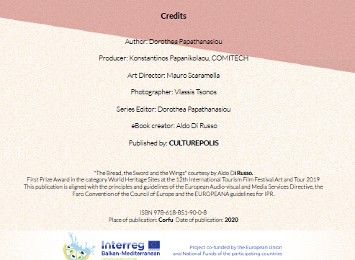
2.4 Digitization
EUROPEANA
Digitization
Preservation
Open access
USES
Cultural Investments
Visitor Experience
Cultural and Creative Industry
Notes:
EUROPEANA should be further developed to become the reference point for European cultural content online. This requires a concentration of financial efforts and political capital at European and at national level for the development of the Europeana site and the underlying structures;
2. EUMS should ensure that all public funding for digitisation is conditional on the subsequent free accessibility of the digitised material through EUROPEANA. They should also ensure that by 2016 they have brought all their public domain masterpieces into EUROPEANA
3. EUROPEANA should add to its portal an application platform, and main activities related to the digitisation and preservation of Europe’s cultural heritage should be linked to the site. In the technical development of the site particular attention
should be paid to multilingual aspects. EUROPEANA should also explore the opportunities of cloud computing in the future.
4. EUROPEANA should have key role in the preservation of Europe’s heritage and to turn it into a European deposit site for public domain digitised cultural material and into a dark archive for in-copyright cultural material, both digitised and born digital.
5. EUROPEANA must be actively and widely promoted by the cultural institutions, by the European Commission and by the Member States.
European VoD services are still at a relatively early stage of development. They are a new opportunity for many European films to reach a broader audience, also across borders. The Commission wants to encourage the development of measures and instruments that could help European films to take advantage of this opportunity without hampering the development of VoD.
Netflix, Amazon and other online streaming services will have to dedicate 30% of their output to TV shows and films made in Europe, which they must subsidise, under the terms of a new EU law (2016)
As well as the “Netflix quota”, the streaming services will have to fund European TV series and films, either by directly commissioning the content or contributing to national film funds, under the terms of an outline deal on EU broadcasting rules reached by legislators.
MEPs and the council of ministers, who are responsible for agreeing the law, struck a deal on a final version of the EU’s audio-visual services directive – a breakthrough in the legislative process.
The law falls into a longstanding tradition of EU lawmakers protecting European film and drama against the encroachments of Hollywood and US TV and online shows.
Sign up to the Media Briefing: news for the news-makers
Read more
Industry groups have criticised cultural quotas as “outdated” and “counterproductive”, but lost the argument to European politicians who see them as vital to protect local languages and culture.
Advertisement
The European commission’s original proposal was for a 20% “Netflix quota” but MEPs said that was not enough.
The European parliament says the law means companies such as Netflix will face the same rules as traditional TV channels, not only on European content but also limits on advertising and product placement.
Video-sharing websites, such as Google and Facebook, will also have to intensify work to clamp down on content “inciting violence, hatred and terrorism”. Under the law, platforms need to create a “transparent, easy-to-use and effective mechanism” to allow users to report hateful content.
The EU is also banning product placement from children’s programmes, although member states can decide whether they want to outlaw corporate sponsorship of under-18’s TV shows.
Advertisers will only be allowed 20% of screen time during the prime-time hours of 6pm to midnight.
“We have now made European media regulation fit for the digital era by applying similar rules to similar services, whether online or offline,” said Sabine Verheyen, a German centre-right MEP who was one of the parliament’s lead negotiators.
The rules on product placement and sponsorship were “a great achievement for the protection of consumers, especially children and minors”, she added.
The law has to jump over several procedural hurdles before it is passed, a process not expected to be completed until September.
Also on Thursday a draft EU regulation was published that would force Amazon, Google, eBay and other tech firms to be more transparent in their dealings with third-party businesses that sell goods on their sites.
Thousands of companies use the platforms to sell goods online, allowing a sole trader working from home to reach millions of potential customers. But many complain that the big firms are opaque about their rankings, which mean some get top billing, while others struggle to be seen. App designers report similar problems when listing on Google’s and Apple’s stores.
Under the draft regulation, large platforms would have to rewrite their terms and conditions to ensure third-party sellers knew how to influence their online ranking, for example, if payment is required for a top spot.
Platforms would also have to explain any decision to suspend a third-party business from their site, and set up a system to handle complaints.
Legislators hope for agreement between European ministers and MEPs on the law by early next year, which would see the law come into effect from autumn 2019.
The draft regulation follows a pan-European survey by the commission, which found that 46% of businesses using online platforms encounter problems, rising to 75% for those that generated more than half of their turnover via the platform. One-third of heavy users complained about lack of transparency, while 22% thought terms and conditions were unfair. The most frequently cited problems were technical ones and lack of support from the platform.
“You see things like user conditions being changed from day to day,” said Mariya Gabriel, the European commissioner for digital economy and society. “We are saying to the platforms you need to have transparency with regard to your conditions for use, data access and so on, to provide businesses with the opportunity to know what their criteria are and to create an environment based on rules that everyone is familiar with.”
“a service as defined by Articles 56 and 57 of the [TFEU] which is under the editorial responsibility10 of a media service provider and the principal purpose of which is the provision of programmes, in order to inform, entertain or educate, to the general public by electronic communications networks”.11
The proposed revision of the audiovisual media services directive (AVMSD) is expected to be opposed by online service providers and kindred spiritsThis is the legislation that governs national rules on all audiovisual media content. This is not just about television, it also includes online portals and on-demand services. The AVMSD has taken various forms over the years whilst adapting to the ongoing changes to the technological environment. Since the initial adoption of the Television without Frontiers Directive back in the 1980s the idea has been to create a harmonised single market for audiovisual content whilst ensuring some key principles. These include technological neutrality, freedom of reception and retransmission and flexibility for Member States to provide more detailed and stricter rules than specified in the AVMSD.
Market developments, notably the rise of the online world, made it necessary to revisit the rules and amend the framework. With the last revision, the Directive was renamed
and extended to include not only the traditional television content but also non-linear services (such as “on-demand” and internet services) providing television-like audiovisual content. This would now include providers like Netflix. The proposal adopted on 25 May/2016 by the Commission has proposed several changes such as the rules of prominence, advertising time limits and protection of minors.
The EU is aiming to create a single, pan-European market encompassing all digital services and thus it is unsurprising that the rules for online services are to be
reinforced. For instance, the Commission proposes a common quota at EU level, taking account of the fact that many member states have already been implementing their own national
quotas for European works. For instance, in Spain and Austria, there is an obligation to reserve 30% and 50% (respectively) of their “on-demand” services catalogues for
European works. In the current AVMSD, a 10% share of the content broadcast must be European works. Accordingly linear (television) and non-linear services providers must ensure that 20 % of their catalogues are European works.

Slide 11
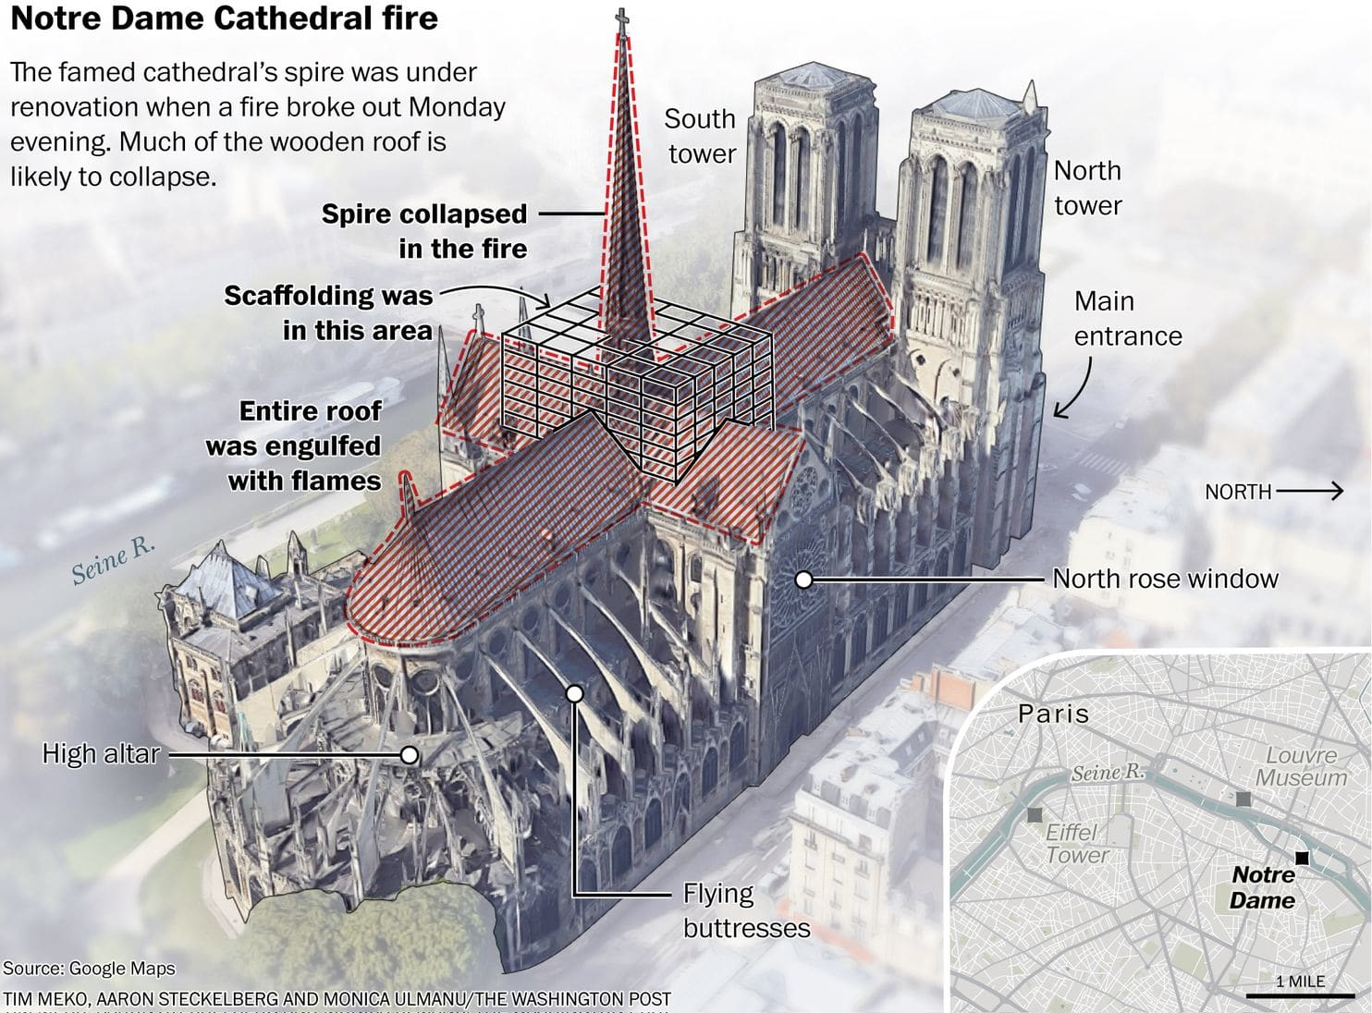
2.4 Digitization
A terrible fire that caused great damage struck Paris' Notre Dame Cathedral in April 2019. Although the cause of the fire was not determined, unintentional causes were subsequently ruled out.
The fires also damaged the windows and vaulted ceilings in addition to destroying the roof and spire.
The ongoing cathedral renovations serve as a perfect example of the advantages of digitalization in construction.
Notes:
EUROPEANA should be further developed to become the reference point for European cultural content online. This requires a concentration of financial efforts and political capital at European and at national level for the development of the Europeana site and the underlying structures;
2. EUMS should ensure that all public funding for digitisation is conditional on the subsequent free accessibility of the digitised material through EUROPEANA. They should also ensure that by 2016 they have brought all their public domain masterpieces into EUROPEANA
3. EUROPEANA should add to its portal an application platform, and main activities related to the digitisation and preservation of Europe’s cultural heritage should be linked to the site. In the technical development of the site particular attention
should be paid to multilingual aspects. EUROPEANA should also explore the opportunities of cloud computing in the future.
4. EUROPEANA should have key role in the preservation of Europe’s heritage and to turn it into a European deposit site for public domain digitised cultural material and into a dark archive for in-copyright cultural material, both digitised and born digital.
5. EUROPEANA must be actively and widely promoted by the cultural institutions, by the European Commission and by the Member States.
European VoD services are still at a relatively early stage of development. They are a new opportunity for many European films to reach a broader audience, also across borders. The Commission wants to encourage the development of measures and instruments that could help European films to take advantage of this opportunity without hampering the development of VoD.
Netflix, Amazon and other online streaming services will have to dedicate 30% of their output to TV shows and films made in Europe, which they must subsidise, under the terms of a new EU law (2016)
As well as the “Netflix quota”, the streaming services will have to fund European TV series and films, either by directly commissioning the content or contributing to national film funds, under the terms of an outline deal on EU broadcasting rules reached by legislators.
MEPs and the council of ministers, who are responsible for agreeing the law, struck a deal on a final version of the EU’s audio-visual services directive – a breakthrough in the legislative process.
The law falls into a longstanding tradition of EU lawmakers protecting European film and drama against the encroachments of Hollywood and US TV and online shows.
Sign up to the Media Briefing: news for the news-makers
Read more
Industry groups have criticised cultural quotas as “outdated” and “counterproductive”, but lost the argument to European politicians who see them as vital to protect local languages and culture.
Advertisement
The European commission’s original proposal was for a 20% “Netflix quota” but MEPs said that was not enough.
The European parliament says the law means companies such as Netflix will face the same rules as traditional TV channels, not only on European content but also limits on advertising and product placement.
Video-sharing websites, such as Google and Facebook, will also have to intensify work to clamp down on content “inciting violence, hatred and terrorism”. Under the law, platforms need to create a “transparent, easy-to-use and effective mechanism” to allow users to report hateful content.
The EU is also banning product placement from children’s programmes, although member states can decide whether they want to outlaw corporate sponsorship of under-18’s TV shows.
Advertisers will only be allowed 20% of screen time during the prime-time hours of 6pm to midnight.
“We have now made European media regulation fit for the digital era by applying similar rules to similar services, whether online or offline,” said Sabine Verheyen, a German centre-right MEP who was one of the parliament’s lead negotiators.
The rules on product placement and sponsorship were “a great achievement for the protection of consumers, especially children and minors”, she added.
The law has to jump over several procedural hurdles before it is passed, a process not expected to be completed until September.
Also on Thursday a draft EU regulation was published that would force Amazon, Google, eBay and other tech firms to be more transparent in their dealings with third-party businesses that sell goods on their sites.
Thousands of companies use the platforms to sell goods online, allowing a sole trader working from home to reach millions of potential customers. But many complain that the big firms are opaque about their rankings, which mean some get top billing, while others struggle to be seen. App designers report similar problems when listing on Google’s and Apple’s stores.
Under the draft regulation, large platforms would have to rewrite their terms and conditions to ensure third-party sellers knew how to influence their online ranking, for example, if payment is required for a top spot.
Platforms would also have to explain any decision to suspend a third-party business from their site, and set up a system to handle complaints.
Legislators hope for agreement between European ministers and MEPs on the law by early next year, which would see the law come into effect from autumn 2019.
The draft regulation follows a pan-European survey by the commission, which found that 46% of businesses using online platforms encounter problems, rising to 75% for those that generated more than half of their turnover via the platform. One-third of heavy users complained about lack of transparency, while 22% thought terms and conditions were unfair. The most frequently cited problems were technical ones and lack of support from the platform.
“You see things like user conditions being changed from day to day,” said Mariya Gabriel, the European commissioner for digital economy and society. “We are saying to the platforms you need to have transparency with regard to your conditions for use, data access and so on, to provide businesses with the opportunity to know what their criteria are and to create an environment based on rules that everyone is familiar with.”
“a service as defined by Articles 56 and 57 of the [TFEU] which is under the editorial responsibility10 of a media service provider and the principal purpose of which is the provision of programmes, in order to inform, entertain or educate, to the general public by electronic communications networks”.11
The proposed revision of the audiovisual media services directive (AVMSD) is expected to be opposed by online service providers and kindred spiritsThis is the legislation that governs national rules on all audiovisual media content. This is not just about television, it also includes online portals and on-demand services. The AVMSD has taken various forms over the years whilst adapting to the ongoing changes to the technological environment. Since the initial adoption of the Television without Frontiers Directive back in the 1980s the idea has been to create a harmonised single market for audiovisual content whilst ensuring some key principles. These include technological neutrality, freedom of reception and retransmission and flexibility for Member States to provide more detailed and stricter rules than specified in the AVMSD.
Market developments, notably the rise of the online world, made it necessary to revisit the rules and amend the framework. With the last revision, the Directive was renamed
and extended to include not only the traditional television content but also non-linear services (such as “on-demand” and internet services) providing television-like audiovisual content. This would now include providers like Netflix. The proposal adopted on 25 May/2016 by the Commission has proposed several changes such as the rules of prominence, advertising time limits and protection of minors.
The EU is aiming to create a single, pan-European market encompassing all digital services and thus it is unsurprising that the rules for online services are to be
reinforced. For instance, the Commission proposes a common quota at EU level, taking account of the fact that many member states have already been implementing their own national
quotas for European works. For instance, in Spain and Austria, there is an obligation to reserve 30% and 50% (respectively) of their “on-demand” services catalogues for
European works. In the current AVMSD, a 10% share of the content broadcast must be European works. Accordingly linear (television) and non-linear services providers must ensure that 20 % of their catalogues are European works.

Slide 12
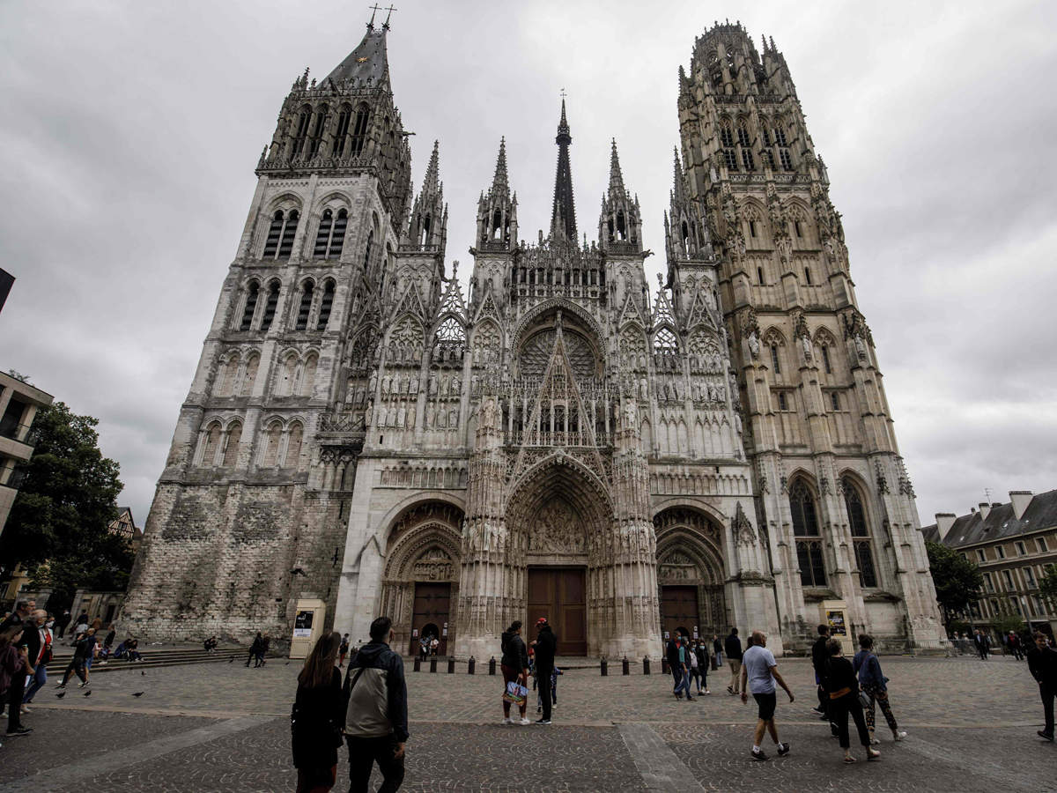
2.4 Digitization
Built between the 12th and the 14th centuries, the Roman Catholic cathedral is one of the best specimens of French Gothic architecture.
Its many different architects and renovators over the course of its many centuries of existence infused their vision into the masterpiece through handwritten drawings.
These records, however, are no longer available to Notre Dame's contemporary architects and renovators. Fortunately, they have 3D digitalization, which is an even greater tool.
Notes:
EUROPEANA should be further developed to become the reference point for European cultural content online. This requires a concentration of financial efforts and political capital at European and at national level for the development of the Europeana site and the underlying structures;
2. EUMS should ensure that all public funding for digitisation is conditional on the subsequent free accessibility of the digitised material through EUROPEANA. They should also ensure that by 2016 they have brought all their public domain masterpieces into EUROPEANA
3. EUROPEANA should add to its portal an application platform, and main activities related to the digitisation and preservation of Europe’s cultural heritage should be linked to the site. In the technical development of the site particular attention
should be paid to multilingual aspects. EUROPEANA should also explore the opportunities of cloud computing in the future.
4. EUROPEANA should have key role in the preservation of Europe’s heritage and to turn it into a European deposit site for public domain digitised cultural material and into a dark archive for in-copyright cultural material, both digitised and born digital.
5. EUROPEANA must be actively and widely promoted by the cultural institutions, by the European Commission and by the Member States.
European VoD services are still at a relatively early stage of development. They are a new opportunity for many European films to reach a broader audience, also across borders. The Commission wants to encourage the development of measures and instruments that could help European films to take advantage of this opportunity without hampering the development of VoD.
Netflix, Amazon and other online streaming services will have to dedicate 30% of their output to TV shows and films made in Europe, which they must subsidise, under the terms of a new EU law (2016)
As well as the “Netflix quota”, the streaming services will have to fund European TV series and films, either by directly commissioning the content or contributing to national film funds, under the terms of an outline deal on EU broadcasting rules reached by legislators.
MEPs and the council of ministers, who are responsible for agreeing the law, struck a deal on a final version of the EU’s audio-visual services directive – a breakthrough in the legislative process.
The law falls into a longstanding tradition of EU lawmakers protecting European film and drama against the encroachments of Hollywood and US TV and online shows.
Sign up to the Media Briefing: news for the news-makers
Read more
Industry groups have criticised cultural quotas as “outdated” and “counterproductive”, but lost the argument to European politicians who see them as vital to protect local languages and culture.
Advertisement
The European commission’s original proposal was for a 20% “Netflix quota” but MEPs said that was not enough.
The European parliament says the law means companies such as Netflix will face the same rules as traditional TV channels, not only on European content but also limits on advertising and product placement.
Video-sharing websites, such as Google and Facebook, will also have to intensify work to clamp down on content “inciting violence, hatred and terrorism”. Under the law, platforms need to create a “transparent, easy-to-use and effective mechanism” to allow users to report hateful content.
The EU is also banning product placement from children’s programmes, although member states can decide whether they want to outlaw corporate sponsorship of under-18’s TV shows.
Advertisers will only be allowed 20% of screen time during the prime-time hours of 6pm to midnight.
“We have now made European media regulation fit for the digital era by applying similar rules to similar services, whether online or offline,” said Sabine Verheyen, a German centre-right MEP who was one of the parliament’s lead negotiators.
The rules on product placement and sponsorship were “a great achievement for the protection of consumers, especially children and minors”, she added.
The law has to jump over several procedural hurdles before it is passed, a process not expected to be completed until September.
Also on Thursday a draft EU regulation was published that would force Amazon, Google, eBay and other tech firms to be more transparent in their dealings with third-party businesses that sell goods on their sites.
Thousands of companies use the platforms to sell goods online, allowing a sole trader working from home to reach millions of potential customers. But many complain that the big firms are opaque about their rankings, which mean some get top billing, while others struggle to be seen. App designers report similar problems when listing on Google’s and Apple’s stores.
Under the draft regulation, large platforms would have to rewrite their terms and conditions to ensure third-party sellers knew how to influence their online ranking, for example, if payment is required for a top spot.
Platforms would also have to explain any decision to suspend a third-party business from their site, and set up a system to handle complaints.
Legislators hope for agreement between European ministers and MEPs on the law by early next year, which would see the law come into effect from autumn 2019.
The draft regulation follows a pan-European survey by the commission, which found that 46% of businesses using online platforms encounter problems, rising to 75% for those that generated more than half of their turnover via the platform. One-third of heavy users complained about lack of transparency, while 22% thought terms and conditions were unfair. The most frequently cited problems were technical ones and lack of support from the platform.
“You see things like user conditions being changed from day to day,” said Mariya Gabriel, the European commissioner for digital economy and society. “We are saying to the platforms you need to have transparency with regard to your conditions for use, data access and so on, to provide businesses with the opportunity to know what their criteria are and to create an environment based on rules that everyone is familiar with.”
“a service as defined by Articles 56 and 57 of the [TFEU] which is under the editorial responsibility10 of a media service provider and the principal purpose of which is the provision of programmes, in order to inform, entertain or educate, to the general public by electronic communications networks”.11
The proposed revision of the audiovisual media services directive (AVMSD) is expected to be opposed by online service providers and kindred spiritsThis is the legislation that governs national rules on all audiovisual media content. This is not just about television, it also includes online portals and on-demand services. The AVMSD has taken various forms over the years whilst adapting to the ongoing changes to the technological environment. Since the initial adoption of the Television without Frontiers Directive back in the 1980s the idea has been to create a harmonised single market for audiovisual content whilst ensuring some key principles. These include technological neutrality, freedom of reception and retransmission and flexibility for Member States to provide more detailed and stricter rules than specified in the AVMSD.
Market developments, notably the rise of the online world, made it necessary to revisit the rules and amend the framework. With the last revision, the Directive was renamed
and extended to include not only the traditional television content but also non-linear services (such as “on-demand” and internet services) providing television-like audiovisual content. This would now include providers like Netflix. The proposal adopted on 25 May/2016 by the Commission has proposed several changes such as the rules of prominence, advertising time limits and protection of minors.
The EU is aiming to create a single, pan-European market encompassing all digital services and thus it is unsurprising that the rules for online services are to be
reinforced. For instance, the Commission proposes a common quota at EU level, taking account of the fact that many member states have already been implementing their own national
quotas for European works. For instance, in Spain and Austria, there is an obligation to reserve 30% and 50% (respectively) of their “on-demand” services catalogues for
European works. In the current AVMSD, a 10% share of the content broadcast must be European works. Accordingly linear (television) and non-linear services providers must ensure that 20 % of their catalogues are European works.

Slide 13
2.4 Digitization
The company Art Graphique Patrimoine completely 3D digitized Notre Dame between 2014 and 2016, using an exceptional tool for all of the project managers of the location. This model allowed architects to thoroughly recreate the reconstruction process while studying the timber frame that was damaged in the fire.
The public organization in charge of the cathedral's preservation and restoration and Autodesk France, a well-known producer of 3D design, engineering, and entertainment software, have inked a sponsorship deal.
Notes:
EUROPEANA should be further developed to become the reference point for European cultural content online. This requires a concentration of financial efforts and political capital at European and at national level for the development of the Europeana site and the underlying structures;
2. EUMS should ensure that all public funding for digitisation is conditional on the subsequent free accessibility of the digitised material through EUROPEANA. They should also ensure that by 2016 they have brought all their public domain masterpieces into EUROPEANA
3. EUROPEANA should add to its portal an application platform, and main activities related to the digitisation and preservation of Europe’s cultural heritage should be linked to the site. In the technical development of the site particular attention
should be paid to multilingual aspects. EUROPEANA should also explore the opportunities of cloud computing in the future.
4. EUROPEANA should have key role in the preservation of Europe’s heritage and to turn it into a European deposit site for public domain digitised cultural material and into a dark archive for in-copyright cultural material, both digitised and born digital.
5. EUROPEANA must be actively and widely promoted by the cultural institutions, by the European Commission and by the Member States.
European VoD services are still at a relatively early stage of development. They are a new opportunity for many European films to reach a broader audience, also across borders. The Commission wants to encourage the development of measures and instruments that could help European films to take advantage of this opportunity without hampering the development of VoD.
Netflix, Amazon and other online streaming services will have to dedicate 30% of their output to TV shows and films made in Europe, which they must subsidise, under the terms of a new EU law (2016)
As well as the “Netflix quota”, the streaming services will have to fund European TV series and films, either by directly commissioning the content or contributing to national film funds, under the terms of an outline deal on EU broadcasting rules reached by legislators.
MEPs and the council of ministers, who are responsible for agreeing the law, struck a deal on a final version of the EU’s audio-visual services directive – a breakthrough in the legislative process.
The law falls into a longstanding tradition of EU lawmakers protecting European film and drama against the encroachments of Hollywood and US TV and online shows.
Sign up to the Media Briefing: news for the news-makers
Read more
Industry groups have criticised cultural quotas as “outdated” and “counterproductive”, but lost the argument to European politicians who see them as vital to protect local languages and culture.
Advertisement
The European commission’s original proposal was for a 20% “Netflix quota” but MEPs said that was not enough.
The European parliament says the law means companies such as Netflix will face the same rules as traditional TV channels, not only on European content but also limits on advertising and product placement.
Video-sharing websites, such as Google and Facebook, will also have to intensify work to clamp down on content “inciting violence, hatred and terrorism”. Under the law, platforms need to create a “transparent, easy-to-use and effective mechanism” to allow users to report hateful content.
The EU is also banning product placement from children’s programmes, although member states can decide whether they want to outlaw corporate sponsorship of under-18’s TV shows.
Advertisers will only be allowed 20% of screen time during the prime-time hours of 6pm to midnight.
“We have now made European media regulation fit for the digital era by applying similar rules to similar services, whether online or offline,” said Sabine Verheyen, a German centre-right MEP who was one of the parliament’s lead negotiators.
The rules on product placement and sponsorship were “a great achievement for the protection of consumers, especially children and minors”, she added.
The law has to jump over several procedural hurdles before it is passed, a process not expected to be completed until September.
Also on Thursday a draft EU regulation was published that would force Amazon, Google, eBay and other tech firms to be more transparent in their dealings with third-party businesses that sell goods on their sites.
Thousands of companies use the platforms to sell goods online, allowing a sole trader working from home to reach millions of potential customers. But many complain that the big firms are opaque about their rankings, which mean some get top billing, while others struggle to be seen. App designers report similar problems when listing on Google’s and Apple’s stores.
Under the draft regulation, large platforms would have to rewrite their terms and conditions to ensure third-party sellers knew how to influence their online ranking, for example, if payment is required for a top spot.
Platforms would also have to explain any decision to suspend a third-party business from their site, and set up a system to handle complaints.
Legislators hope for agreement between European ministers and MEPs on the law by early next year, which would see the law come into effect from autumn 2019.
The draft regulation follows a pan-European survey by the commission, which found that 46% of businesses using online platforms encounter problems, rising to 75% for those that generated more than half of their turnover via the platform. One-third of heavy users complained about lack of transparency, while 22% thought terms and conditions were unfair. The most frequently cited problems were technical ones and lack of support from the platform.
“You see things like user conditions being changed from day to day,” said Mariya Gabriel, the European commissioner for digital economy and society. “We are saying to the platforms you need to have transparency with regard to your conditions for use, data access and so on, to provide businesses with the opportunity to know what their criteria are and to create an environment based on rules that everyone is familiar with.”
“a service as defined by Articles 56 and 57 of the [TFEU] which is under the editorial responsibility10 of a media service provider and the principal purpose of which is the provision of programmes, in order to inform, entertain or educate, to the general public by electronic communications networks”.11
The proposed revision of the audiovisual media services directive (AVMSD) is expected to be opposed by online service providers and kindred spiritsThis is the legislation that governs national rules on all audiovisual media content. This is not just about television, it also includes online portals and on-demand services. The AVMSD has taken various forms over the years whilst adapting to the ongoing changes to the technological environment. Since the initial adoption of the Television without Frontiers Directive back in the 1980s the idea has been to create a harmonised single market for audiovisual content whilst ensuring some key principles. These include technological neutrality, freedom of reception and retransmission and flexibility for Member States to provide more detailed and stricter rules than specified in the AVMSD.
Market developments, notably the rise of the online world, made it necessary to revisit the rules and amend the framework. With the last revision, the Directive was renamed
and extended to include not only the traditional television content but also non-linear services (such as “on-demand” and internet services) providing television-like audiovisual content. This would now include providers like Netflix. The proposal adopted on 25 May/2016 by the Commission has proposed several changes such as the rules of prominence, advertising time limits and protection of minors.
The EU is aiming to create a single, pan-European market encompassing all digital services and thus it is unsurprising that the rules for online services are to be
reinforced. For instance, the Commission proposes a common quota at EU level, taking account of the fact that many member states have already been implementing their own national
quotas for European works. For instance, in Spain and Austria, there is an obligation to reserve 30% and 50% (respectively) of their “on-demand” services catalogues for
European works. In the current AVMSD, a 10% share of the content broadcast must be European works. Accordingly linear (television) and non-linear services providers must ensure that 20 % of their catalogues are European works.

Slide 14
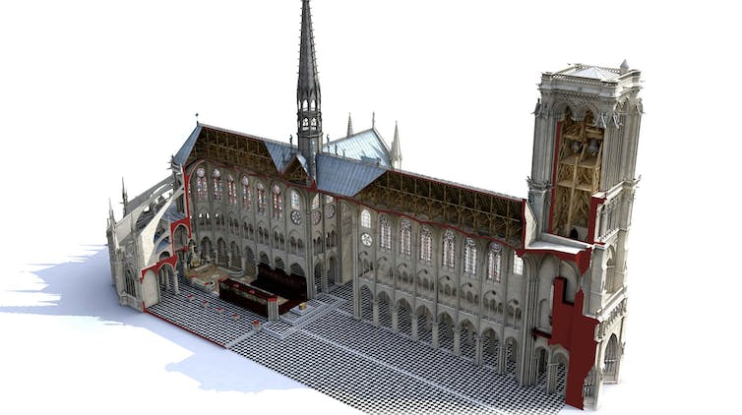
2.4 Digitization
According to the two companies, "this cooperative and intelligent work style enables construction site participants to benefit in real-time from a shared and scalable 3D database that pulls together the rich information necessary for the smooth conduct of these operations."
Notes:
EUROPEANA should be further developed to become the reference point for European cultural content online. This requires a concentration of financial efforts and political capital at European and at national level for the development of the Europeana site and the underlying structures;
2. EUMS should ensure that all public funding for digitisation is conditional on the subsequent free accessibility of the digitised material through EUROPEANA. They should also ensure that by 2016 they have brought all their public domain masterpieces into EUROPEANA
3. EUROPEANA should add to its portal an application platform, and main activities related to the digitisation and preservation of Europe’s cultural heritage should be linked to the site. In the technical development of the site particular attention
should be paid to multilingual aspects. EUROPEANA should also explore the opportunities of cloud computing in the future.
4. EUROPEANA should have key role in the preservation of Europe’s heritage and to turn it into a European deposit site for public domain digitised cultural material and into a dark archive for in-copyright cultural material, both digitised and born digital.
5. EUROPEANA must be actively and widely promoted by the cultural institutions, by the European Commission and by the Member States.
European VoD services are still at a relatively early stage of development. They are a new opportunity for many European films to reach a broader audience, also across borders. The Commission wants to encourage the development of measures and instruments that could help European films to take advantage of this opportunity without hampering the development of VoD.
Netflix, Amazon and other online streaming services will have to dedicate 30% of their output to TV shows and films made in Europe, which they must subsidise, under the terms of a new EU law (2016)
As well as the “Netflix quota”, the streaming services will have to fund European TV series and films, either by directly commissioning the content or contributing to national film funds, under the terms of an outline deal on EU broadcasting rules reached by legislators.
MEPs and the council of ministers, who are responsible for agreeing the law, struck a deal on a final version of the EU’s audio-visual services directive – a breakthrough in the legislative process.
The law falls into a longstanding tradition of EU lawmakers protecting European film and drama against the encroachments of Hollywood and US TV and online shows.
Sign up to the Media Briefing: news for the news-makers
Read more
Industry groups have criticised cultural quotas as “outdated” and “counterproductive”, but lost the argument to European politicians who see them as vital to protect local languages and culture.
Advertisement
The European commission’s original proposal was for a 20% “Netflix quota” but MEPs said that was not enough.
The European parliament says the law means companies such as Netflix will face the same rules as traditional TV channels, not only on European content but also limits on advertising and product placement.
Video-sharing websites, such as Google and Facebook, will also have to intensify work to clamp down on content “inciting violence, hatred and terrorism”. Under the law, platforms need to create a “transparent, easy-to-use and effective mechanism” to allow users to report hateful content.
The EU is also banning product placement from children’s programmes, although member states can decide whether they want to outlaw corporate sponsorship of under-18’s TV shows.
Advertisers will only be allowed 20% of screen time during the prime-time hours of 6pm to midnight.
“We have now made European media regulation fit for the digital era by applying similar rules to similar services, whether online or offline,” said Sabine Verheyen, a German centre-right MEP who was one of the parliament’s lead negotiators.
The rules on product placement and sponsorship were “a great achievement for the protection of consumers, especially children and minors”, she added.
The law has to jump over several procedural hurdles before it is passed, a process not expected to be completed until September.
Also on Thursday a draft EU regulation was published that would force Amazon, Google, eBay and other tech firms to be more transparent in their dealings with third-party businesses that sell goods on their sites.
Thousands of companies use the platforms to sell goods online, allowing a sole trader working from home to reach millions of potential customers. But many complain that the big firms are opaque about their rankings, which mean some get top billing, while others struggle to be seen. App designers report similar problems when listing on Google’s and Apple’s stores.
Under the draft regulation, large platforms would have to rewrite their terms and conditions to ensure third-party sellers knew how to influence their online ranking, for example, if payment is required for a top spot.
Platforms would also have to explain any decision to suspend a third-party business from their site, and set up a system to handle complaints.
Legislators hope for agreement between European ministers and MEPs on the law by early next year, which would see the law come into effect from autumn 2019.
The draft regulation follows a pan-European survey by the commission, which found that 46% of businesses using online platforms encounter problems, rising to 75% for those that generated more than half of their turnover via the platform. One-third of heavy users complained about lack of transparency, while 22% thought terms and conditions were unfair. The most frequently cited problems were technical ones and lack of support from the platform.
“You see things like user conditions being changed from day to day,” said Mariya Gabriel, the European commissioner for digital economy and society. “We are saying to the platforms you need to have transparency with regard to your conditions for use, data access and so on, to provide businesses with the opportunity to know what their criteria are and to create an environment based on rules that everyone is familiar with.”
“a service as defined by Articles 56 and 57 of the [TFEU] which is under the editorial responsibility10 of a media service provider and the principal purpose of which is the provision of programmes, in order to inform, entertain or educate, to the general public by electronic communications networks”.11
The proposed revision of the audiovisual media services directive (AVMSD) is expected to be opposed by online service providers and kindred spiritsThis is the legislation that governs national rules on all audiovisual media content. This is not just about television, it also includes online portals and on-demand services. The AVMSD has taken various forms over the years whilst adapting to the ongoing changes to the technological environment. Since the initial adoption of the Television without Frontiers Directive back in the 1980s the idea has been to create a harmonised single market for audiovisual content whilst ensuring some key principles. These include technological neutrality, freedom of reception and retransmission and flexibility for Member States to provide more detailed and stricter rules than specified in the AVMSD.
Market developments, notably the rise of the online world, made it necessary to revisit the rules and amend the framework. With the last revision, the Directive was renamed
and extended to include not only the traditional television content but also non-linear services (such as “on-demand” and internet services) providing television-like audiovisual content. This would now include providers like Netflix. The proposal adopted on 25 May/2016 by the Commission has proposed several changes such as the rules of prominence, advertising time limits and protection of minors.
The EU is aiming to create a single, pan-European market encompassing all digital services and thus it is unsurprising that the rules for online services are to be
reinforced. For instance, the Commission proposes a common quota at EU level, taking account of the fact that many member states have already been implementing their own national
quotas for European works. For instance, in Spain and Austria, there is an obligation to reserve 30% and 50% (respectively) of their “on-demand” services catalogues for
European works. In the current AVMSD, a 10% share of the content broadcast must be European works. Accordingly linear (television) and non-linear services providers must ensure that 20 % of their catalogues are European works.

Slide 15
2.4 Digitization
What we forget: digital culture is not about scanning, or about models.
Its about people
Notes:
EUROPEANA should be further developed to become the reference point for European cultural content online. This requires a concentration of financial efforts and political capital at European and at national level for the development of the Europeana site and the underlying structures;
2. EUMS should ensure that all public funding for digitisation is conditional on the subsequent free accessibility of the digitised material through EUROPEANA. They should also ensure that by 2016 they have brought all their public domain masterpieces into EUROPEANA
3. EUROPEANA should add to its portal an application platform, and main activities related to the digitisation and preservation of Europe’s cultural heritage should be linked to the site. In the technical development of the site particular attention
should be paid to multilingual aspects. EUROPEANA should also explore the opportunities of cloud computing in the future.
4. EUROPEANA should have key role in the preservation of Europe’s heritage and to turn it into a European deposit site for public domain digitised cultural material and into a dark archive for in-copyright cultural material, both digitised and born digital.
5. EUROPEANA must be actively and widely promoted by the cultural institutions, by the European Commission and by the Member States.
European VoD services are still at a relatively early stage of development. They are a new opportunity for many European films to reach a broader audience, also across borders. The Commission wants to encourage the development of measures and instruments that could help European films to take advantage of this opportunity without hampering the development of VoD.
Netflix, Amazon and other online streaming services will have to dedicate 30% of their output to TV shows and films made in Europe, which they must subsidise, under the terms of a new EU law (2016)
As well as the “Netflix quota”, the streaming services will have to fund European TV series and films, either by directly commissioning the content or contributing to national film funds, under the terms of an outline deal on EU broadcasting rules reached by legislators.
MEPs and the council of ministers, who are responsible for agreeing the law, struck a deal on a final version of the EU’s audio-visual services directive – a breakthrough in the legislative process.
The law falls into a longstanding tradition of EU lawmakers protecting European film and drama against the encroachments of Hollywood and US TV and online shows.
Sign up to the Media Briefing: news for the news-makers
Read more
Industry groups have criticised cultural quotas as “outdated” and “counterproductive”, but lost the argument to European politicians who see them as vital to protect local languages and culture.
Advertisement
The European commission’s original proposal was for a 20% “Netflix quota” but MEPs said that was not enough.
The European parliament says the law means companies such as Netflix will face the same rules as traditional TV channels, not only on European content but also limits on advertising and product placement.
Video-sharing websites, such as Google and Facebook, will also have to intensify work to clamp down on content “inciting violence, hatred and terrorism”. Under the law, platforms need to create a “transparent, easy-to-use and effective mechanism” to allow users to report hateful content.
The EU is also banning product placement from children’s programmes, although member states can decide whether they want to outlaw corporate sponsorship of under-18’s TV shows.
Advertisers will only be allowed 20% of screen time during the prime-time hours of 6pm to midnight.
“We have now made European media regulation fit for the digital era by applying similar rules to similar services, whether online or offline,” said Sabine Verheyen, a German centre-right MEP who was one of the parliament’s lead negotiators.
The rules on product placement and sponsorship were “a great achievement for the protection of consumers, especially children and minors”, she added.
The law has to jump over several procedural hurdles before it is passed, a process not expected to be completed until September.
Also on Thursday a draft EU regulation was published that would force Amazon, Google, eBay and other tech firms to be more transparent in their dealings with third-party businesses that sell goods on their sites.
Thousands of companies use the platforms to sell goods online, allowing a sole trader working from home to reach millions of potential customers. But many complain that the big firms are opaque about their rankings, which mean some get top billing, while others struggle to be seen. App designers report similar problems when listing on Google’s and Apple’s stores.
Under the draft regulation, large platforms would have to rewrite their terms and conditions to ensure third-party sellers knew how to influence their online ranking, for example, if payment is required for a top spot.
Platforms would also have to explain any decision to suspend a third-party business from their site, and set up a system to handle complaints.
Legislators hope for agreement between European ministers and MEPs on the law by early next year, which would see the law come into effect from autumn 2019.
The draft regulation follows a pan-European survey by the commission, which found that 46% of businesses using online platforms encounter problems, rising to 75% for those that generated more than half of their turnover via the platform. One-third of heavy users complained about lack of transparency, while 22% thought terms and conditions were unfair. The most frequently cited problems were technical ones and lack of support from the platform.
“You see things like user conditions being changed from day to day,” said Mariya Gabriel, the European commissioner for digital economy and society. “We are saying to the platforms you need to have transparency with regard to your conditions for use, data access and so on, to provide businesses with the opportunity to know what their criteria are and to create an environment based on rules that everyone is familiar with.”
“a service as defined by Articles 56 and 57 of the [TFEU] which is under the editorial responsibility10 of a media service provider and the principal purpose of which is the provision of programmes, in order to inform, entertain or educate, to the general public by electronic communications networks”.11
The proposed revision of the audiovisual media services directive (AVMSD) is expected to be opposed by online service providers and kindred spiritsThis is the legislation that governs national rules on all audiovisual media content. This is not just about television, it also includes online portals and on-demand services. The AVMSD has taken various forms over the years whilst adapting to the ongoing changes to the technological environment. Since the initial adoption of the Television without Frontiers Directive back in the 1980s the idea has been to create a harmonised single market for audiovisual content whilst ensuring some key principles. These include technological neutrality, freedom of reception and retransmission and flexibility for Member States to provide more detailed and stricter rules than specified in the AVMSD.
Market developments, notably the rise of the online world, made it necessary to revisit the rules and amend the framework. With the last revision, the Directive was renamed
and extended to include not only the traditional television content but also non-linear services (such as “on-demand” and internet services) providing television-like audiovisual content. This would now include providers like Netflix. The proposal adopted on 25 May/2016 by the Commission has proposed several changes such as the rules of prominence, advertising time limits and protection of minors.
The EU is aiming to create a single, pan-European market encompassing all digital services and thus it is unsurprising that the rules for online services are to be
reinforced. For instance, the Commission proposes a common quota at EU level, taking account of the fact that many member states have already been implementing their own national
quotas for European works. For instance, in Spain and Austria, there is an obligation to reserve 30% and 50% (respectively) of their “on-demand” services catalogues for
European works. In the current AVMSD, a 10% share of the content broadcast must be European works. Accordingly linear (television) and non-linear services providers must ensure that 20 % of their catalogues are European works.

Slide 16
2.4 Digitization
European Audiovisual Media Services Directive
Notes:
Instead of sitting in front of the family TV, millions of Europeans, especially young people, watch content online, on demand and on different mobile devices.
European VoD services are still at a relatively early stage of development. They are a new opportunity for many European films to reach a broader audience, also across borders. The Commission wants to encourage the development of measures and instruments that could help European films to take advantage of this opportunity without hampering the development of VoD. Taking into account emerging developments, the new Audiovisual Media Services Directive is a new deal by the European Commission, the EU Council and the European Parliament.
Now the EU institutions have made European media rules fit for the digital era. Finally a level of protection was agreed for internet media services similar to that in place for traditional broadcast media.
Some very significant cornerstones of the new audiovisual media rules:
First, very good news for the European film sector and our European cultural diversity. The quotas for European works will be 30% for both TV service providers and video-on-demand service providers in their catalogues (‘Netflix quota’).
The quotas for European works will be 30% for both TV service providers and video-on-demand service providers in their catalogues (‘Netflix quota’)
Second, a level of protection for internet media services was negotiated which is similar to that in place for traditional broadcast media. This means that users will get equal protection whether they are watching a film on traditional TV or on on-demand TV.
Users will get equal protection whether they are watching a film on traditional TV or on on-demand TV
Third, strict rules on advertising and product placement in children’s programmes and content available on VOD platforms. Broadcasters are required to put in place measures to effectively reduce children’s exposure to publicity for unhealthy food and beverages. The transparency rules for advertising, especially on product placement and sponsorship, will now also apply to video-sharing platforms. This is a great achievement for the protection of consumers, especially children and minors. It was one of the main goals to protect consumers against excessive advertising.
The transparency rules for advertising, especially on product placement and sponsorship, will now also apply to video-sharing platforms
Fourth, the existing rules already cover traditional TV broadcasters and video on-demand services. In the updated rules, the scope of application has been extended to also cover video-sharing platforms. The revised rules will also apply to user-generated videos shared on platforms like Facebook, when providing audiovisual content is an essential functionality of the service.
The revised rules will also apply to user-generated videos shared on platforms like Facebook, when providing audiovisual content is an essential functionality of the service
A video-sharing platform is defined as a commercial service addressed to the public where the principal purpose of the service (or an essential functionality of such service) is devoted to providing programmes and user-generated videos to the general public, in order to inform, entertain or educate; which is made available by electronic communications networks; and where the content is organised in a way determined by the provider of the service, in particular by displaying, tagging and sequencing.
Services such as YouTube will fall under the scope of the revised Directive. Audiovisual content shared on social media services will also be covered by the new deal.
This means that services such as YouTube will fall under the scope of the revised Directive. Audiovisual content shared on social media services, such as Facebook, will also be covered by the new deal.
While newspaper websites remain outside the scope of the rules, standalone parts of newspapers' websites which feature audiovisual programmes or user-generated videos will be considered as video-sharing platforms for the purpose of the AVMSD. However, any occasional use of videos on websites, blogs or news portals will be outside the scope of the rules.
Stronger rules against hate speech and public provocation to commit terrorist offences
Last, but not least, stronger rules against hate speech and public provocation to commit terrorist offences, that prohibit incitement to violence or hatred and provocation to commit terrorist offences in audiovisual media services as well as on video-sharing platforms.
Netflix, Amazon and other online streaming services will have to dedicate 30% of their output to TV shows and films made in Europe, which they must subsidise, under the terms of a new EU law (2016)
As well as the “Netflix quota”, the streaming services will have to fund European TV series and films, either by directly commissioning the content or contributing to national film funds, under the terms of an outline deal on EU broadcasting rules reached by legislators.
MEPs and the council of ministers, who are responsible for agreeing the law, struck a deal on a final version of the EU’s audio-visual services directive – a breakthrough in the legislative process.
The law falls into a longstanding tradition of EU lawmakers protecting European film and drama against the encroachments of Hollywood and US TV and online shows.
Sign up to the Media Briefing: news for the news-makers
Read more
Industry groups have criticised cultural quotas as “outdated” and “counterproductive”, but lost the argument to European politicians who see them as vital to protect local languages and culture.
Advertisement
The European commission’s original proposal was for a 20% “Netflix quota” but MEPs said that was not enough.
The European parliament says the law means companies such as Netflix will face the same rules as traditional TV channels, not only on European content but also limits on advertising and product placement.
Video-sharing websites, such as Google and Facebook, will also have to intensify work to clamp down on content “inciting violence, hatred and terrorism”. Under the law, platforms need to create a “transparent, easy-to-use and effective mechanism” to allow users to report hateful content.
The EU is also banning product placement from children’s programmes, although member states can decide whether they want to outlaw corporate sponsorship of under-18’s TV shows.
Advertisers will only be allowed 20% of screen time during the prime-time hours of 6pm to midnight.
“We have now made European media regulation fit for the digital era by applying similar rules to similar services, whether online or offline,” said Sabine Verheyen, a German centre-right MEP who was one of the parliament’s lead negotiators.
The rules on product placement and sponsorship were “a great achievement for the protection of consumers, especially children and minors”, she added.
The law has to jump over several procedural hurdles before it is passed, a process not expected to be completed until September.
Also on Thursday a draft EU regulation was published that would force Amazon, Google, eBay and other tech firms to be more transparent in their dealings with third-party businesses that sell goods on their sites.
Thousands of companies use the platforms to sell goods online, allowing a sole trader working from home to reach millions of potential customers. But many complain that the big firms are opaque about their rankings, which mean some get top billing, while others struggle to be seen. App designers report similar problems when listing on Google’s and Apple’s stores.
Under the draft regulation, large platforms would have to rewrite their terms and conditions to ensure third-party sellers knew how to influence their online ranking, for example, if payment is required for a top spot.
Platforms would also have to explain any decision to suspend a third-party business from their site, and set up a system to handle complaints.
Legislators hope for agreement between European ministers and MEPs on the law by early next year, which would see the law come into effect from autumn 2019.
The draft regulation follows a pan-European survey by the commission, which found that 46% of businesses using online platforms encounter problems, rising to 75% for those that generated more than half of their turnover via the platform. One-third of heavy users complained about lack of transparency, while 22% thought terms and conditions were unfair. The most frequently cited problems were technical ones and lack of support from the platform.
“You see things like user conditions being changed from day to day,” said Mariya Gabriel, the European commissioner for digital economy and society. “We are saying to the platforms you need to have transparency with regard to your conditions for use, data access and so on, to provide businesses with the opportunity to know what their criteria are and to create an environment based on rules that everyone is familiar with.”
“a service as defined by Articles 56 and 57 of the [TFEU] which is under the editorial responsibility10 of a media service provider and the principal purpose of which is the provision of programmes, in order to inform, entertain or educate, to the general public by electronic communications networks”.11
The proposed revision of the audiovisual media services directive (AVMSD) is expected to be opposed by online service providers and kindred spiritsThis is the legislation that governs national rules on all audiovisual media content. This is not just about television, it also includes online portals and on-demand services. The AVMSD has taken various forms over the years whilst adapting to the ongoing changes to the technological environment. Since the initial adoption of the Television without Frontiers Directive back in the 1980s the idea has been to create a harmonised single market for audiovisual content whilst ensuring some key principles. These include technological neutrality, freedom of reception and retransmission and flexibility for Member States to provide more detailed and stricter rules than specified in the AVMSD.
Market developments, notably the rise of the online world, made it necessary to revisit the rules and amend the framework. With the last revision, the Directive was renamed
and extended to include not only the traditional television content but also non-linear services (such as “on-demand” and internet services) providing television-like audiovisual content. This would now include providers like Netflix. The proposal adopted on 25 May/2016 by the Commission has proposed several changes such as the rules of prominence, advertising time limits and protection of minors.
The EU is aiming to create a single, pan-European market encompassing all digital services and thus it is unsurprising that the rules for online services are to be
reinforced. For instance, the Commission proposes a common quota at EU level, taking account of the fact that many member states have already been implementing their own national
quotas for European works. For instance, in Spain and Austria, there is an obligation to reserve 30% and 50% (respectively) of their “on-demand” services catalogues for
European works. In the current AVMSD, a 10% share of the content broadcast must be European works. Accordingly linear (television) and non-linear services providers must ensure that 20 % of their catalogues are European works.

Slide 17
2.4 Digitization
European Audiovisual Media Services Directive
Article 16: Promotion and Distribution of European Heritage Works
20-30% quota for both TV service providers and video-on-demand service providers in their catalogues (‘Netflix quota’).
User protection whether they are watching a film on traditional TV or on on-demand TV
The transparency rules for advertising, especially on product placement and sponsorship, will now also apply to video-sharing platforms
Notes:
Instead of sitting in front of the family TV, millions of Europeans, especially young people, watch content online, on demand and on different mobile devices.
European VoD services are still at a relatively early stage of development. They are a new opportunity for many European films to reach a broader audience, also across borders. The Commission wants to encourage the development of measures and instruments that could help European films to take advantage of this opportunity without hampering the development of VoD. Taking into account emerging developments, the new Audiovisual Media Services Directive is a new deal by the European Commission, the EU Council and the European Parliament.
Now the EU institutions have made European media rules fit for the digital era. Finally a level of protection was agreed for internet media services similar to that in place for traditional broadcast media.
Some very significant cornerstones of the new audiovisual media rules:
First, very good news for the European film sector and our European cultural diversity. The quotas for European works will be 30% for both TV service providers and video-on-demand service providers in their catalogues (‘Netflix quota’).
The quotas for European works will be 30% for both TV service providers and video-on-demand service providers in their catalogues (‘Netflix quota’)
Second, a level of protection for internet media services was negotiated which is similar to that in place for traditional broadcast media. This means that users will get equal protection whether they are watching a film on traditional TV or on on-demand TV.
Users will get equal protection whether they are watching a film on traditional TV or on on-demand TV
Third, strict rules on advertising and product placement in children’s programmes and content available on VOD platforms. Broadcasters are required to put in place measures to effectively reduce children’s exposure to publicity for unhealthy food and beverages. The transparency rules for advertising, especially on product placement and sponsorship, will now also apply to video-sharing platforms. This is a great achievement for the protection of consumers, especially children and minors. It was one of the main goals to protect consumers against excessive advertising.
The transparency rules for advertising, especially on product placement and sponsorship, will now also apply to video-sharing platforms
Fourth, the existing rules already cover traditional TV broadcasters and video on-demand services. In the updated rules, the scope of application has been extended to also cover video-sharing platforms. The revised rules will also apply to user-generated videos shared on platforms like Facebook, when providing audiovisual content is an essential functionality of the service.
The revised rules will also apply to user-generated videos shared on platforms like Facebook, when providing audiovisual content is an essential functionality of the service
A video-sharing platform is defined as a commercial service addressed to the public where the principal purpose of the service (or an essential functionality of such service) is devoted to providing programmes and user-generated videos to the general public, in order to inform, entertain or educate; which is made available by electronic communications networks; and where the content is organised in a way determined by the provider of the service, in particular by displaying, tagging and sequencing.
Services such as YouTube will fall under the scope of the revised Directive. Audiovisual content shared on social media services will also be covered by the new deal.
This means that services such as YouTube will fall under the scope of the revised Directive. Audiovisual content shared on social media services, such as Facebook, will also be covered by the new deal.
While newspaper websites remain outside the scope of the rules, standalone parts of newspapers' websites which feature audiovisual programmes or user-generated videos will be considered as video-sharing platforms for the purpose of the AVMSD. However, any occasional use of videos on websites, blogs or news portals will be outside the scope of the rules.
Stronger rules against hate speech and public provocation to commit terrorist offences
Last, but not least, stronger rules against hate speech and public provocation to commit terrorist offences, that prohibit incitement to violence or hatred and provocation to commit terrorist offences in audiovisual media services as well as on video-sharing platforms.
Netflix, Amazon and other online streaming services will have to dedicate 30% of their output to TV shows and films made in Europe, which they must subsidise, under the terms of a new EU law (2016)
As well as the “Netflix quota”, the streaming services will have to fund European TV series and films, either by directly commissioning the content or contributing to national film funds, under the terms of an outline deal on EU broadcasting rules reached by legislators.
MEPs and the council of ministers, who are responsible for agreeing the law, struck a deal on a final version of the EU’s audio-visual services directive – a breakthrough in the legislative process.
The law falls into a longstanding tradition of EU lawmakers protecting European film and drama against the encroachments of Hollywood and US TV and online shows.
Sign up to the Media Briefing: news for the news-makers
Read more
Industry groups have criticised cultural quotas as “outdated” and “counterproductive”, but lost the argument to European politicians who see them as vital to protect local languages and culture.
Advertisement
The European commission’s original proposal was for a 20% “Netflix quota” but MEPs said that was not enough.
The European parliament says the law means companies such as Netflix will face the same rules as traditional TV channels, not only on European content but also limits on advertising and product placement.
Video-sharing websites, such as Google and Facebook, will also have to intensify work to clamp down on content “inciting violence, hatred and terrorism”. Under the law, platforms need to create a “transparent, easy-to-use and effective mechanism” to allow users to report hateful content.
The EU is also banning product placement from children’s programmes, although member states can decide whether they want to outlaw corporate sponsorship of under-18’s TV shows.
Advertisers will only be allowed 20% of screen time during the prime-time hours of 6pm to midnight.
“We have now made European media regulation fit for the digital era by applying similar rules to similar services, whether online or offline,” said Sabine Verheyen, a German centre-right MEP who was one of the parliament’s lead negotiators.
The rules on product placement and sponsorship were “a great achievement for the protection of consumers, especially children and minors”, she added.
The law has to jump over several procedural hurdles before it is passed, a process not expected to be completed until September.
Also on Thursday a draft EU regulation was published that would force Amazon, Google, eBay and other tech firms to be more transparent in their dealings with third-party businesses that sell goods on their sites.
Thousands of companies use the platforms to sell goods online, allowing a sole trader working from home to reach millions of potential customers. But many complain that the big firms are opaque about their rankings, which mean some get top billing, while others struggle to be seen. App designers report similar problems when listing on Google’s and Apple’s stores.
Under the draft regulation, large platforms would have to rewrite their terms and conditions to ensure third-party sellers knew how to influence their online ranking, for example, if payment is required for a top spot.
Platforms would also have to explain any decision to suspend a third-party business from their site, and set up a system to handle complaints.
Legislators hope for agreement between European ministers and MEPs on the law by early next year, which would see the law come into effect from autumn 2019.
The draft regulation follows a pan-European survey by the commission, which found that 46% of businesses using online platforms encounter problems, rising to 75% for those that generated more than half of their turnover via the platform. One-third of heavy users complained about lack of transparency, while 22% thought terms and conditions were unfair. The most frequently cited problems were technical ones and lack of support from the platform.
“You see things like user conditions being changed from day to day,” said Mariya Gabriel, the European commissioner for digital economy and society. “We are saying to the platforms you need to have transparency with regard to your conditions for use, data access and so on, to provide businesses with the opportunity to know what their criteria are and to create an environment based on rules that everyone is familiar with.”
“a service as defined by Articles 56 and 57 of the [TFEU] which is under the editorial responsibility10 of a media service provider and the principal purpose of which is the provision of programmes, in order to inform, entertain or educate, to the general public by electronic communications networks”.11
The proposed revision of the audiovisual media services directive (AVMSD) is expected to be opposed by online service providers and kindred spiritsThis is the legislation that governs national rules on all audiovisual media content. This is not just about television, it also includes online portals and on-demand services. The AVMSD has taken various forms over the years whilst adapting to the ongoing changes to the technological environment. Since the initial adoption of the Television without Frontiers Directive back in the 1980s the idea has been to create a harmonised single market for audiovisual content whilst ensuring some key principles. These include technological neutrality, freedom of reception and retransmission and flexibility for Member States to provide more detailed and stricter rules than specified in the AVMSD.
Market developments, notably the rise of the online world, made it necessary to revisit the rules and amend the framework. With the last revision, the Directive was renamed
and extended to include not only the traditional television content but also non-linear services (such as “on-demand” and internet services) providing television-like audiovisual content. This would now include providers like Netflix. The proposal adopted on 25 May/2016 by the Commission has proposed several changes such as the rules of prominence, advertising time limits and protection of minors.
The EU is aiming to create a single, pan-European market encompassing all digital services and thus it is unsurprising that the rules for online services are to be
reinforced. For instance, the Commission proposes a common quota at EU level, taking account of the fact that many member states have already been implementing their own national
quotas for European works. For instance, in Spain and Austria, there is an obligation to reserve 30% and 50% (respectively) of their “on-demand” services catalogues for
European works. In the current AVMSD, a 10% share of the content broadcast must be European works. Accordingly linear (television) and non-linear services providers must ensure that 20 % of their catalogues are European works.

Slide 18
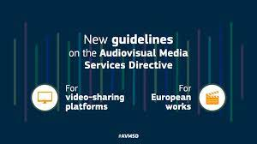
2.4 Digitization
The rules apply to user-generated videos shared on platforms like Facebook, when providing AV content is an essential functionality of the service
Services such as YouTube will fall under the scope of the revised AVMS Directive.
AV content shared on social media services will also be covered by the new deal.
Stronger rules against hate speech and public provocation to commit terrorist offences, that prohibit incitement to violence or hatred and provocation to commit terrorist offences in AV media services as well as on video-sharing platforms.
Notes:
Netflix, Amazon and other online streaming services will have to dedicate 30% of their output to TV shows and films made in Europe, which they must subsidise, under the terms of a new EU law (2016)
As well as the “Netflix quota”, the streaming services will have to fund European TV series and films, either by directly commissioning the content or contributing to national film funds, under the terms of an outline deal on EU broadcasting rules reached by legislators.
MEPs and the council of ministers, who are responsible for agreeing the law, struck a deal on a final version of the EU’s audio-visual services directive – a breakthrough in the legislative process.
The law falls into a longstanding tradition of EU lawmakers protecting European film and drama against the encroachments of Hollywood and US TV and online shows.
Sign up to the Media Briefing: news for the news-makers
Read more
Industry groups have criticised cultural quotas as “outdated” and “counterproductive”, but lost the argument to European politicians who see them as vital to protect local languages and culture.
Advertisement
The European commission’s original proposal was for a 20% “Netflix quota” but MEPs said that was not enough.
The European parliament says the law means companies such as Netflix will face the same rules as traditional TV channels, not only on European content but also limits on advertising and product placement.
Video-sharing websites, such as Google and Facebook, will also have to intensify work to clamp down on content “inciting violence, hatred and terrorism”. Under the law, platforms need to create a “transparent, easy-to-use and effective mechanism” to allow users to report hateful content.
The EU is also banning product placement from children’s programmes, although member states can decide whether they want to outlaw corporate sponsorship of under-18’s TV shows.
Advertisers will only be allowed 20% of screen time during the prime-time hours of 6pm to midnight.
“We have now made European media regulation fit for the digital era by applying similar rules to similar services, whether online or offline,” said Sabine Verheyen, a German centre-right MEP who was one of the parliament’s lead negotiators.
The rules on product placement and sponsorship were “a great achievement for the protection of consumers, especially children and minors”, she added.
The law has to jump over several procedural hurdles before it is passed, a process not expected to be completed until September.
Also on Thursday a draft EU regulation was published that would force Amazon, Google, eBay and other tech firms to be more transparent in their dealings with third-party businesses that sell goods on their sites.
Thousands of companies use the platforms to sell goods online, allowing a sole trader working from home to reach millions of potential customers. But many complain that the big firms are opaque about their rankings, which mean some get top billing, while others struggle to be seen. App designers report similar problems when listing on Google’s and Apple’s stores.
Under the draft regulation, large platforms would have to rewrite their terms and conditions to ensure third-party sellers knew how to influence their online ranking, for example, if payment is required for a top spot.
Platforms would also have to explain any decision to suspend a third-party business from their site, and set up a system to handle complaints.
Legislators hope for agreement between European ministers and MEPs on the law by early next year, which would see the law come into effect from autumn 2019.
The draft regulation follows a pan-European survey by the commission, which found that 46% of businesses using online platforms encounter problems, rising to 75% for those that generated more than half of their turnover via the platform. One-third of heavy users complained about lack of transparency, while 22% thought terms and conditions were unfair. The most frequently cited problems were technical ones and lack of support from the platform.
“You see things like user conditions being changed from day to day,” said Mariya Gabriel, the European commissioner for digital economy and society. “We are saying to the platforms you need to have transparency with regard to your conditions for use, data access and so on, to provide businesses with the opportunity to know what their criteria are and to create an environment based on rules that everyone is familiar with.”
“a service as defined by Articles 56 and 57 of the [TFEU] which is under the editorial responsibility10 of a media service provider and the principal purpose of which is the provision of programmes, in order to inform, entertain or educate, to the general public by electronic communications networks”.11
, a 10% share of the content broadcast must be European works. Accordingly linear (television) and non-linear services providers must ensure that 20 % of their catalogues are European works.

Slide 19
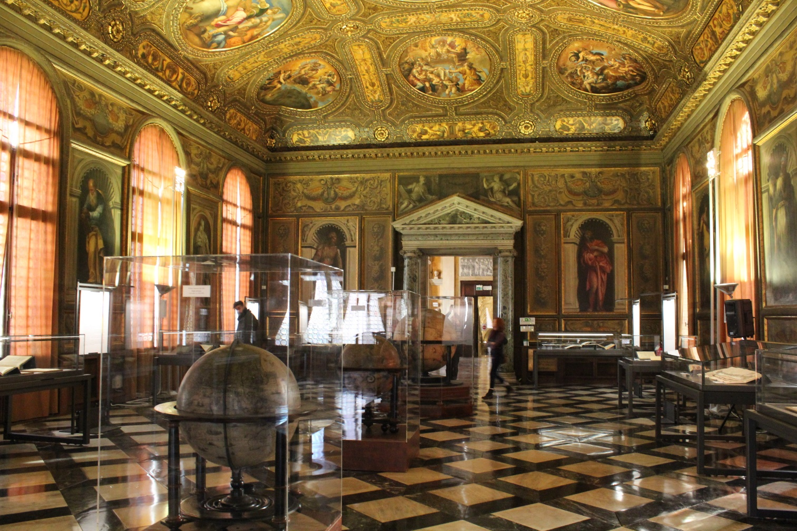
2.4 Digitization
Notes:
The proposed revision of the audiovisual media services directive (AVMSD) is expected to be opposed by online service providers and kindred spirits. This is the legislation that governs national rules on all audiovisual media content. This is not just about television, it also includes online portals and on-demand services. The AVMSD has taken various forms over the years whilst adapting to the ongoing changes to the technological environment. Since the initial adoption of the Television without Frontiers Directive back in the 1980s the idea has been to create a harmonised single market for audiovisual content whilst ensuring some key principles. These include technological neutrality, freedom of reception and retransmission and flexibility for Member States to provide more detailed and stricter rules than specified in the AVMSD.
Market developments, notably the rise of the online world, made it necessary to revisit the rules and amend the framework. With the last revision, the Directive was renamed
and extended to include not only the traditional television content but also non-linear services (such as “on-demand” and internet services) providing television-like audiovisual content. This would now include providers like Netflix. The proposal adopted on 25 May/2016 by the Commission has proposed several changes such as the rules of prominence, advertising time limits and protection of minors.
The EU is aiming to create a single, pan-European market encompassing all digital services and thus it is unsurprising that the rules for online services are to be
reinforced. For instance, the Commission proposes a common quota at EU level, taking account of the fact that many member states have already been implementing their own national
quotas for European works. For instance, in Spain and Austria, there is an obligation to reserve 30% and 50% (respectively) of their “on-demand” services catalogues for
European works. In the current AVMSD, a 10% share of the content broadcast must be European works. Accordingly linear (television) and non-linear services providers must ensure that 20 % of their catalogues are European works.

Slide 20
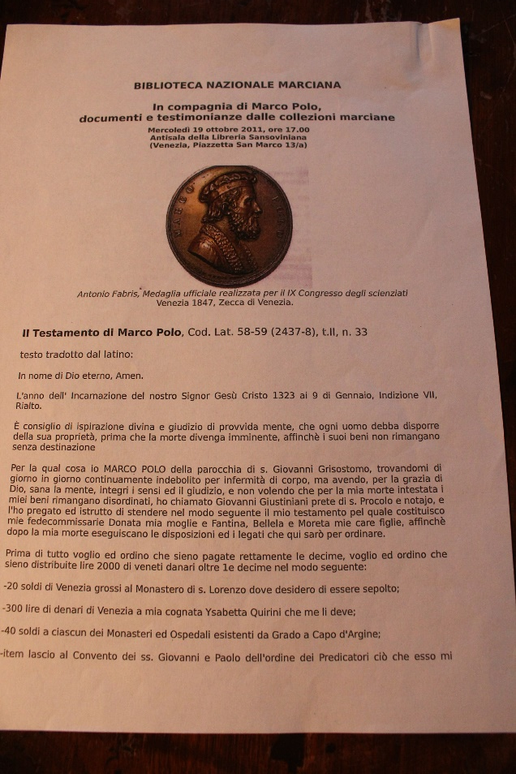
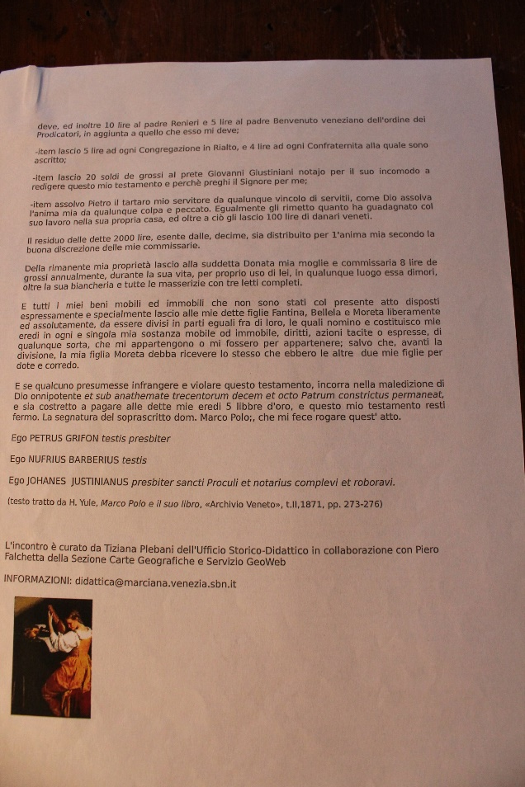
2.4 Digitization
The Will of Marco Polo
Notes:
Instead of sitting in front of the family TV, millions of Europeans, especially young people, watch content online, on demand and on different mobile devices.
European VoD services are still at a relatively early stage of development. They are a new opportunity for many European films to reach a broader audience, also across borders. The Commission wants to encourage the development of measures and instruments that could help European films to take advantage of this opportunity without hampering the development of VoD. Taking into account emerging developments, the new Audiovisual Media Services Directive is a new deal by the European Commission, the EU Council and the European Parliament.
Now the EU institutions have made European media rules fit for the digital era. Finally a level of protection was agreed for internet media services similar to that in place for traditional broadcast media.
Some very significant cornerstones of the new audiovisual media rules:
First, very good news for the European film sector and our European cultural diversity. The quotas for European works will be 30% for both TV service providers and video-on-demand service providers in their catalogues (‘Netflix quota’).
The quotas for European works will be 30% for both TV service providers and video-on-demand service providers in their catalogues (‘Netflix quota’)
Second, a level of protection for internet media services was negotiated which is similar to that in place for traditional broadcast media. This means that users will get equal protection whether they are watching a film on traditional TV or on on-demand TV.
Users will get equal protection whether they are watching a film on traditional TV or on on-demand TV
Third, strict rules on advertising and product placement in children’s programmes and content available on VOD platforms. Broadcasters are required to put in place measures to effectively reduce children’s exposure to publicity for unhealthy food and beverages. The transparency rules for advertising, especially on product placement and sponsorship, will now also apply to video-sharing platforms. This is a great achievement for the protection of consumers, especially children and minors. It was one of the main goals to protect consumers against excessive advertising.
The transparency rules for advertising, especially on product placement and sponsorship, will now also apply to video-sharing platforms
Fourth, the existing rules already cover traditional TV broadcasters and video on-demand services. In the updated rules, the scope of application has been extended to also cover video-sharing platforms. The revised rules will also apply to user-generated videos shared on platforms like Facebook, when providing audiovisual content is an essential functionality of the service.
The revised rules will also apply to user-generated videos shared on platforms like Facebook, when providing audiovisual content is an essential functionality of the service
A video-sharing platform is defined as a commercial service addressed to the public where the principal purpose of the service (or an essential functionality of such service) is devoted to providing programmes and user-generated videos to the general public, in order to inform, entertain or educate; which is made available by electronic communications networks; and where the content is organised in a way determined by the provider of the service, in particular by displaying, tagging and sequencing.
Services such as YouTube will fall under the scope of the revised Directive. Audiovisual content shared on social media services will also be covered by the new deal.
This means that services such as YouTube will fall under the scope of the revised Directive. Audiovisual content shared on social media services, such as Facebook, will also be covered by the new deal.
While newspaper websites remain outside the scope of the rules, standalone parts of newspapers' websites which feature audiovisual programmes or user-generated videos will be considered as video-sharing platforms for the purpose of the AVMSD. However, any occasional use of videos on websites, blogs or news portals will be outside the scope of the rules.
Stronger rules against hate speech and public provocation to commit terrorist offences
Last, but not least, stronger rules against hate speech and public provocation to commit terrorist offences, that prohibit incitement to violence or hatred and provocation to commit terrorist offences in audiovisual media services as well as on video-sharing platforms.
Netflix, Amazon and other online streaming services will have to dedicate 30% of their output to TV shows and films made in Europe, which they must subsidise, under the terms of a new EU law (2016)
As well as the “Netflix quota”, the streaming services will have to fund European TV series and films, either by directly commissioning the content or contributing to national film funds, under the terms of an outline deal on EU broadcasting rules reached by legislators.
MEPs and the council of ministers, who are responsible for agreeing the law, struck a deal on a final version of the EU’s audio-visual services directive – a breakthrough in the legislative process.
The law falls into a longstanding tradition of EU lawmakers protecting European film and drama against the encroachments of Hollywood and US TV and online shows.
Sign up to the Media Briefing: news for the news-makers
Read more
Industry groups have criticised cultural quotas as “outdated” and “counterproductive”, but lost the argument to European politicians who see them as vital to protect local languages and culture.
Advertisement
The European commission’s original proposal was for a 20% “Netflix quota” but MEPs said that was not enough.
The European parliament says the law means companies such as Netflix will face the same rules as traditional TV channels, not only on European content but also limits on advertising and product placement.
Video-sharing websites, such as Google and Facebook, will also have to intensify work to clamp down on content “inciting violence, hatred and terrorism”. Under the law, platforms need to create a “transparent, easy-to-use and effective mechanism” to allow users to report hateful content.
The EU is also banning product placement from children’s programmes, although member states can decide whether they want to outlaw corporate sponsorship of under-18’s TV shows.
Advertisers will only be allowed 20% of screen time during the prime-time hours of 6pm to midnight.
“We have now made European media regulation fit for the digital era by applying similar rules to similar services, whether online or offline,” said Sabine Verheyen, a German centre-right MEP who was one of the parliament’s lead negotiators.
The rules on product placement and sponsorship were “a great achievement for the protection of consumers, especially children and minors”, she added.
The law has to jump over several procedural hurdles before it is passed, a process not expected to be completed until September.
Also on Thursday a draft EU regulation was published that would force Amazon, Google, eBay and other tech firms to be more transparent in their dealings with third-party businesses that sell goods on their sites.
Thousands of companies use the platforms to sell goods online, allowing a sole trader working from home to reach millions of potential customers. But many complain that the big firms are opaque about their rankings, which mean some get top billing, while others struggle to be seen. App designers report similar problems when listing on Google’s and Apple’s stores.
Under the draft regulation, large platforms would have to rewrite their terms and conditions to ensure third-party sellers knew how to influence their online ranking, for example, if payment is required for a top spot.
Platforms would also have to explain any decision to suspend a third-party business from their site, and set up a system to handle complaints.
Legislators hope for agreement between European ministers and MEPs on the law by early next year, which would see the law come into effect from autumn 2019.
The draft regulation follows a pan-European survey by the commission, which found that 46% of businesses using online platforms encounter problems, rising to 75% for those that generated more than half of their turnover via the platform. One-third of heavy users complained about lack of transparency, while 22% thought terms and conditions were unfair. The most frequently cited problems were technical ones and lack of support from the platform.
“You see things like user conditions being changed from day to day,” said Mariya Gabriel, the European commissioner for digital economy and society. “We are saying to the platforms you need to have transparency with regard to your conditions for use, data access and so on, to provide businesses with the opportunity to know what their criteria are and to create an environment based on rules that everyone is familiar with.”
“a service as defined by Articles 56 and 57 of the [TFEU] which is under the editorial responsibility10 of a media service provider and the principal purpose of which is the provision of programmes, in order to inform, entertain or educate, to the general public by electronic communications networks”.11
The proposed revision of the audiovisual media services directive (AVMSD) is expected to be opposed by online service providers and kindred spiritsThis is the legislation that governs national rules on all audiovisual media content. This is not just about television, it also includes online portals and on-demand services. The AVMSD has taken various forms over the years whilst adapting to the ongoing changes to the technological environment. Since the initial adoption of the Television without Frontiers Directive back in the 1980s the idea has been to create a harmonised single market for audiovisual content whilst ensuring some key principles. These include technological neutrality, freedom of reception and retransmission and flexibility for Member States to provide more detailed and stricter rules than specified in the AVMSD.
Market developments, notably the rise of the online world, made it necessary to revisit the rules and amend the framework. With the last revision, the Directive was renamed
and extended to include not only the traditional television content but also non-linear services (such as “on-demand” and internet services) providing television-like audiovisual content. This would now include providers like Netflix. The proposal adopted on 25 May/2016 by the Commission has proposed several changes such as the rules of prominence, advertising time limits and protection of minors.
The EU is aiming to create a single, pan-European market encompassing all digital services and thus it is unsurprising that the rules for online services are to be
reinforced. For instance, the Commission proposes a common quota at EU level, taking account of the fact that many member states have already been implementing their own national
quotas for European works. For instance, in Spain and Austria, there is an obligation to reserve 30% and 50% (respectively) of their “on-demand” services catalogues for
European works. In the current AVMSD, a 10% share of the content broadcast must be European works. Accordingly linear (television) and non-linear services providers must ensure that 20 % of their catalogues are European works.

Slide 21
2.5 The Digital Media
Electronic publications
Software of any kind (from translators to web apps, to mobile games)
Records of activities
Electronic databases with various themes (e.g. cultures, history, geography etc.)
Educational information (academic e-journals, iBooks, etc.)
Artworks (music, film)
Digital museums
Onsite and mobile apps
Products of entertainment etc.

Slide 22
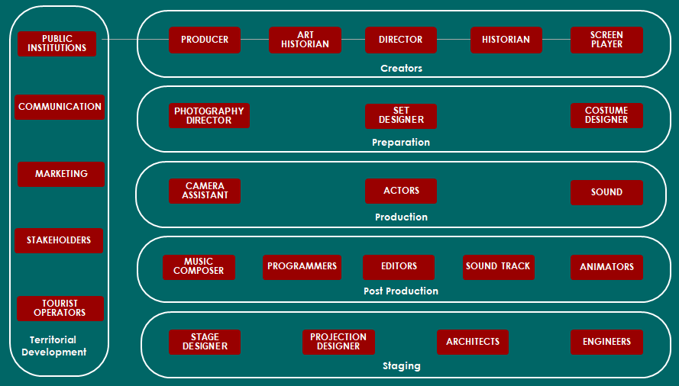
2.5 The BBC Model

Slide 23
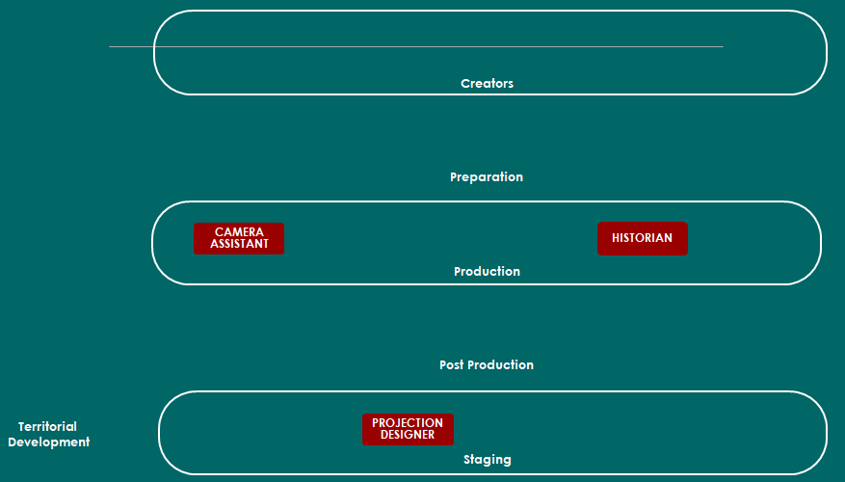
2.5 The Public Investment

Slide 24
2.6 Digital Tools
2.6 Digital Tools
2.6.1 Virtual Reality
2.6.2 Augmented Reality
2.6.3 Serious Games
2.6.4 Multivision Technologies
2.6.5 iBooks and eBooks
Notes:
ULTIVISIONS
A multivision is a complex audiovisual technology, which is integrated different types of documents (fotos, texts, manuscripts, objects, shooting on location etc.) into meaningful subdivisions (chapters) and integrates the whole into a cultural communication project.

Slide 25
2.6.2 Augmented Reality
Notes:
Augmented reality (AR) technology is one of the most exciting advancements of our time. It can generate empathy and new perspectives by transporting people, sometimes literally, into the shoes of another person with no barriers in time or space. Not surprisingly, many industries are considering the technology’s potential to improve customer experience.
Using Technology to Enhance Customer Experience
The museum industry is among the pioneers who are embracing this opportunity. Museums are currently facing a period of financial stagnation, with costs and insurance premiums rising and government funds dwindling. Many are forced to delay projects, downsize exhibitions, and even lay off staff. Forward-thinking museums, though, are embracing new technologies that enable visitors to have deeper connections with exhibits.
For example, the Terracotta Warriors exhibit at the Franklin Institute in Philadelphia was AR-enhanced, with visitors able to see more detailed representations of how the sculptures and weapons looked through their AR app. They also have a Virtual Reality Demonstration Space, an immersive VR zone where you can go inside the human body, tour the solar system, walk around Chernobyl, peek into a brain, and more.
Researchers at the School of Sport, Tourism and Hospital Management are studying how these new technologies can be best deployed in fields where consumers still crave authentic experiences.
AR and VR: Technological Innovation Creates New Research Space
While virtual reality is a fully immersive experience (think of the VR headsets and being transported to a simulated environment), augmented reality is simply an enhanced version of reality created by adding information (image, text, or effects) to real places or objects using a piece of technology.
Despite the extensive discussions around the applications of AR technology, little research has been done on what kind of immersive experiences are best to use on visitors. Zeya He, an STHM PhD student, alongside professors Laurie Wu and Robert Li, recently examined the impact of different types of AR enhancements. Their paper, “When art meets tech: The role of augmented reality in enhancing museum experiences and purchase intentions,” will be published this fall in Tourism Management. He, Wu, and Li recruited more than 200 participants for their online study and gave them video simulations of an AR-enhanced scene. The video showed a museum scene with Vincent Van Gogh’s painting Starry Night Over the Rhône, testing visual and text animations on the painting itself: glimmering stars, reflections on the river, a couple strolling on the bank, and added verbal information. In some videos, the museum environment was also augmented with a visual of gently rippling water, testing virtual alterations to the museum’s ambience.
The researchers wanted to see what the participants found most engaging: adding animation to the different aspects of the painting, adding text over the painting, or adjusting the “virtual presence” by making the museum environment match that of the painting.
Enhancing Reality vs. Depriving Imagination
Though we might expect the most AR-enhanced scenario to have been the most highly rated, participants liked the one with the additional text and added ambience the most. The participants said the animation of the painting itself felt too intrusive. “It seems that technology may sometimes help create meaningfulness and excitement, but it can also make you think less, become less engaged,” He explains. While environmental visual cues can improve connection with an art piece, visual enhancement of the actual object seems to deprive the viewer of the freedom of imagination. Participants felt that they could no longer appreciate the painting itself with the added technological visualization, but the added text actually helped guide their eye to aspects of the painting and deepened their understanding.
Looking to the Future
Though doing the study online had certain benefits, such as eliminating other possible confounding factors, further research is needed to test the effects of different kinds of technological enhancements of the museum experience, especially real AR technology in real museum spaces. The effects and results may also differ depending on the context, and the type of museum or exhibit.
“[These] results can be used by museums directly to design their content, but we also need to continue doing research on how it is possible to balance the excitement that technology brings and the meaningfulness the museum is trying to create,” He says. “So, it is the degree of technological enhancements that really matters, how we design the technology really matters.”
Augmented Reality can provide a number of key benefits to brands and organisations:
AR increases engagement and interaction and provides a richer user experience
Research has shown that AR increases the perceived value of products and brands
Well implemented AR activity conveys innovation and responsiveness from forward-thinking brands
AR is mobile and personal and, therefore, hugely accessible to a rapidly growing smartphone market
AR is an inexpensive alternative to other media platforms as no specific media needs to be purchased
Brands have access to detailed analytics enabling them to truly understand their audience

Slide 26
2.6.1 Virtual Reality
Notes:
Faster Learning
Because of the sensory and experiential of VR and AR, learners of all three modalities – kinesthetic, visual, and auditory – benefit from Augmented and Virtual Reality education and achieve faster learning while developing higher level cognitive skills.
Higher Level Knowledge Transfer
Augmented and Virtual Reality education solutions empower students to learn-by-doing by directly engaging with their subject matter through immersive interactive experiences. Learning transitions from traditional memorization giving students the ability to apply, analyze, evaluate their knowledge improving creativity, critical thinking, problem solving, and communication.
Attention through Greater Level of Engagement
These Augmented and Virtual Reality education solutions and lessons create an environment in which students are actively participating in their learning material and are incentivized through gamification as well as assessment.
2.6.1 VIRTUAL REALITY
Tourism constitutes a fertile terrain for VR applications. An important feature of VR is that when a user observes a monument, a building or a sculpture the perception of additional information will be straightforward and engaging. Thus Virtual Reality (VR) can be a tool destined for the enhancement of heritage education and visitor learning. Furthermore, serious games are employed for telling stories and narrations for education-al purposes, allowing users to experience a personalized view of mythology.
Virtual Reality is an alternate world filled with computer generated images that respond to human movements. Virtual Reality (VR) is an interdisciplinary field of research, including the domains of human-computer inter-action (HCI), computer-generated imagery (CGI) and computer graphics. Virtual reality technologies (VR) offer unprecedented user experience when it comes to 3D visualization, constituting a domain that is employed in a variety of fields.
VR systems make users perceive that they are physically present in the rendered non-physical world. This feeling of immersion is accomplished through the combination primarily of vision and secondarily of sound. Other approaches involve addition-al human senses such as touch and olfaction. Virtual environments (VEs) are used to let users interact with places, characters or objects, where they should experience the feeling of “being there”, also known as presence. For various VR/MR/AR applications, such as virtual usability studies, it is fundamental that the participants have the feeling that they are really in the environment. Two important factors that influence presence are the level of immersion and the navigation method. Jung’s et al research showed that social presence in mixed (VR & AR) environments is a strong predictor of four realms of experience, i.e. education, esthetics, escapism and entertainment. Immersion in VR environments can be helpful for further engaging people into the virtual world, suspending the feeling of disbelief and stepping out of the real world into another dimension through which they can accomplish their own goals. These goals can be set by the creators of the virtual environments so that they are constructive and helpful across a variety of domains.

Slide 27
VR or AR?
TATE GALLERY_THE MODIGLIANI EXHIBITION
Notes:
Modigliani Exhibition
https://www.youtube.com/watch?v=CdYLscE6kE0
https://www.youtube.com/watch?v=QJ_NFvL9wpY
https://arts.vive.com/uk/articles/projects/art-photography/tate_modigliani_vr/
https://www.viveport.com/apps/64a94f1a-09eb-41b3-b251-d8de2b73b339/Modigliani_VR:_The_Ochre_Atelier/?_ga=2.69490704.1632677625.1562321828-1008418894.1562321828

Slide 28
2.6.2 Augmented Reality
increase engagement in learning by augmenting historical and cultural locations
augmented exhibition content for premium museum/gallery visitors
virtual tour guides for specific city tours (i.e. cultural, food & drink, historical)
Notes:
2.6.2 AUGMENTED REALITY
Augmented reality (AR) is an enhanced version of reality created by the use of technology to add digital information on an image of something. AR is used in apps for smartphones and tablets. AR apps use your phone's camera to show a view of the real world in front of the spectator, then put a layer of information, including text and/or images, on top of that view. Apps can use AR for fun, such as the game Pokémon GO.
Augmented reality (AR) technology is one of the most exciting advancements of our time. It can generate empathy and new perspectives by transporting people, sometimes literally, into the shoes of another person with no barriers in time or space. Not surprisingly, many industries are considering the technology’s potential to improve customer experience.
Using Technology to Enhance Customer Experience
The museum industry is among the pioneers who are embracing this opportunity. Museums are currently facing a period of financial stagnation, with costs and insurance premiums rising and government funds dwindling. Many are forced to delay projects, downsize exhibitions, and even lay off staff. Forward-thinking museums, though, are embracing new technologies that enable visitors to have deeper connections with exhibits.
For example, the Terracotta Warriors exhibit at the Franklin Institute in Philadelphia was AR-enhanced, with visitors able to see more detailed representations of how the sculptures and weapons looked through their AR app. They also have a Virtual Reality Demonstration Space, an immersive VR zone where you can go inside the human body, tour the solar system, walk around Chernobyl, peek into a brain, and more.
Researchers at the School of Sport, Tourism and Hospital Management are studying how these new technologies can be best deployed in fields where consumers still crave authentic experiences.
AR and VR: Technological Innovation Creates New Research Space
While virtual reality is a fully immersive experience (think of the VR headsets and being transported to a simulated environment), augmented reality is simply an enhanced version of reality created by adding information (image, text, or effects) to real places or objects using a piece of technology.
Despite the extensive discussions around the applications of AR technology, little research has been done on what kind of immersive experiences are best to use on visitors. Zeya He, an STHM PhD student, alongside professors Laurie Wu and Robert Li, recently examined the impact of different types of AR enhancements. Their paper, “When art meets tech: The role of augmented reality in enhancing museum experiences and purchase intentions,” will be published this fall in Tourism Management. He, Wu, and Li recruited more than 200 participants for their online study and gave them video simulations of an AR-enhanced scene. The video showed a museum scene with Vincent Van Gogh’s painting Starry Night Over the Rhône, testing visual and text animations on the painting itself: glimmering stars, reflections on the river, a couple strolling on the bank, and added verbal information. In some videos, the museum environment was also augmented with a visual of gently rippling water, testing virtual alterations to the museum’s ambience.
The researchers wanted to see what the participants found most engaging: adding animation to the different aspects of the painting, adding text over the painting, or adjusting the “virtual presence” by making the museum environment match that of the painting.
Enhancing Reality vs. Depriving Imagination
Though we might expect the most AR-enhanced scenario to have been the most highly rated, participants liked the one with the additional text and added ambience the most. The participants said the animation of the painting itself felt too intrusive. “It seems that technology may sometimes help create meaningfulness and excitement, but it can also make you think less, become less engaged,” He explains. While environmental visual cues can improve connection with an art piece, visual enhancement of the actual object seems to deprive the viewer of the freedom of imagination. Participants felt that they could no longer appreciate the painting itself with the added technological visualization, but the added text actually helped guide their eye to aspects of the painting and deepened their understanding.
Looking to the Future
Though doing the study online had certain benefits, such as eliminating other possible confounding factors, further research is needed to test the effects of different kinds of technological enhancements of the museum experience, especially real AR technology in real museum spaces. The effects and results may also differ depending on the context, and the type of museum or exhibit.
“[These] results can be used by museums directly to design their content, but we also need to continue doing research on how it is possible to balance the excitement that technology brings and the meaningfulness the museum is trying to create,” He says. “So, it is the degree of technological enhancements that really matters, how we design the technology really matters.”
Augmented Reality can provide a number of key benefits to brands and organisations:
AR increases engagement and interaction and provides a richer user experience
Research has shown that AR increases the perceived value of products and brands
Well implemented AR activity conveys innovation and responsiveness from forward-thinking brands
AR is mobile and personal and, therefore, hugely accessible to a rapidly growing smartphone market
AR is an inexpensive alternative to other media platforms as no specific media needs to be purchased
Brands have access to detailed analytics enabling them to truly understand their audience

Slide 29
2.6.2 VR or AR?
Notes:
Faster Learning
Because of the sensory and experiential of VR and AR, learners of all three modalities – kinesthetic, visual, and auditory – benefit from Augmented and Virtual Reality education and achieve faster learning while developing higher level cognitive skills.
Higher Level Knowledge Transfer
Augmented and Virtual Reality education solutions empower students to learn-by-doing by directly engaging with their subject matter through immersive interactive experiences. Learning transitions from traditional memorization giving students the ability to apply, analyze, evaluate their knowledge improving creativity, critical thinking, problem solving, and communication.
Attention through Greater Level of Engagement
These Augmented and Virtual Reality education solutions and lessons create an environment in which students are actively participating in their learning material and are incentivized through gamification as well as assessment.
First Things First…
Before going on to the benefits of using Augmented and Visual Reality in eLearning, let's briefly recap exactly what alternate reality technologies encompass. The term Virtual Reality means recreating an experience through the use of software and specialized devices, whereas Augmented Reality is about combining digital information with our own environment. Unlike Virtual Reality, instead of "creating" a new learning experience it uses the existing surroundings.
1. Make The eLearning Process Engaging And Exciting
The use of Augmented and Visual Reality is making eLearning courses more innovative and enjoyable. Engaging online learners within the eLearning environment is one of the biggest hurdles eLearning professionals face. Fortunately, alternate reality technologies take care of that. The idea that they can actually try out what they learn without the risk of any repercussion appeals to online learners. Besides giving online learners the opportunity to develop a deep understanding of the concept under study, they also embolden them to ask questions and inquire about what they are trying to learn. They have the chance to participate in experiences that otherwise would not have been possible. Moreover, research shows that learners prefer to watch rather than read or write for learning purposes. This research also compliments the concept of kinesthetic learning, which involves physical activity to improve knowledge assimilation and retention. Augmented and Visual Reality are out of the box thinking technologies that break the conventional boring method of learning. Thus, online learners can immerse themselves in situations and take action instead of merely observe.
2. Create Scenarios That Otherwise Are Impossible To Create
Augmented and Visual Reality technologies have added another dimension to the field of eLearning. They take online learners to another world and allow them to gain experience without any risk. This technology also enables organizations to incorporate environments that would be too costly to recreate in the real world. For example, paying for employees to travel to other work sites or manufacturing a Hollywood-worthy set to put things into context. Besides saving costs, training in a virtual environment also increases the levels of safety. This method ensures the online learner is clear about what they are being taught and can apply it in real life.
3. Focus On A Practical Approach Rather Than Just Theory
For the most part, our existing education system focuses more on theory than practical approach. That is the reason why people tend to forget rotely learned concepts so easily. On the contrary, Augmented and Visual Reality make learning a practical experience. And experiences are what stick with online learners and enable them to recall the information for later use. Some concepts that in theory appear to be dry, fail to catch online learners' attention for more than 15 minutes. However, AR and VR can make them more interesting by adding practical application and immersion to eLearning. This also helps online learners to appreciate the importance of concepts and ideas instead of merely brushing them off as a theoretical knowledge that has no correlation with their work duties or responsibilities.
4. Encourage Online Learners To Learn From Their Mistakes
Learners tend to experience some degree of confusion when they encounter new challenges or unfamiliar situations. This usually happens when their minds contradict what the theory teaches. In that case, incorporation of alternate reality technologies gives you the power to remove any doubts from the minds of your online learners. With these technologies, you put your online learners in a situation where they can try out their own ideas and reach their own conclusions. This also ensures that the lesson learned sticks with them and creates an emotional connection.
5. Allow For Self-Guided Exploration
Augmented and Visual Reality technologies give you the ability to create a safe environment for online learners to experiment and try things which would otherwise be impossible. Take medical training for instance. Imagine the pressure a medical student must face when he comes across a sensitive case for the first time. A wrong decision at this point can make the situation worse and that may even shatter the confidence of the doctor for the rest of his life. However, by replicating the same situation with the help of Virtual Reality, doctors can be prepared for such dangerous situations beforehand without having to worry about any repercussions.
Although their full implications are yet to be explored, alternate reality technologies make eLearning more engaging and productive. They are here to stay, and who knows what benefits they will bring to future learners. As the technology evolves, so too will the applications in eLearning. Which is why it's essential for eLearning pros to keep up with cutting-edge tech and think of new and innovative uses for AR and VR tools.
What is AR/VR’s true potential for online training? Download our free eBook Step into the Screen: AR/VR Technology's Role In The Future Of eLearning to find out what the future holds for VR and AR in the eLearning sector. We'll also share a step-by-step guide on how to develop alternate reality resources and top pitfalls to avoid when integrating VR into your eLearning strategy.
https://elearningindustry.com/benefits-using-augmented-virtual-reality-technologies-elearning

Slide 30
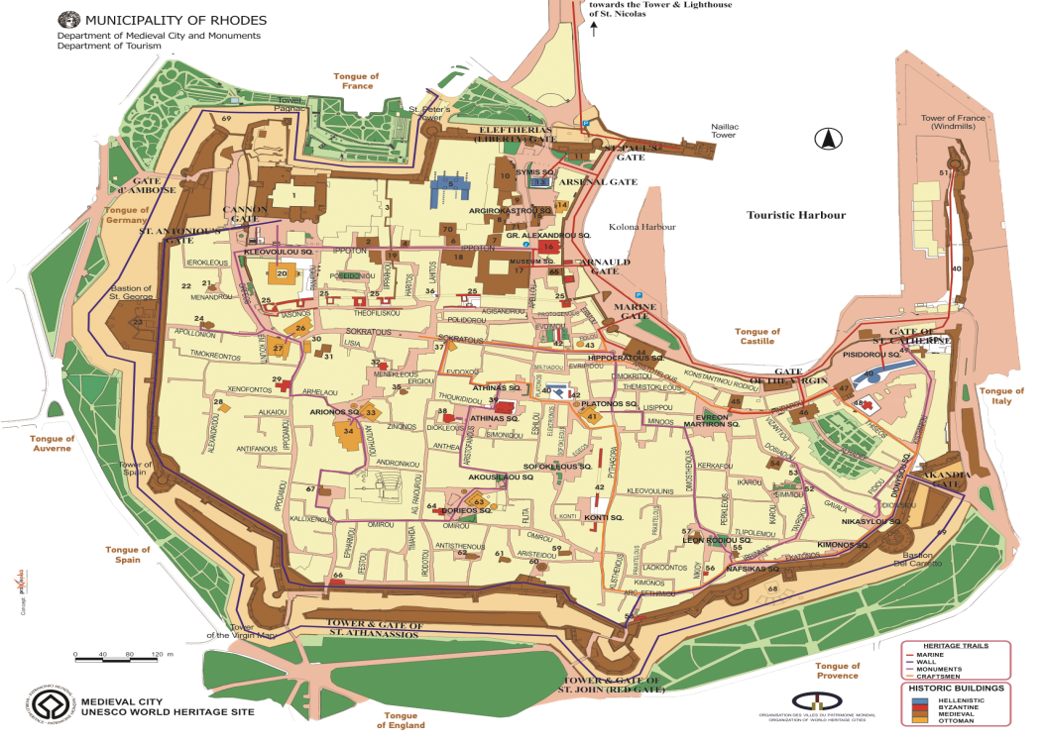
2.6.3 Heritage Games
Notes:
“Grand Master Challenge” is a heritage game developed under the umbrella of DIVERTIMENTO, an ongoing Project within the COSME Programme 2014-2020. The Game aims to effectively facilitate tourism consumption choices and stimulate a new heritage mobility model in Unesco enlisted Medieval City of Rhodes by communicating heritage values to non-captives audiences in an entertaining and participatory way. It is supported by an iBook for iOS/Android operating systems specifically designed to serve as an information hub for the Game plot, narratives and clues and facilitate spatial navigation through the embedded Google Map. Structure and contents are aligned with human cognitive architecture to facilitate cognitive processing of information with tourism value. The Game enables an unlimited number of users to retrieve key media information and customize it according to their personal preferences and points of enthusiasm, transforming their personal experiences into a ludic marketing tool.
4.1 The Planning Concept
The Game is supported by a cohesive heritage narrative “THE UNITED STATES OF EUROPE: DRESS REHEARSAL, RHODES, 1306-1522” developed according to the values of the Council of Europe and it is embedded in the iBook. It involves 32 monuments connects 20 geolocations, in the Unesco enlisted Medieval City of Rhodes, structured in 10 trail stations. Given the multiethnic character of the Knights Hospitallers and the visibility of monuments in the landscape, 5 interpretive spheres are introduced to inspire the comparison of the sovereignty of Rhodes (1306-1522) with European Union values “united in diversity”. Following recent scholarly research that challenging games help the learning process (Hamari et al., 2016), the Game is designed to facilitate visitors familiarize with known schemes from their everyday life such as: (multi-ethnic) governance, citizen services (administration, health, defense, etc.), economy and commerce, faith, social life and arts, private life, so as to enable quick understanding and foster participatory cultural consumption. The cultural route developed entails 10 play units that include 20 geolocations. Each play unit is embedded in the EUROTHENTICA eBook.
4.2 Heritage Assessment
The National Heritage Register declares 281 assets within the wall of the Medieval Town of Rhodes (1948). 32 assets have been selected, following the Significance Assessment methodology adopted by DIVERTIMENTO, documenting exactly why assets are significant using a multivariate analysis. A Statement of Significance produced for each asset on the basis of the historic-archaeological information, intrinsic qualities, inherent values, visibility in the landscape, spatial importance, social recognition, physical accessibility and interpretive potential, build the asset values, the meanings that shall be conveyed to the audience. Meanings are contextual in nature, including a linguistic, spatial and a social context. To access any meaning is to comprehend it within a given context. The significant context of meanings in tourism is a spatial one, the sense of place. Meanings extracted from a visit to place, heritage or natural site, collection etc., constitute the high added value experience a visitor takes away in memory. In this vein, the visitor experience is the meaning as a result of cognitive processing.
4.3 Audience and Stakeholders
The audience at heritage attractions, heritage places and sites, whether it is called, visitor, tourist, or cultural consumer, a gourmet seeking customer, or a curious soul, it belongs to the very heterogeneous groups, often comprised of multi-generational and multicultural identities. Capturing and keeping their attention high up during the Game, it means to create bridges between the inherent values of the heritage assets selected for presentation and the Game players. Far beyond the dissemination of factual information, an interpretation process creates meanings, so that the Game Players can put a place into personal perspective and identify with it in more profound and enduring way.
The Game refers to the inherently interesting and valuable tales that most heritage assets can narrate about the history, culture and environment of the surrounding landscape and communities. Telling the story is a creative process that includes many types of synergies within the Local Stakeholder Map. Through the story, citizens can express what is unusual and special about their communities. The Game is the intentional, coordinated message conveyed to the audience about the heritage assets and their qualities. The additional emphasis of quality and continuity of the visitor’s experience distinguishes the Game from other tourism products and management issues like landscape protection or land management efforts. The development of the game encourages the Local stakeholders to seek out, document and communicate all of the special qualities of a place: archaeological, natural, cultural, historic, recreational and scenic. This makes the onsite experience an integrative experience: visual, educational, physical and emotional. The Game aims at increasing cultural and tourism consumption: while most culture and tourism-oriented services include exceptional scenic or recreational heritage assets to attract consumer flows, the Game will draw experiences, broadened and deepened by the story and its interpretation.
Public, private and third sector local actors and project stakeholders form the supply side. However the Local Stakeholder Map is fragmented because: a) different institutional/legal structures and frameworks/capacities with overlapping state-regional-local government responsibilities perpetuate tensions in the policy context; b) different perceptions of culture by different actors at different levels give rise to competition between the public-private sector actors. The perception of the Game as a novelty in the heritage ladscape has been embraced more by the audience and the businesses than the public sector and the local authorities.

Slide 31
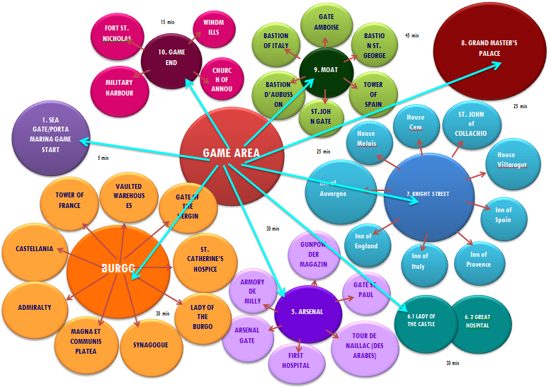
2.6.3 Heritage Games
Notes:
THE GAME DESIGN
2.6.3 HERITAGE GAMES
Heritage games, e.g. games designed with the purpose of learning rather than entertainment are also useful for the heritage visit. Important features include.
Story
A good game, like a good movie, has a gripping storyline. When creating a serious game, the story can be used to reinforce the company’s values and add an additional level of learning.
Game mechanics & Interactivity
Game mechanics are the tools provide an element of interactivity that keeps the learner involved throughout the whole process.
Game Rules
Rules provide the framework that differentiates a fun game from utter chaos. This is another interactive element that subliminally delivers a learning objective. In life, our most profound lessons come from failures. When a rule is disregarded in a serious game, the player penalized and loses its competitive advancement against other players. This leads them to change their behavior in order to avoid breaking that rule again.
Immersive graphical environment
Some of the most successful games are graphically unimpressive. For casual (non-serious) games, the gameplay itself usually wins out over how pretty it is. Although a serious game can be created without immersive graphics, most of them have a user interface that represents and reinforces the learning objective.
Challenge/competition
All games involve an element of challenge. At its simplest form, the player’s main challenge is to beat their high score. The success of the game industry runs parallel with developments in interconnectivity. Serious games with a social element allow learners to challenge each other. This element of friendly competition is another way to boost engagement
Risks and consequences
Serious games provide a risk free environment to experience cultural heritage and past history.
The Game is addressing multinational, multigenerational non captive audiences, with sufficient knowledge of English as a foreign language. Embedded in EUROTHENTICA, an the eBook Collection for iOS/Android/Windows iBook available at the Appstore and Google Play, the Game is exploiting storytelling to create a new cultural heritage experience in situ. Storytelling, old as prehistoric times, is still a powerful tool for conveying and sharing ideas, beliefs, values and traditions exactly because stories are so effective at explaining the meaning of things. The Game refers to the inherently interesting and valuable tales that most heritage assets can narrate about the history, culture and environment of the surrounding landscape and communities. The story is an aspect that people often find highly interesting, fun and compelling, and this encourages participation.
As the Medieval Town is a Unesco enlisted monument, signposting is prohibited. At major entry gates i.e. moat, gates exists directional signage, while labels onsite offer information strongly coded in expert language. A narrative structure around each monument has been developed with a reading duration of 60 secs for each story, that is embedded in the iOS/Android iBook. The game play developed in in the Medieval Town and the Moat has duration of 180 minutes.
Modern neuroscience is yielding insights which can give valuable tools for the design and delivery of quality visitor experience. Brain literacy can help accurately identify aesthetic reactions to the visual environment and catalogue the features which sustain or detract from important aesthetic experiences (Papathanasiou-Zuhrt and Di Russo, 2015). Aligned with the principles of human cognitive architecture, information units in the iOS/Windows/Android environment are chunked with max. 3 novel concepts per unit, below the limit proposed by Miller (1956), Baddeley and Hitch (1981) and Baddeley (2003 and 2012). Graphic design is aligned with the eye-scan-path movement, information layering follows international standards for the interpretation of heritage (Papathanasiou-Zuhrt and Weiss-Ibanez, 2014). In order to decongest working memory, redirect attention and allow visitors to connect with prior knowledge from the everyday life, metaphors and associations have been extensively utilized. Meanings communicated through the use of associations and metaphors are based on universal concepts, and differ substantially from transmitting formal knowledge Main goal is to inspire visitors co-create content; experience heritage in a playful way without alienating the socio-historical context; have fun and realize the benefits.
The Game tells a story at each play unit. Depth and complexity depend directly on the location-task correlation, which affects the time required to play at each location, perform the tasks, the ease of accessing and processing information. The Game is linked to Social Media Channels and the Google Map through the iBook. Winners, who have mastered all tasks, are awarded the title of the Grand Master. To promote the Game’s ludic character, winners receive the Game diploma and a free meal/drink and their photograph is uploaded in the Grand Master’s Gallery, Generation II.
The Game design considers also site facilities and orientation, tourism related services such as transport and accessibility issues, catering, shopping and accommodation information, distance and time on tracks, important features identified on an orientation map, seasonal problems such as high/low temperatures etc. With an ability to objectively identify the essential elements of indoor and outdoor heritage spaces, strategies and plans which better safeguard valuable assets can be crafted. Environmental protection and scenic preservation has become an increasingly important part of open space planning as the public desire for such amenities grows and the prospect of losing natural and scenic resources increases in response to growth pressures. The emphasis on quality of the visitor experience distinguishes the Game from other tourism products. While most culture and tourism-oriented services include exceptional scenic or recreational heritage assets to attract consumer flows, the Game will draw experiences, broadened and deepened by the story and its interpretation.
Experience seekers crave for authentic experiences at heritage places (Bulancea and Egger, 2015). Highlighting cultural experiences along the Game Area a win-win scenario for the host community and its guests emerges as stories provide a mechanism for encouraging the audience to lengthen stay, an economic impact felt throughout the Project Area.
4.1 The Game Area
The eBook narratives reinforce the association chain enabling new cognitive content to relate to prior knowledge.The narrative is the part of the story told to the player, either by the stakeholder member, either by dislocated information and further clues, either by evident information in a digital device The narrative is the non-interactive part of the story, but nevertheless is may motivate or discourage the player to carry on. As game playing is an interactive process, the narrative may be also used to provide for relaxation and further encouragement, provided is well planned and written. Writing in an entertaining, short, precise and interpretive way is a task that shall involve high expertise in the domain. The narrative shall embed the clues and the story flow, but not as an account of facts in a scientific language. Here will be defined the actual progress of the Game Plot. As you do so, think about ways that the player can take an active role in helping the avatar to make it through the story: overcoming obstacles, meeting challenges, solving problems, and so on.
4.2 The Game: Mission, Narrative, Plot and Rules
The objective of GRAND MASTER’S CHALLENGE is to offer an entertaining experience in the Unesco enlisted Medieval City of Rhodes. Therefore the Plot is defined by the socio-historical contents of the period of the Knights Hospitallers in Rhodes, Greece: 1306-1522.As the defined landscape is set around 1500, for reasons of a clear visibility of the selected monuments in the landscpape, the plot is associated with stories, events and technology standards of this particular type: dresses, weapons, titles, societal stratigram, roles, socio-historical background and connections to Europe are set in the time period 1306-1522. The plot is simple and includes the discovery of a theft, which is crucial for the defense. 4.000 golden ducats which are destined for the acquisition of a new chain for the Military Harbour vanish mysteriously from the Inn of Spain and this fact is associated with the sudden death of Grand Master Fra Guy de Rochefoucault. The Vice Chancellor of the Knights in Rhodes Fra Giovanni-Battista delle Scalle invites Knights from all European priories to come to Rhodes and contribute to the revealing of the culpable. The knight who solves the mystery becomes the next Grand Master.
Players are assisted by an avatar who helps overcome the obstacles and giving the hints for the clues that are embedded in the eBook Narrative. The introductory text sounds: I am Professor Hans von Puppet, archaeologist. I have spent my life without any sensational discoveries and I was thinking to retire. But suddenly, a clue from the Hidden Book of Knights in Rhodes, lost for 500 years, changed my life. And this clue will change your life too. Play the game in the CITY OF THE KNIGHTS in Rhodes and I will share with you the secrets of the Knights Hospitallers. I will reveal the Game rules. The invisible hand will help you. You will win the Game and become the next Grand Master of Rhodes. And remember: “The Mediterranean is the key to three Continents”.

Slide 32
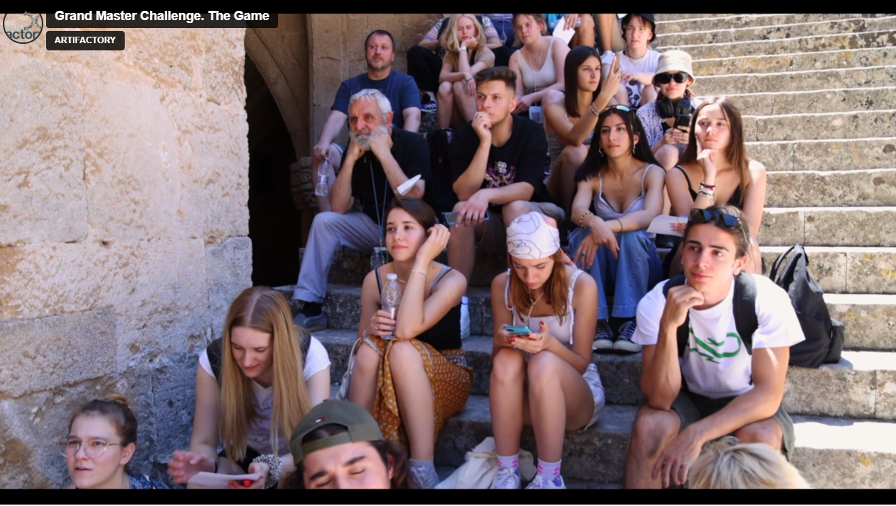
2.6.3 Heritage Games
Notes:
THE GAME DESIGN
2.6.3 HERITAGE GAMES
Heritage games, e.g. games designed with the purpose of learning rather than entertainment are also useful for the heritage visit. Important features include.
Story
A good game, like a good movie, has a gripping storyline. When creating a serious game, the story can be used to reinforce the company’s values and add an additional level of learning.
Game mechanics & Interactivity
Game mechanics are the tools provide an element of interactivity that keeps the learner involved throughout the whole process.
Game Rules
Rules provide the framework that differentiates a fun game from utter chaos. This is another interactive element that subliminally delivers a learning objective. In life, our most profound lessons come from failures. When a rule is disregarded in a serious game, the player penalized and loses its competitive advancement against other players. This leads them to change their behavior in order to avoid breaking that rule again.
Immersive graphical environment
Some of the most successful games are graphically unimpressive. For casual (non-serious) games, the gameplay itself usually wins out over how pretty it is. Although a serious game can be created without immersive graphics, most of them have a user interface that represents and reinforces the learning objective.
Challenge/competition
All games involve an element of challenge. At its simplest form, the player’s main challenge is to beat their high score. The success of the game industry runs parallel with developments in interconnectivity. Serious games with a social element allow learners to challenge each other. This element of friendly competition is another way to boost engagement
Risks and consequences
Serious games provide a risk free environment to experience cultural heritage and past history.
The Game is addressing multinational, multigenerational non captive audiences, with sufficient knowledge of English as a foreign language. Embedded in EUROTHENTICA, an the eBook Collection for iOS/Android/Windows iBook available at the Appstore and Google Play, the Game is exploiting storytelling to create a new cultural heritage experience in situ. Storytelling, old as prehistoric times, is still a powerful tool for conveying and sharing ideas, beliefs, values and traditions exactly because stories are so effective at explaining the meaning of things. The Game refers to the inherently interesting and valuable tales that most heritage assets can narrate about the history, culture and environment of the surrounding landscape and communities. The story is an aspect that people often find highly interesting, fun and compelling, and this encourages participation.
As the Medieval Town is a Unesco enlisted monument, signposting is prohibited. At major entry gates i.e. moat, gates exists directional signage, while labels onsite offer information strongly coded in expert language. A narrative structure around each monument has been developed with a reading duration of 60 secs for each story, that is embedded in the iOS/Android iBook. The game play developed in in the Medieval Town and the Moat has duration of 180 minutes.
Modern neuroscience is yielding insights which can give valuable tools for the design and delivery of quality visitor experience. Brain literacy can help accurately identify aesthetic reactions to the visual environment and catalogue the features which sustain or detract from important aesthetic experiences (Papathanasiou-Zuhrt and Di Russo, 2015). Aligned with the principles of human cognitive architecture, information units in the iOS/Windows/Android environment are chunked with max. 3 novel concepts per unit, below the limit proposed by Miller (1956), Baddeley and Hitch (1981) and Baddeley (2003 and 2012). Graphic design is aligned with the eye-scan-path movement, information layering follows international standards for the interpretation of heritage (Papathanasiou-Zuhrt and Weiss-Ibanez, 2014). In order to decongest working memory, redirect attention and allow visitors to connect with prior knowledge from the everyday life, metaphors and associations have been extensively utilized. Meanings communicated through the use of associations and metaphors are based on universal concepts, and differ substantially from transmitting formal knowledge Main goal is to inspire visitors co-create content; experience heritage in a playful way without alienating the socio-historical context; have fun and realize the benefits.
The Game tells a story at each play unit. Depth and complexity depend directly on the location-task correlation, which affects the time required to play at each location, perform the tasks, the ease of accessing and processing information. The Game is linked to Social Media Channels and the Google Map through the iBook. Winners, who have mastered all tasks, are awarded the title of the Grand Master. To promote the Game’s ludic character, winners receive the Game diploma and a free meal/drink and their photograph is uploaded in the Grand Master’s Gallery, Generation II.
The Game design considers also site facilities and orientation, tourism related services such as transport and accessibility issues, catering, shopping and accommodation information, distance and time on tracks, important features identified on an orientation map, seasonal problems such as high/low temperatures etc. With an ability to objectively identify the essential elements of indoor and outdoor heritage spaces, strategies and plans which better safeguard valuable assets can be crafted. Environmental protection and scenic preservation has become an increasingly important part of open space planning as the public desire for such amenities grows and the prospect of losing natural and scenic resources increases in response to growth pressures. The emphasis on quality of the visitor experience distinguishes the Game from other tourism products. While most culture and tourism-oriented services include exceptional scenic or recreational heritage assets to attract consumer flows, the Game will draw experiences, broadened and deepened by the story and its interpretation.
Experience seekers crave for authentic experiences at heritage places (Bulancea and Egger, 2015). Highlighting cultural experiences along the Game Area a win-win scenario for the host community and its guests emerges as stories provide a mechanism for encouraging the audience to lengthen stay, an economic impact felt throughout the Project Area.
4.1 The Game Area
The eBook narratives reinforce the association chain enabling new cognitive content to relate to prior knowledge.The narrative is the part of the story told to the player, either by the stakeholder member, either by dislocated information and further clues, either by evident information in a digital device The narrative is the non-interactive part of the story, but nevertheless is may motivate or discourage the player to carry on. As game playing is an interactive process, the narrative may be also used to provide for relaxation and further encouragement, provided is well planned and written. Writing in an entertaining, short, precise and interpretive way is a task that shall involve high expertise in the domain. The narrative shall embed the clues and the story flow, but not as an account of facts in a scientific language. Here will be defined the actual progress of the Game Plot. As you do so, think about ways that the player can take an active role in helping the avatar to make it through the story: overcoming obstacles, meeting challenges, solving problems, and so on.
4.2 The Game: Mission, Narrative, Plot and Rules
The objective of GRAND MASTER’S CHALLENGE is to offer an entertaining experience in the Unesco enlisted Medieval City of Rhodes. Therefore the Plot is defined by the socio-historical contents of the period of the Knights Hospitallers in Rhodes, Greece: 1306-1522.As the defined landscape is set around 1500, for reasons of a clear visibility of the selected monuments in the landscpape, the plot is associated with stories, events and technology standards of this particular type: dresses, weapons, titles, societal stratigram, roles, socio-historical background and connections to Europe are set in the time period 1306-1522. The plot is simple and includes the discovery of a theft, which is crucial for the defense. 4.000 golden ducats which are destined for the acquisition of a new chain for the Military Harbour vanish mysteriously from the Inn of Spain and this fact is associated with the sudden death of Grand Master Fra Guy de Rochefoucault. The Vice Chancellor of the Knights in Rhodes Fra Giovanni-Battista delle Scalle invites Knights from all European priories to come to Rhodes and contribute to the revealing of the culpable. The knight who solves the mystery becomes the next Grand Master.
Players are assisted by an avatar who helps overcome the obstacles and giving the hints for the clues that are embedded in the eBook Narrative. The introductory text sounds: I am Professor Hans von Puppet, archaeologist. I have spent my life without any sensational discoveries and I was thinking to retire. But suddenly, a clue from the Hidden Book of Knights in Rhodes, lost for 500 years, changed my life. And this clue will change your life too. Play the game in the CITY OF THE KNIGHTS in Rhodes and I will share with you the secrets of the Knights Hospitallers. I will reveal the Game rules. The invisible hand will help you. You will win the Game and become the next Grand Master of Rhodes. And remember: “The Mediterranean is the key to three Continents”.

Slide 33
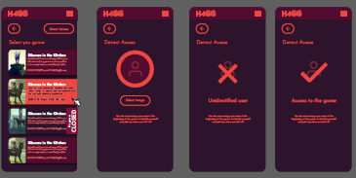
2.6.3 Heritage Games

Slide 34
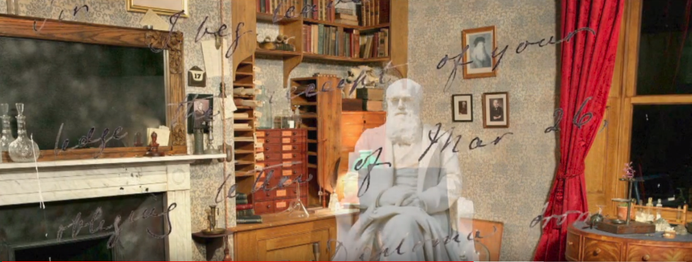
2.6.4 Multivision Technologies
A COMPLEX AV TECHNOLOGY
is merging elements of archives in one great ensemble that has the possibility to create emotions and thus interact with the viewer.
Notes:
To clarify the situation a multivision is: a complex audiovisual technology, which is integrated different types of documents (fotos, texts, mauscripts, objects, actors etc) into meaningful subdivisions (chapters) and integrates the whole into a cultural communication project.
• Multivisions allow using the use of very big screens with resolutions that cannot be achieved by any other media, i.e. they are producing vast screens with a resolution unattainable by any other means creating thus the enabling technical environment to enhance the possibilities of the photographic medium in animation. This allows to fully exploit animation and use archives and documents of any kind and all real deposits of culture.
• Multivisions exploit the infinite potential of static documents with unprecendented possibilities for the creation of emotions and effects (photographs, documents, newspapers etc) by enriching them with new elements and infinite possibilities. Thus multivisions may provide the market for rich media, which otherwise would stay limited. The use of digital graphics and videos allows many possible changes, enabling to infer the unknown from something known within the horizon of the visitors, put together and reassemble
• Stories presented in multivisions are not made only by documents, but by a cluster of links between each document that creates a bridge between each event, between a letter and photograph, an object and a label i.e. multiple links between different elements. A multivision is merging elements of archives in one great ensemble that has the possibility to create emotions and thus interact with the viewer. Photos, portraits and manuscripts of all kinds may be put together in a counterpoint of a contemporary event and thus facilitate the perception, bridging the spatiotemporal gap

Slide 35
2.6.4 Multivision Technologies
exploit the infinite potential of static documents with unprecedented possibilities for the creation of emotions and effects
Notes:
To clarify the situation a multivision is: a complex audiovisual technology, which is integrated different types of documents (fotos, texts, mauscripts, objects, actors etc) into meaningful subdivisions (chapters) and integrates the whole into a cultural communication project.
• Multivisions allow using the use of very big screens with resolutions that cannot be achieved by any other media, i.e. they are producing vast screens with a resolution unattainable by any other means creating thus the enabling technical environment to enhance the possibilities of the photographic medium in animation. This allows to fully exploit animation and use archives and documents of any kind and all real deposits of culture.
• Multivisions exploit the infinite potential of static documents with unprecendented possibilities for the creation of emotions and effects (photographs, documents, newspapers etc) by enriching them with new elements and infinite possibilities. Thus multivisions may provide the market for rich media, which otherwise would stay limited. The use of digital graphics and videos allows many possible changes, enabling to infer the unknown from something known within the horizon of the visitors, put together and reassemble
• Stories presented in multivisions are not made only by documents, but by a cluster of links between each document that creates a bridge between each event, between a letter and photograph, an object and a label i.e. multiple links between different elements. A multivision is merging elements of archives in one great ensemble that has the possibility to create emotions and thus interact with the viewer. Photos, portraits and manuscripts of all kinds may be put together in a counterpoint of a contemporary event and thus facilitate the perception, bridging the spatiotemporal gap

Slide 36
2.6.4 Multivision Technologies
exploits the infinite potential of static documents with unprecedented possibilities for the creation of emotions and effects (photographs, documents, newspapers etc.) by enriching them with new elements and infinite possibilities;
Notes:
To clarify the situation a multivision is: a complex audiovisual technology, which is integrated different types of documents (fotos, texts, mauscripts, objects, actors etc) into meaningful subdivisions (chapters) and integrates the whole into a cultural communication project.
• Multivisions allow using the use of very big screens with resolutions that cannot be achieved by any other media, i.e. they are producing vast screens with a resolution unattainable by any other means creating thus the enabling technical environment to enhance the possibilities of the photographic medium in animation. This allows to fully exploit animation and use archives and documents of any kind and all real deposits of culture.
• Multivisions exploit the infinite potential of static documents with unprecendented possibilities for the creation of emotions and effects (photographs, documents, newspapers etc) by enriching them with new elements and infinite possibilities. Thus multivisions may provide the market for rich media, which otherwise would stay limited. The use of digital graphics and videos allows many possible changes, enabling to infer the unknown from something known within the horizon of the visitors, put together and reassemble
• Stories presented in multivisions are not made only by documents, but by a cluster of links between each document that creates a bridge between each event, between a letter and photograph, an object and a label i.e. multiple links between different elements. A multivision is merging elements of archives in one great ensemble that has the possibility to create emotions and thus interact with the viewer. Photos, portraits and manuscripts of all kinds may be put together in a counterpoint of a contemporary event and thus facilitate the perception, bridging the spatiotemporal gap

Slide 37
2.6.4 Multivision Technologies
provides the market for rich media, which otherwise would stay limited;
Notes:
To clarify the situation a multivision is: a complex audiovisual technology, which is integrated different types of documents (fotos, texts, mauscripts, objects, actors etc) into meaningful subdivisions (chapters) and integrates the whole into a cultural communication project.
• Multivisions allow using the use of very big screens with resolutions that cannot be achieved by any other media, i.e. they are producing vast screens with a resolution unattainable by any other means creating thus the enabling technical environment to enhance the possibilities of the photographic medium in animation. This allows to fully exploit animation and use archives and documents of any kind and all real deposits of culture.
• Multivisions exploit the infinite potential of static documents with unprecendented possibilities for the creation of emotions and effects (photographs, documents, newspapers etc) by enriching them with new elements and infinite possibilities. Thus multivisions may provide the market for rich media, which otherwise would stay limited. The use of digital graphics and videos allows many possible changes, enabling to infer the unknown from something known within the horizon of the visitors, put together and reassemble
• Stories presented in multivisions are not made only by documents, but by a cluster of links between each document that creates a bridge between each event, between a letter and photograph, an object and a label i.e. multiple links between different elements. A multivision is merging elements of archives in one great ensemble that has the possibility to create emotions and thus interact with the viewer. Photos, portraits and manuscripts of all kinds may be put together in a counterpoint of a contemporary event and thus facilitate the perception, bridging the spatiotemporal gap

Slide 38
2.6.4 Multivision Technologies
the use of digital graphics and videos allows many possible changes, enabling to infer the unknown from something known within the horizon of the visitors, put together and reassemble
Notes:
To clarify the situation a multivision is: a complex audiovisual technology, which is integrated different types of documents (fotos, texts, mauscripts, objects, actors etc) into meaningful subdivisions (chapters) and integrates the whole into a cultural communication project.
• Multivisions allow using the use of very big screens with resolutions that cannot be achieved by any other media, i.e. they are producing vast screens with a resolution unattainable by any other means creating thus the enabling technical environment to enhance the possibilities of the photographic medium in animation. This allows to fully exploit animation and use archives and documents of any kind and all real deposits of culture.
• Multivisions exploit the infinite potential of static documents with unprecendented possibilities for the creation of emotions and effects (photographs, documents, newspapers etc) by enriching them with new elements and infinite possibilities. Thus multivisions may provide the market for rich media, which otherwise would stay limited. The use of digital graphics and videos allows many possible changes, enabling to infer the unknown from something known within the horizon of the visitors, put together and reassemble
• Stories presented in multivisions are not made only by documents, but by a cluster of links between each document that creates a bridge between each event, between a letter and photograph, an object and a label i.e. multiple links between different elements. A multivision is merging elements of archives in one great ensemble that has the possibility to create emotions and thus interact with the viewer. Photos, portraits and manuscripts of all kinds may be put together in a counterpoint of a contemporary event and thus facilitate the perception, bridging the spatiotemporal gap

Slide 39
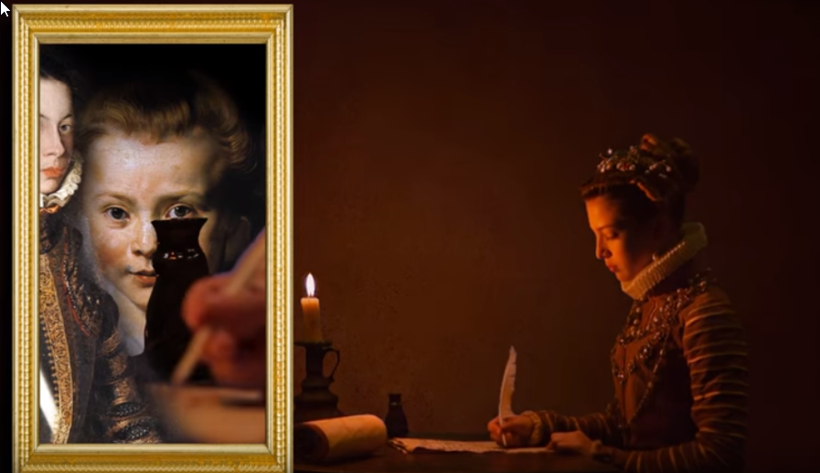
2.6.4 Multivision Technologies
are merging elements of archives in one great ensemble that has the possibility to create emotions and thus interact with the viewer
Notes:
To clarify the situation a multivision is: a complex audiovisual technology, which is integrated different types of documents (fotos, texts, mauscripts, objects, actors etc) into meaningful subdivisions (chapters) and integrates the whole into a cultural communication project.
• Multivisions allow using the use of very big screens with resolutions that cannot be achieved by any other media, i.e. they are producing vast screens with a resolution unattainable by any other means creating thus the enabling technical environment to enhance the possibilities of the photographic medium in animation. This allows to fully exploit animation and use archives and documents of any kind and all real deposits of culture.
• Multivisions exploit the infinite potential of static documents with unprecendented possibilities for the creation of emotions and effects (photographs, documents, newspapers etc) by enriching them with new elements and infinite possibilities. Thus multivisions may provide the market for rich media, which otherwise would stay limited. The use of digital graphics and videos allows many possible changes, enabling to infer the unknown from something known within the horizon of the visitors, put together and reassemble
• Stories presented in multivisions are not made only by documents, but by a cluster of links between each document that creates a bridge between each event, between a letter and photograph, an object and a label i.e. multiple links between different elements. A multivision is merging elements of archives in one great ensemble that has the possibility to create emotions and thus interact with the viewer. Photos, portraits and manuscripts of all kinds may be put together in a counterpoint of a contemporary event and thus facilitate the perception, bridging the spatiotemporal gap

Slide 40
2.6.4 Multivision Technologies
A COMPLEX AV TECHNOLOGY
which is merging different types of documents (fotos, texts, manuscripts, objects, voice; sound; shooting on location/studio s etc.) into meaningful subdivisions (chapters) and integrates the whole into a cultural communication project;
is merging elements of archives in one great ensemble that has the possibility to create emotions and thus interact with the viewer.
allow using the use of very big screens with resolutions that cannot be achieved by any other media
exploit the infinite potential of static documents with unprecedented possibilities for the creation of emotions and effects
Notes:
To clarify the situation a multivision is: a complex audiovisual technology, which is integrated different types of documents (fotos, texts, mauscripts, objects, actors etc) into meaningful subdivisions (chapters) and integrates the whole into a cultural communication project.
• Multivisions allow using the use of very big screens with resolutions that cannot be achieved by any other media, i.e. they are producing vast screens with a resolution unattainable by any other means creating thus the enabling technical environment to enhance the possibilities of the photographic medium in animation. This allows to fully exploit animation and use archives and documents of any kind and all real deposits of culture.
• Multivisions exploit the infinite potential of static documents with unprecendented possibilities for the creation of emotions and effects (photographs, documents, newspapers etc) by enriching them with new elements and infinite possibilities. Thus multivisions may provide the market for rich media, which otherwise would stay limited. The use of digital graphics and videos allows many possible changes, enabling to infer the unknown from something known within the horizon of the visitors, put together and reassemble
• Stories presented in multivisions are not made only by documents, but by a cluster of links between each document that creates a bridge between each event, between a letter and photograph, an object and a label i.e. multiple links between different elements. A multivision is merging elements of archives in one great ensemble that has the possibility to create emotions and thus interact with the viewer. Photos, portraits and manuscripts of all kinds may be put together in a counterpoint of a contemporary event and thus facilitate the perception, bridging the spatiotemporal gap

Slide 41
2.6.4 Multivision Technologies
which is merging different types of documents (fotos, texts, manuscripts, objects, voice; sound; shooting on location/studio s etc.) into meaningful subdivisions (chapters) and integrates the whole into a cultural communication project;
is merging elements of archives in one great ensemble that has the possibility to create emotions and thus interact with the viewer.
allow using the use of very big screens with resolutions that cannot be achieved by any other media
exploit the infinite potential of static documents with unprecedented possibilities for the creation of emotions and effects
Notes:
To clarify the situation a multivision is: a complex audiovisual technology, which is integrated different types of documents (fotos, texts, manuscripts, objects, actors etc) into meaningful subdivisions (chapters) and integrates the whole into a cultural communication project.
• Multivisions allow using the use of very big screens with resolutions that cannot be achieved by any other media, i.e. they are producing vast screens with a resolution unattainable by any other means creating thus the enabling technical environment to enhance the possibilities of the photographic medium in animation. This allows to fully exploit animation and use archives and documents of any kind and all real deposits of culture.
• Multivisions exploit the infinite potential of static documents with unprecendented possibilities for the creation of emotions and effects (photographs, documents, newspapers etc) by enriching them with new elements and infinite possibilities. Thus multivisions may provide the market for rich media, which otherwise would stay limited. The use of digital graphics and videos allows many possible changes, enabling to infer the unknown from something known within the horizon of the visitors, put together and reassemble
• Stories presented in multivisions are not made only by documents, but by a cluster of links between each document that creates a bridge between each event, between a letter and photograph, an object and a label i.e. multiple links between different elements. A multivision is merging elements of archives in one great ensemble that has the possibility to create emotions and thus interact with the viewer. Photos, portraits and manuscripts of all kinds may be put together in a counterpoint of a contemporary event and thus facilitate the perception, bridging the spatiotemporal gap

Slide 42
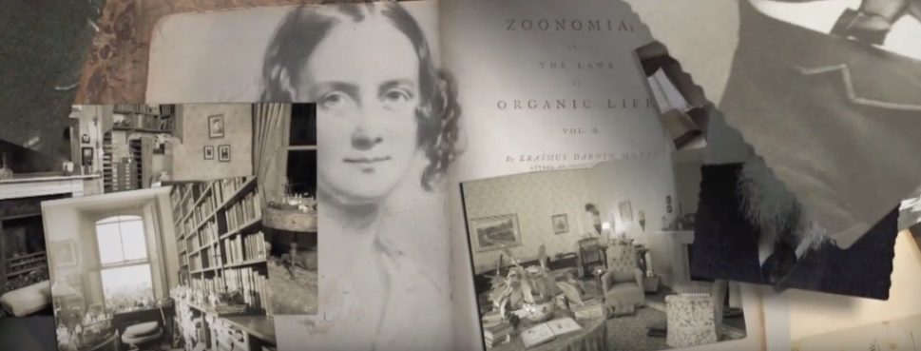
2.6.4 Multivision Technologies
A COMPLEX AV TECHNOLOGY
Stories presented in multivisions are not made only by documents, but by a cluster of links between each document that creates a bridge between each event, between a letter and photograph, an object and a label i.e. multiple links between different elements.
https://vimeo.com/798110898
Notes:
https://vimeo.com/798110898
https://miro.com/app/board/uXjVOXzdfz8=/?share_link_id=284761931106
To clarify the situation a multivision is: a complex audiovisual technology, which is integrated different types of documents (fotos, texts, mauscripts, objects, actors etc) into meaningful subdivisions (chapters) and integrates the whole into a cultural communication project.
• Multivisions allow using the use of very big screens with resolutions that cannot be achieved by any other media, i.e. they are producing vast screens with a resolution unattainable by any other means creating thus the enabling technical environment to enhance the possibilities of the photographic medium in animation. This allows to fully exploit animation and use archives and documents of any kind and all real deposits of culture.
• Multivisions exploit the infinite potential of static documents with unprecendented possibilities for the creation of emotions and effects (photographs, documents, newspapers etc) by enriching them with new elements and infinite possibilities. Thus multivisions may provide the market for rich media, which otherwise would stay limited. The use of digital graphics and videos allows many possible changes, enabling to infer the unknown from something known within the horizon of the visitors, put together and reassemble
• Stories presented in multivisions are not made only by documents, but by a cluster of links between each document that creates a bridge between each event, between a letter and photograph, an object and a label i.e. multiple links between different elements. A multivision is merging elements of archives in one great ensemble that has the possibility to create emotions and thus interact with the viewer. Photos, portraits and manuscripts of all kinds may be put together in a counterpoint of a contemporary event and thus facilitate the perception, bridging the spatiotemporal gap

Slide 43
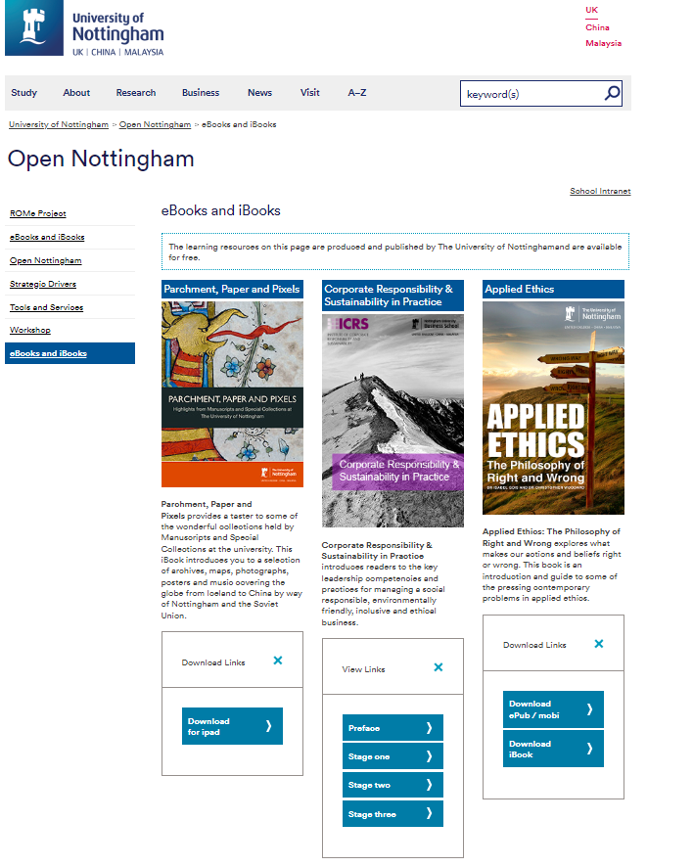
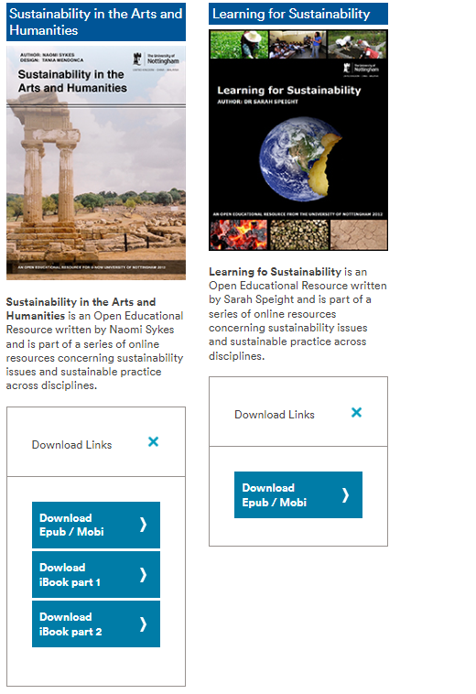
2.6.5 iBooks & eBooks
Notes:
The digital revolution provides means to our ability to use symbols, which allows the audience set out on the path to a work of art, to history, to culture to appropriate a degree of knowledge he did not have before. Knowledge is always a traumatic process, caused by the condition of thaumazein, the existential upheaval of which Aristotle spoke. It means generating an imbalance and moving from a consequent imbalance to a new, more advanced and solid balance, reconfiguring the old information with the new in a new scheme. The digital publishing market, the one that is specific to the composite cultural communication is particularly blessed with the ability to reconfigure any type of static data, as it is heavily relies on multi image production and has a computer graphic-base. Its ability to synthesize an integrated interpretation of composite images reveals one of the hidden features not used by any other means of communication in the digital age: the ability to manipulate an image, the ability to write a story from a white page makes digital publishing one of the most interesting new products for the cultural and touristic market.
iBooks available at the Appstore and eBook at Google Play belong to the digital publishing sector, which recently operates within the 4th Industrial Revolution. Good quality iBooks and eBooks may uses a fusion technology that includes various and different electronic formats in one format like, pictures, sound, music, text, video, multivisions and interactive pictures converging into a cohesive communication audiovisual narrative. They can embed non-textual multi-media including interactive images and image galleries, videos, audio files and interactive animated graphic design. In this way they inevitably become an agent for experience-driven cultural heritage products and services that are not yet in place, but are needed in the context of the re-valorization of the territory.
Being a free downloadable book at the Appstore/Google Play these advanced digital artworks offer to onsite and dislocated audiences a significance chance to create their personal place-bonding through a digital publication, which consists of text, images, interactive images, videos and multimedia and a variety of shared practices (Bookry/Reader Cloud; Google+; Facebook; Twitter; Email; Web embedding). Mobile availability is provided for users with a mobile data connection, alternatively it a copy can be stored on the device. They can very well capitalize on existing local resources to enable local businesses with proximity to the selected geolocations benefit by being present in the interactive Google Map that leads to the enhanced visitation. By being a pure digital publishing product, iBooks and eBooks can exceed their own life, re-inventing itself, available for further updates and considering transformations in the connected consumer market.
https://www.nottingham.ac.uk/open/ebooksandibooks.aspx

Slide 44
2.6.5 iBooks & eBooks
Looking for Myths
https://itunes.apple.com/it/book/looking-for-myths/id1190301195?mt=11
The United States of Europe
https://itunes.apple.com/it/book/the-united-states-of-europe/id1260359727?mt=11
Mazaricos. The Inner journey on the Santiago Way
https://itunes.apple.com/us/book/id1254840124
The Last Conspiracy
https://itunes.apple.com/us/book/the-last-conspiracy/id1261845854?ls=1&mt=11
The People’s Verdict. Alba Iulia, 1st of December 1918
https://itunes.apple.com/us/book/id1276583560
The Golden Anchor. Varna, 1869
https://itunes.apple.com/us/book/id1260626665
Connecting Cultures. A truly Eurasian Story
https://itunes.apple.com/us/book/connecting-cultures/id1265400693
411 years, 11 months and 11 days
https://books.apple.com/us/book/id1543896689
Queen of the Seas. In the midst of the Empire
https://books.apple.com/us/book/id1555058924

Slide 45
EXERCISE ON MIRO

Slide 46
THANK YOU
NEXT:
3rd Pact4Skills TUTORIAL
Monday the 20th February 2023
14:00 CET
Notes:
The digital revolution provides means to our ability to use symbols, which allows the audience set out on the path to a work of art, to history, to culture to appropriate a degree of knowledge he did not have before. Knowledge is always a traumatic process, caused by the condition of thaumazein, the existential upheaval of which Aristotle spoke. It means generating an imbalance and moving from a consequent imbalance to a new, more advanced and solid balance, reconfiguring the old information with the new in a new scheme. The digital publishing market, the one that is specific to the composite cultural communication is particularly blessed with the ability to reconfigure any type of static data, as it is heavily relies on multi image production and has a computer graphic-base. Its ability to synthesize an integrated interpretation of composite images reveals one of the hidden features not used by any other means of communication in the digital age: the ability to manipulate an image, the ability to write a story from a white page makes digital publishing one of the most interesting new products for the cultural and touristic market.
iBooks available at the Appstore and eBook at Google Play belong to the digital publishing sector, which recently operates within the 4th Industrial Revolution. Good quality iBooks and eBooks may uses a fusion technology that includes various and different electronic formats in one format like, pictures, sound, music, text, video, multivisions and interactive pictures converging into a cohesive communication audiovisual narrative. They can embed non-textual multi-media including interactive images and image galleries, videos, audio files and interactive animated graphic design. In this way they inevitably become an agent for experience-driven cultural heritage products and services that are not yet in place, but are needed in the context of the re-valorization of the territory.
Being a free downloadable book at the Appstore/Google Play these advanced digital artworks offer to onsite and dislocated audiences a significance chance to create their personal place-bonding through a digital publication, which consists of text, images, interactive images, videos and multimedia and a variety of shared practices (Bookry/Reader Cloud; Google+; Facebook; Twitter; Email; Web embedding). Mobile availability is provided for users with a mobile data connection, alternatively it a copy can be stored on the device. They can very well capitalize on existing local resources to enable local businesses with proximity to the selected geolocations benefit by being present in the interactive Google Map that leads to the enhanced visitation. By being a pure digital publishing product, iBooks and eBooks can exceed their own life, re-inventing itself, available for further updates and considering transformations in the connected consumer market.
https://www.nottingham.ac.uk/open/ebooksandibooks.aspx

