Slide 1


Presentation at
IFITT TURKEY SUMMER SCHOOL & SUMMIT 2022
Dissemination Activity of SmartDEMA Erasmus+ Project
Emir Ozeren (PhD)
Associate Professor, Dokuz Eylül University, Coordinator of SmartDEMA Project
19 August 2022
İzQ Innovation Centre

Slide 2
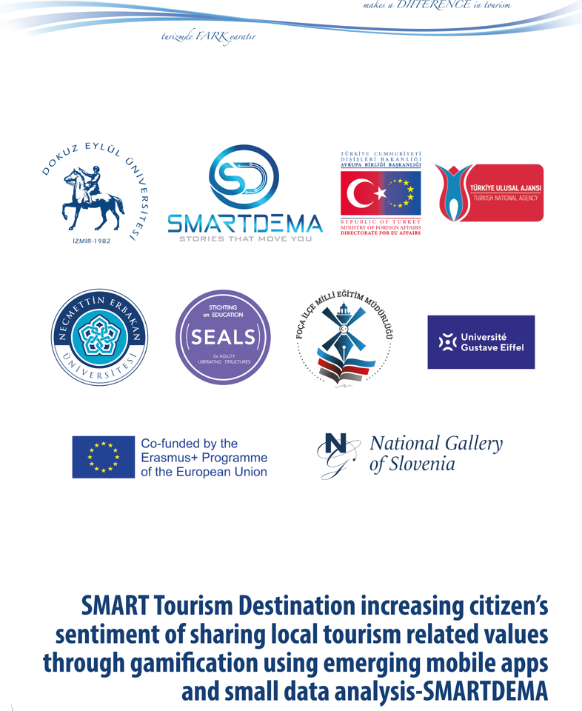
The EU Erasmus+ Project: SMARTDEMA (Smart Destination Management)
KA203 - Strategic Partnerships for higher education

Slide 3
BRIEF INFORMATION & DESCRIPTION OF THE SMARTDEMA PROJECT

Slide 4
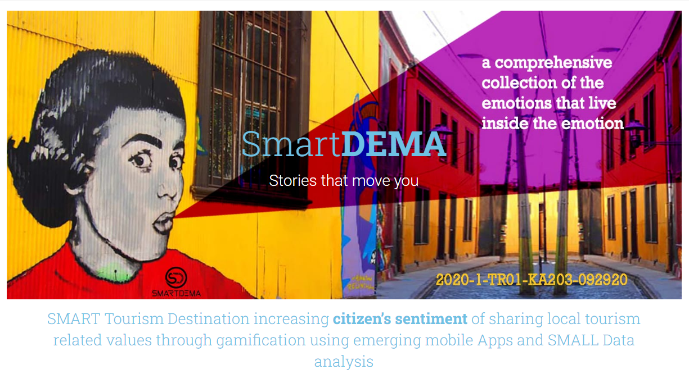
Why emotions are so critical?
an emotion-based app. by a destination (SmartDEMA)

Slide 5
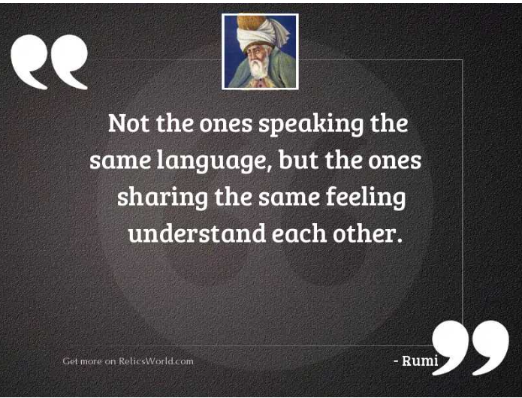

Slide 6
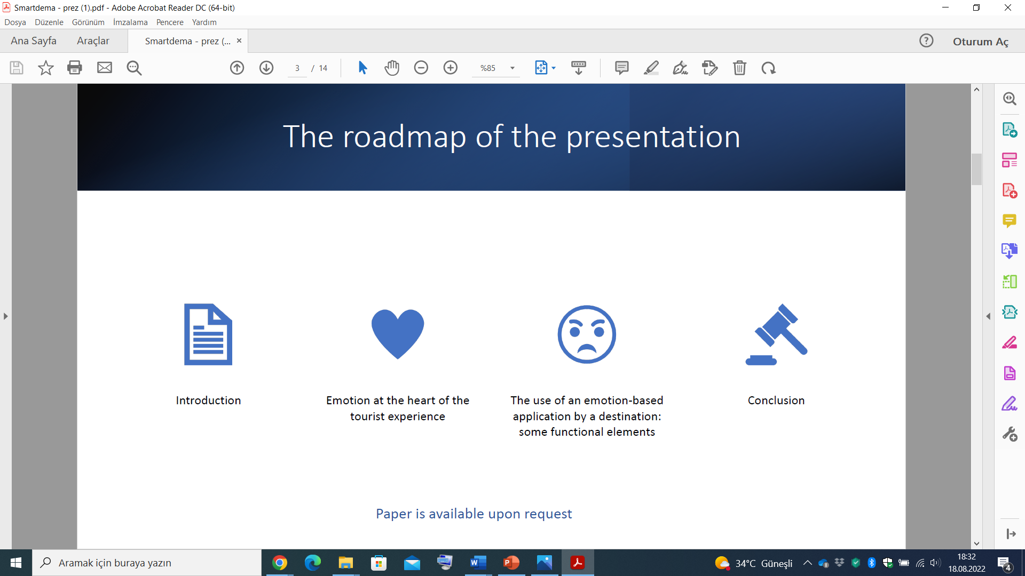
Revisit our (research) question!
Why emotions?
  We developed and tested the use of an emotion-based app. by a destination (SmartDema).
  Indeed, it is rare for apps. to associate emotions, life moments and values carried by residents with places through geolocation.
  We explore the boundary between experience and emotion.
Co-Creation: The inhabitants co-create and co-value the destination through a digital dialogue with visitors. (Tourism itself is a co-creation process!)
Our Strong Proposition/Argument: Emotion is at the heart of the tourism experience (Aho 2001, Bastiaansen & al. 2019, Knobloch & al. 2017, Tussyadiah 2014)
Emotions should be an element of destination management programs.

Slide 7
Emotions and Tourism
Evidence suggests that
  Experience is a process (Aho, 2001)
  Experience is an element of experiential marketing (Knobloch et al.,2017)
  Experience is composite: awareness and mindfulness, attention, memory, feelings, emotions, and a cognitive pattern with experience (Skavronskaya et al., 2017)
Emotion is associated in the (tourism) literature with various tourist practices: festivals, shopping, leisure parks, heritage, and adventure (Hosany et al., 2020).
Emotion has an aesthetic, artistic, literary, musical, spiritual, or cultural origin.
Emotions shape tourism experiences (Kim & Fesenmeier, 2015; Volo, 2016).
We consider that emotion gives the experience its memorable character and, as such, is at the heart of the new tourism experience.
Emotions contribute to creating a lasting memory, thus influencing future behaviour and travel choices.

Slide 8
What is emotion?
From an etymological perspective, emotion derives from the Latin motio 'to move' and 'to emote.’
The motto of our Project: ‘Stories that move you’
Emotion: is a complex reaction of the individual to a state of the environment or an event (Gauducheau 2008, p. 390).
An emotion is experienced, felt, and generates sensations and feelings.

Slide 9
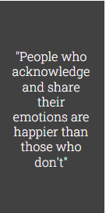
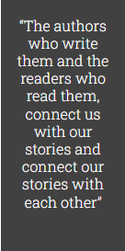
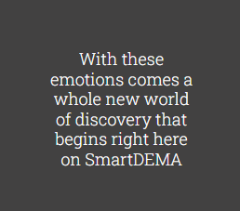
Emotions through stories/storytelling
Emotions are shared with others through storytelling, becoming powerful motivators of future behaviour for self and others.

Slide 10
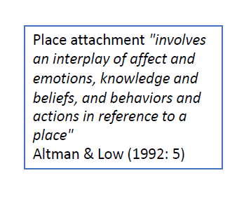
Place Attachment
Places: are sources of identification and affiliation that give meaning and purpose to life (Gustafson 2001; Williams & Vaske 2003).
People develop relationships with places, also known as place attachment.
Place attachment : emotional connection between an individual and a particular spatial setting (Williams & al. 1992; Gustafson 2001; Williams & Vaske 2003).
People's relationships with place can represent a range of positive emotions from love to contentment (Manzo 2005; Hidalgo & Hernandez, 2001).

Slide 11
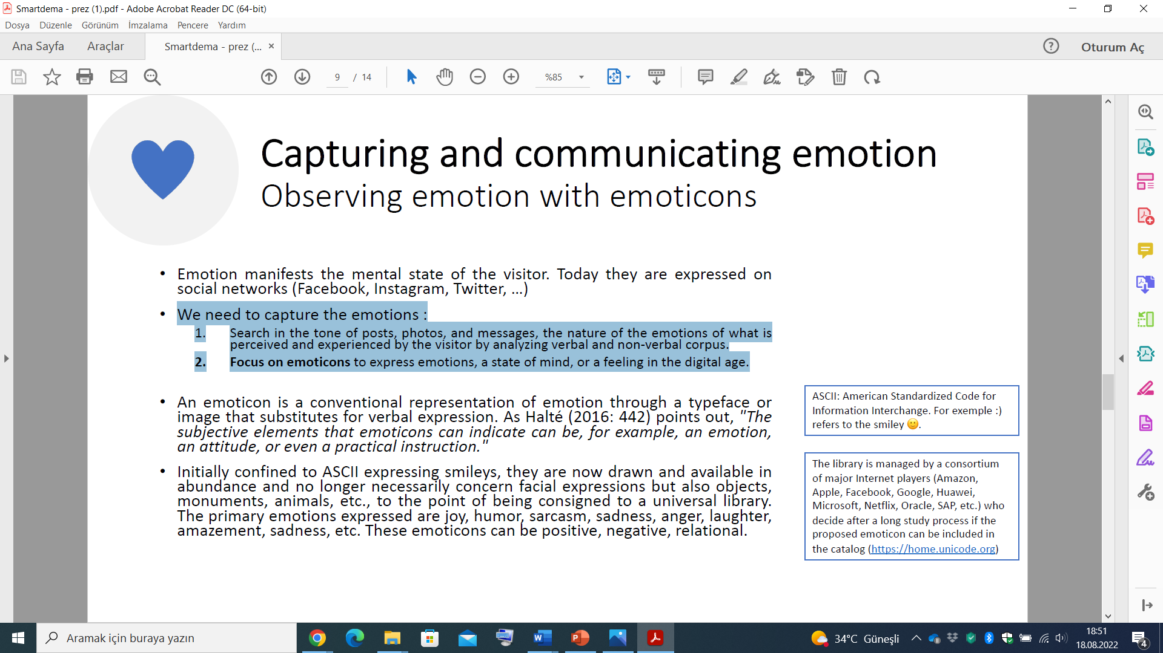
How to Capture and communicate emotion???
Observing emotion with emoticons
Emotion manifests the mental state of the visitor. Today they are expressed on
social networks (Facebook, Instagram, Twitter, …).
These emoticons can be positive, negative, or relational.
We need to capture the emotions :
  1. Search in the tone of posts, photos, and messages, the nature of the emotions of what is perceived and experienced by the visitor by analyzing verbal and non-verbal corpus.
  2. Focus on emoticons to express emotions, a state of mind, or a feeling in the digital age.

Slide 12
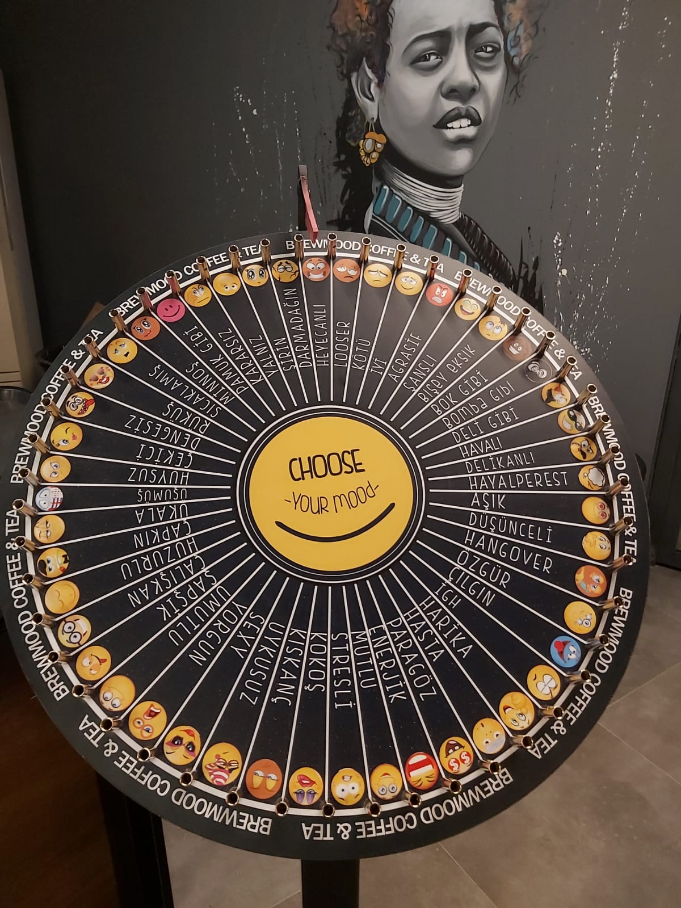
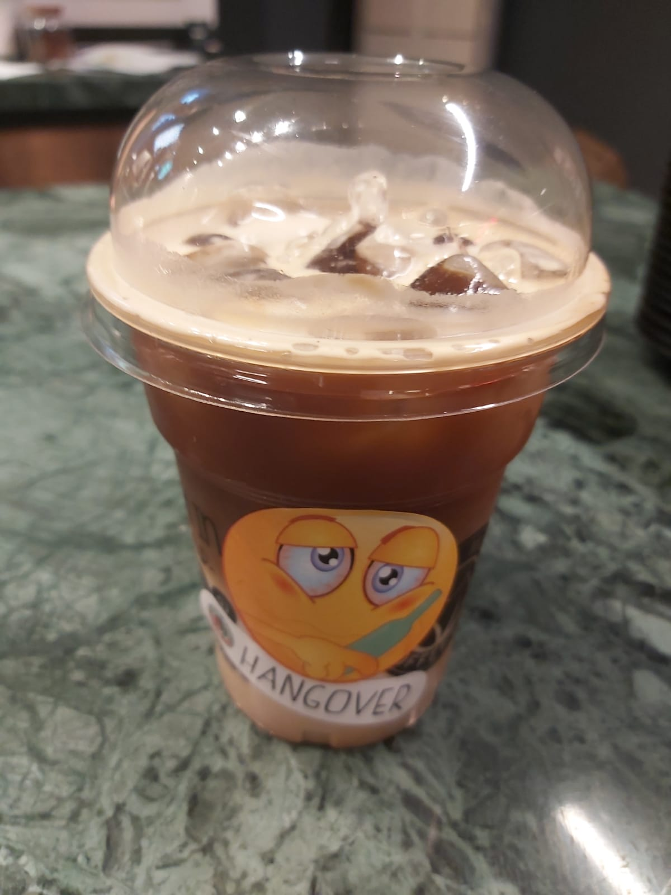
Emoticons in the service sector

Slide 13
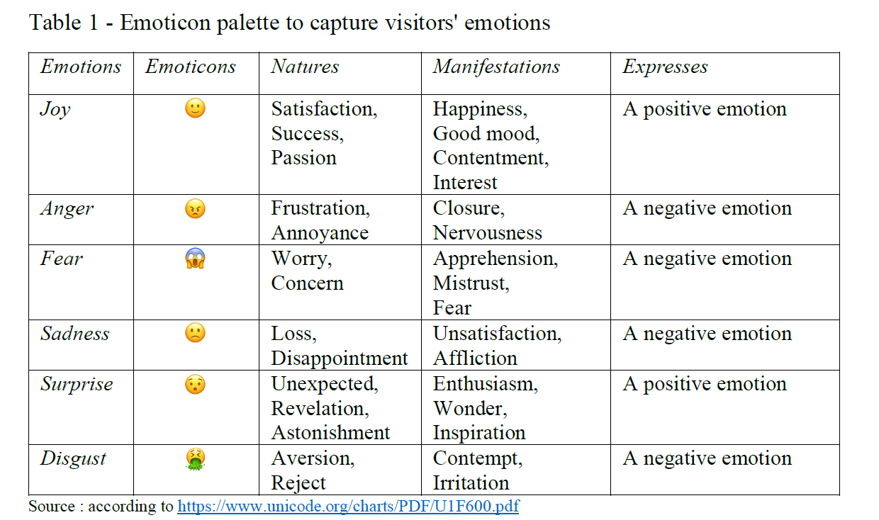
Capturing the emotion of visitors via emoticons
Emotion is complex and composite.
Emotion reflects several categories of mental dispositions, including the six fundamental facial emotions identified by Eckmann (2002).
These are joy, anger, fear, sadness, surprise, and disgust. These emotions serve as the basis for the development of other derived emotions. They have a universal character.

Slide 14
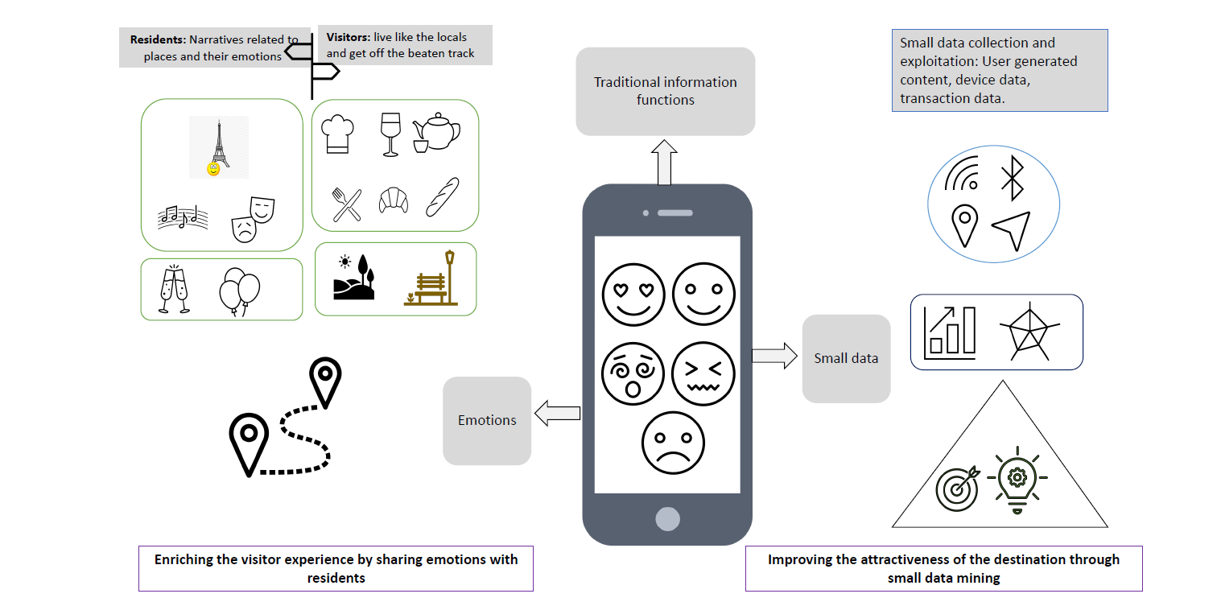
The place of emotions in the tourism experience managed by destinations

Slide 15
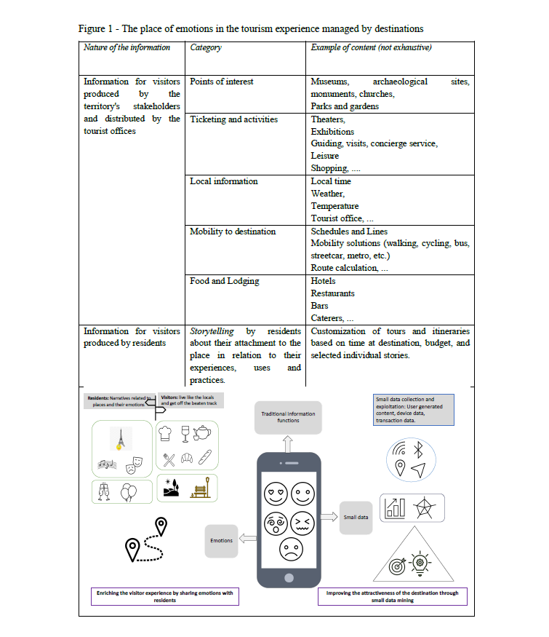

Slide 16
What can we do with this data?
By proposing to visitors to express their emotion(s) by selecting from a panel of emoticons, it then becomes possible to capture moments of satisfaction (positive emotion) and moments of disappointment (negative emotions).
The use of location data will make it possible to associate a place/point of interest with the emotions expressed.
Thanks to the app., we can capture the sense of emotion expressed by visitors/users
The data generated by the app. promote an understanding of visitors' needs and behaviour to improve and individualise the tourism offer.
Ways for destinations to stand out and differentiate themselves.
It would be possible to respond to the following questions:
  how can a destination be enhanced through emotion?
  how a destination can explore visitors' emotions during and after their journey
  how to make their visits enriching experiences.

Slide 17
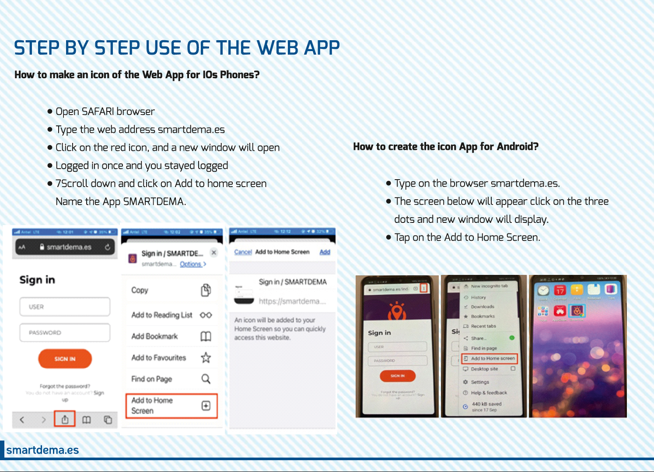

Slide 18
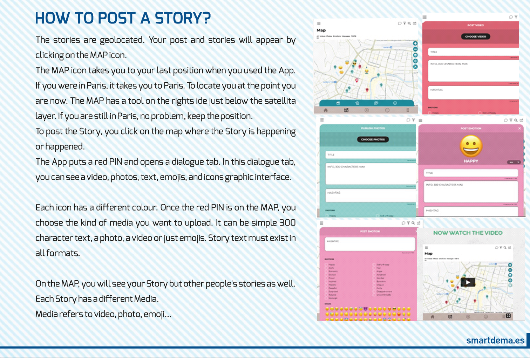

Slide 19
Go to
www.smartdema.es
www.smartdema.org

Slide 21
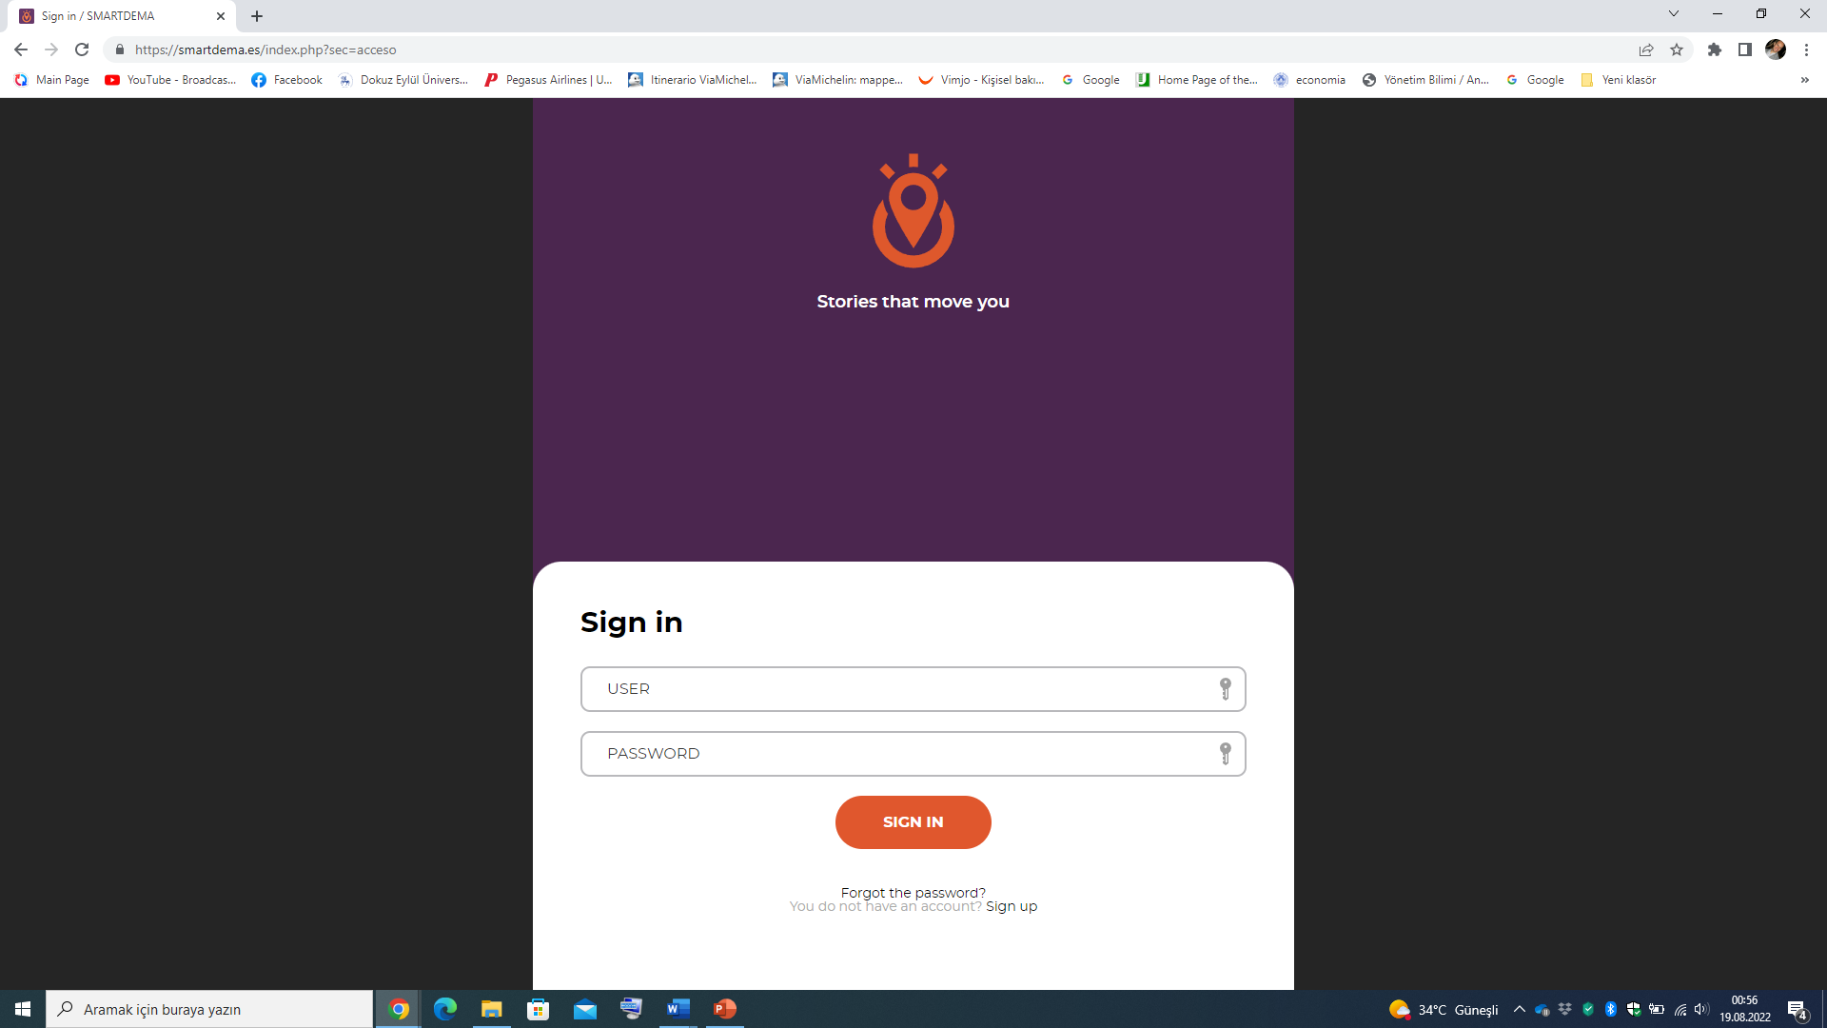
Register first!

Slide 22
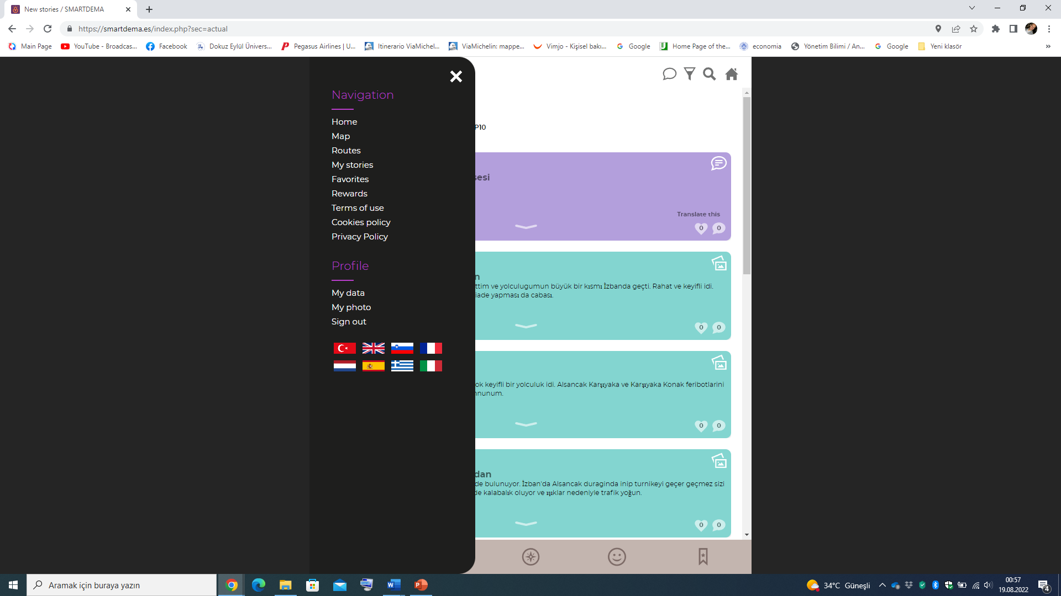

Slide 23
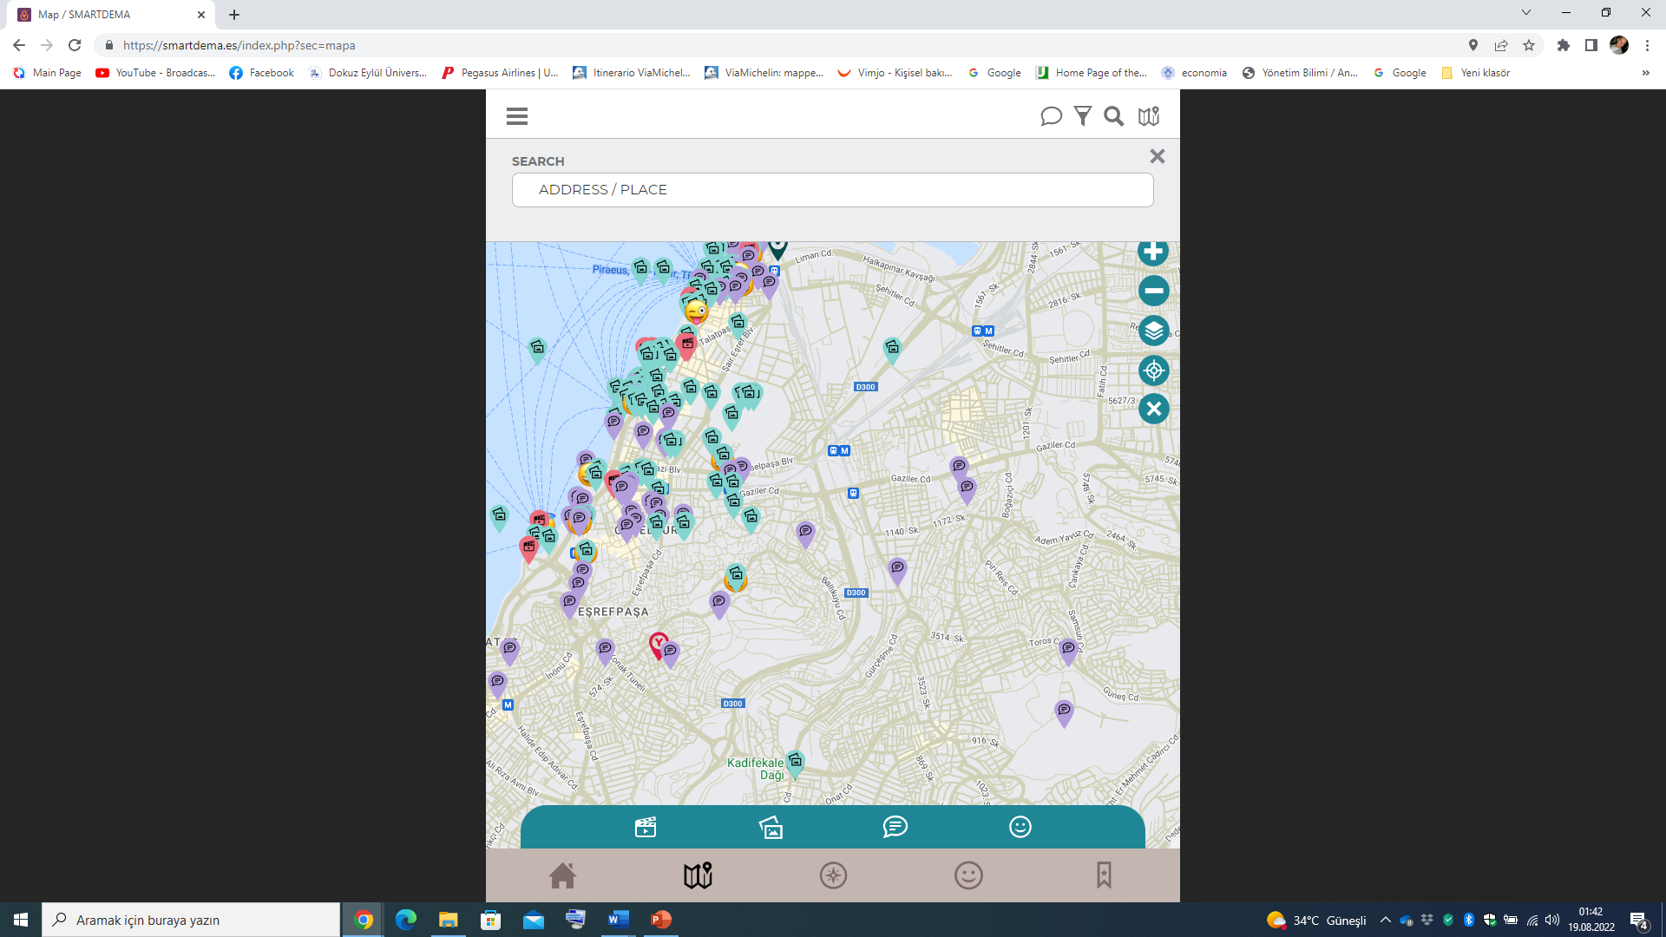

Slide 24
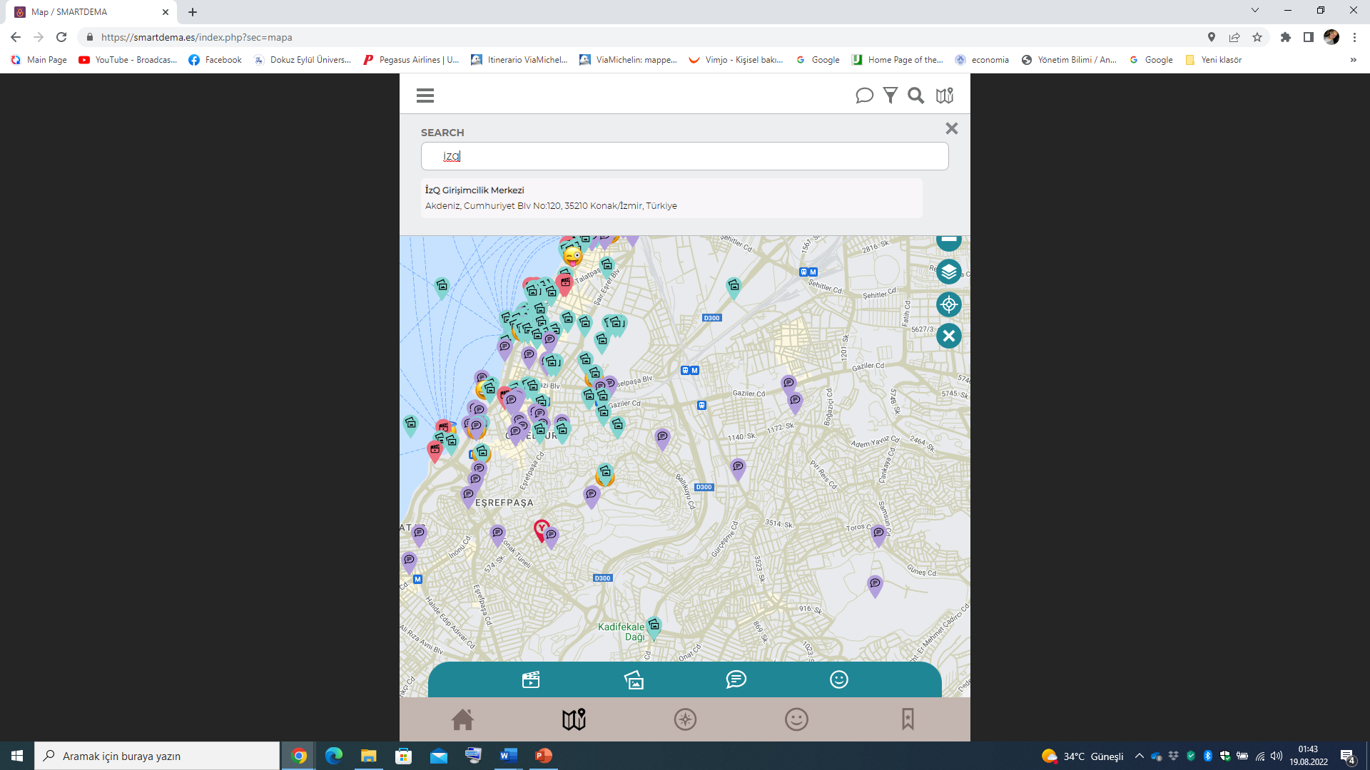

Slide 25
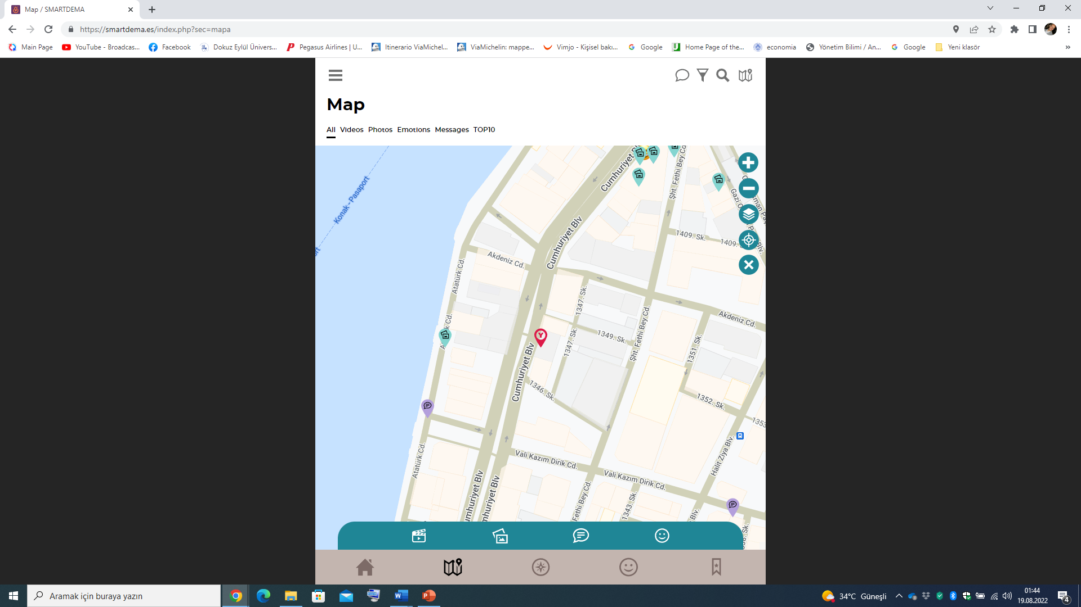

Slide 26
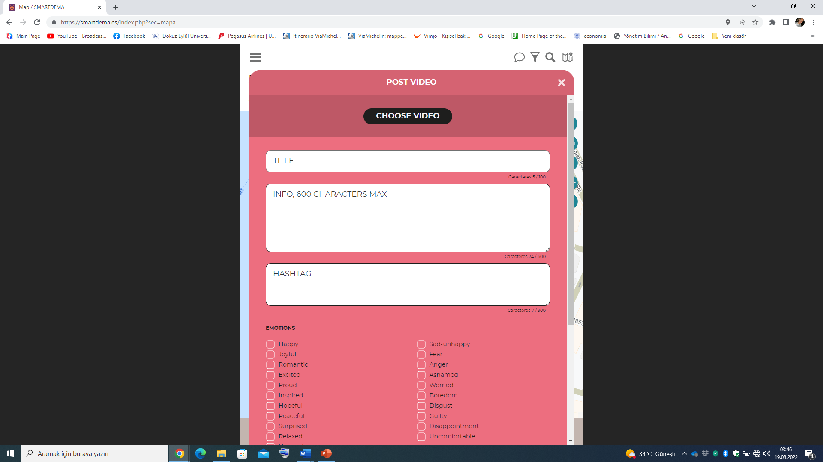

Slide 27
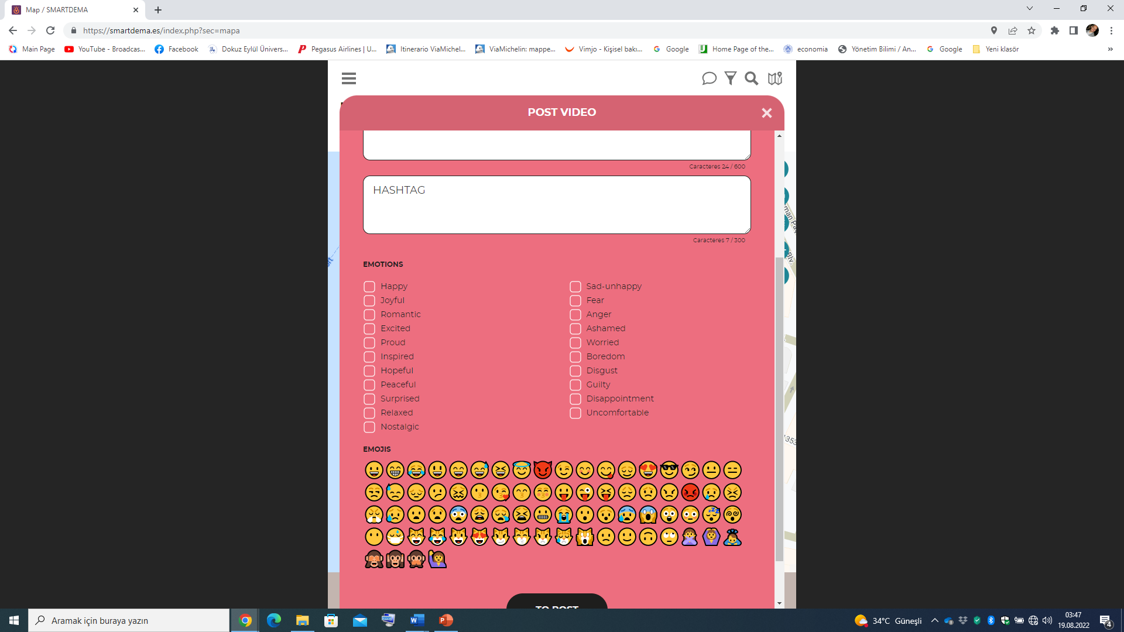

Slide 28
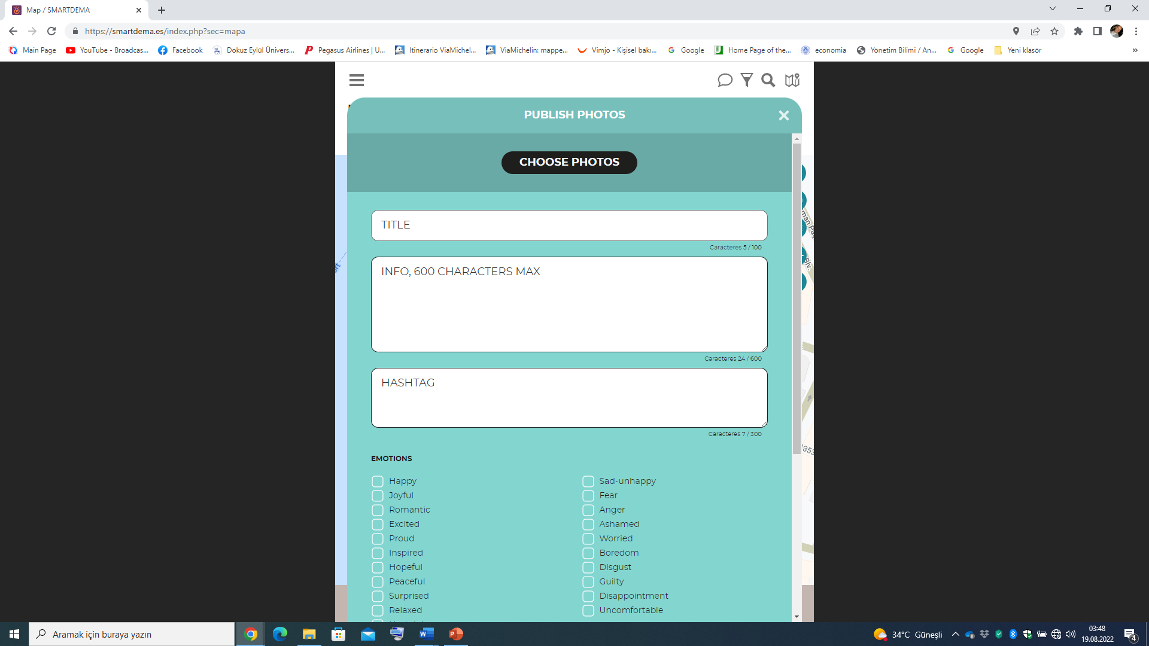

Slide 29
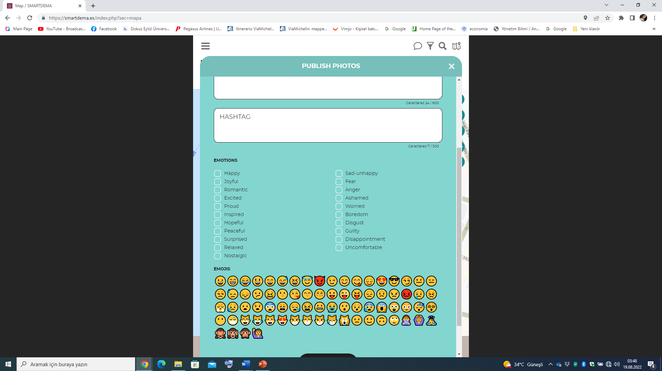

Slide 30
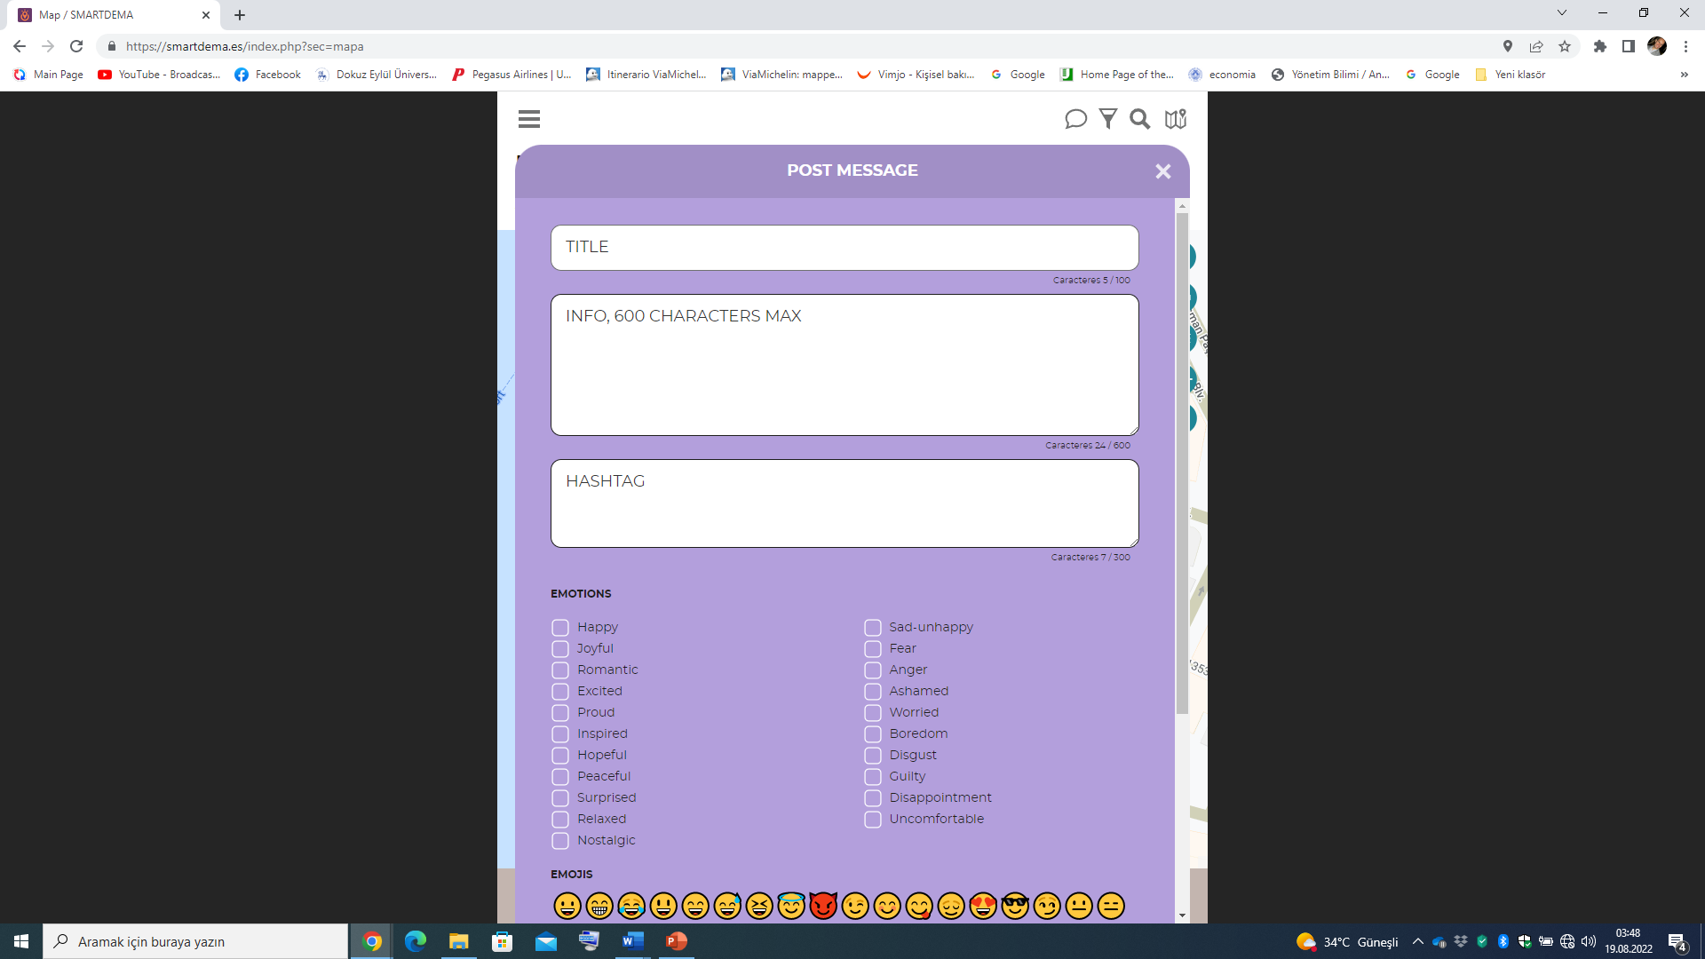

Slide 31
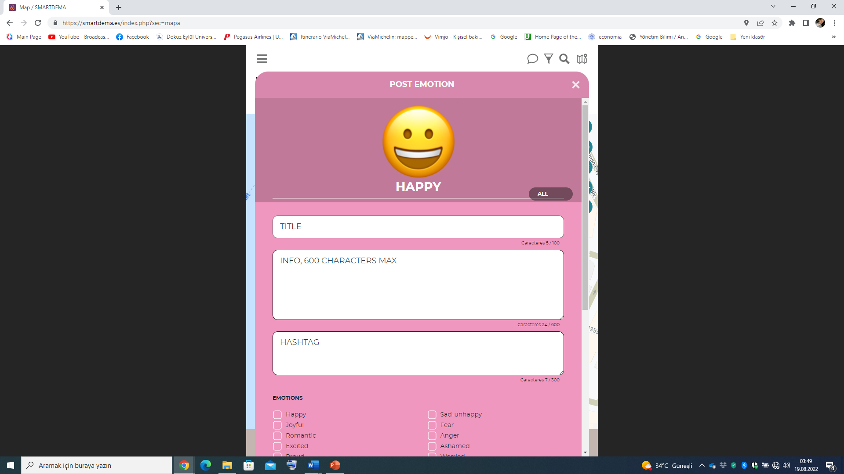

Slide 32
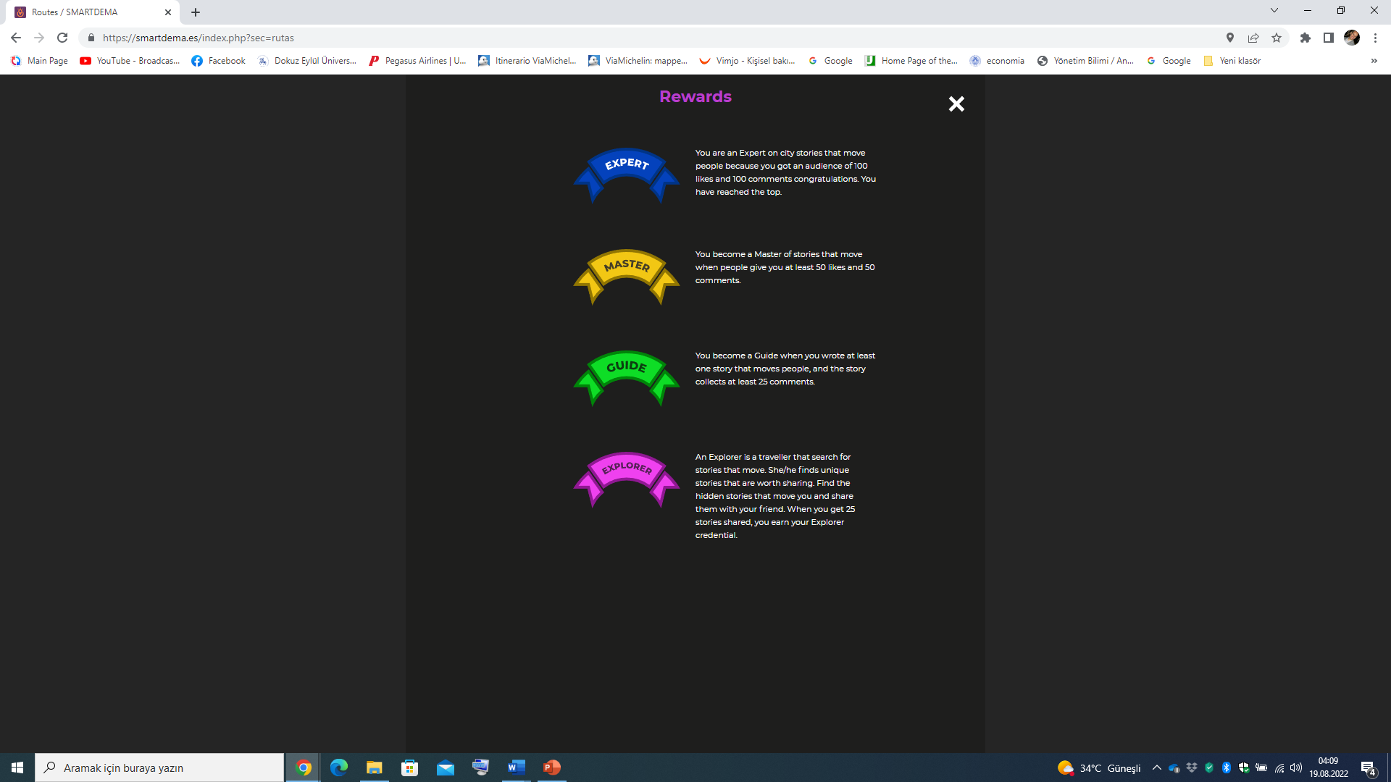

Slide 33
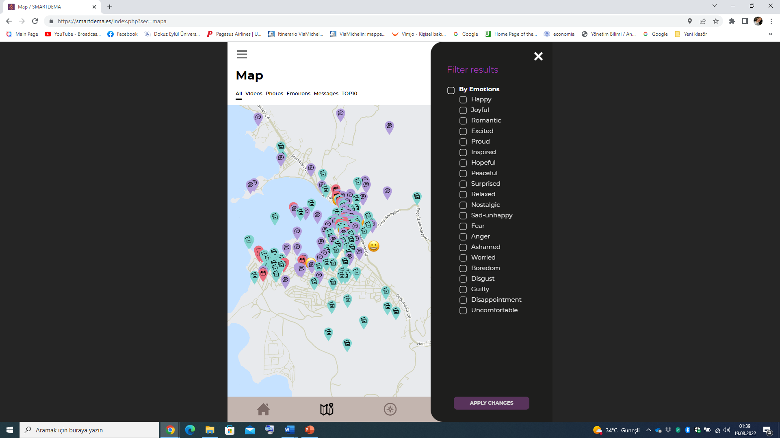

Slide 34


Slide 35
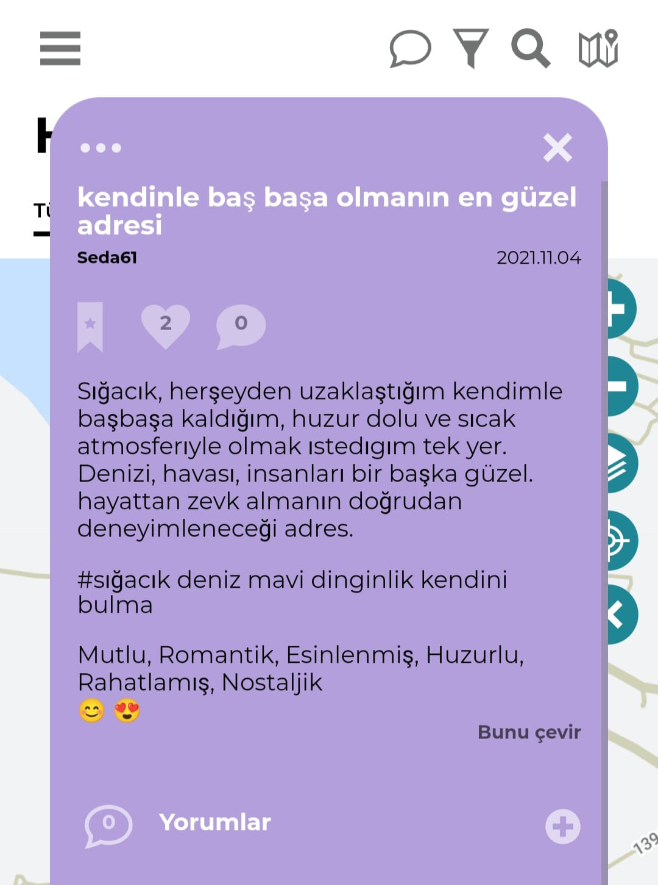
STORIES
  The stories reflect the real sentiment of citizens/people concerning the city and destination of Izmir.
THE BEST ADDRESS TO BE ALONE WITH YOURSELF
Sığacık is the only place where I want to be away from everything, where I can be alone with myself, with its restful and warm atmosphere.
Its sea, air, and people are very beautiful. The only address where you can experience enjoying life.

Slide 36
  The users until now have shared stories & routes about lesser-known, hidden, undiscovered destination spots that are worth seeing in Ljubljana, Izmir and its districts.

Slide 37
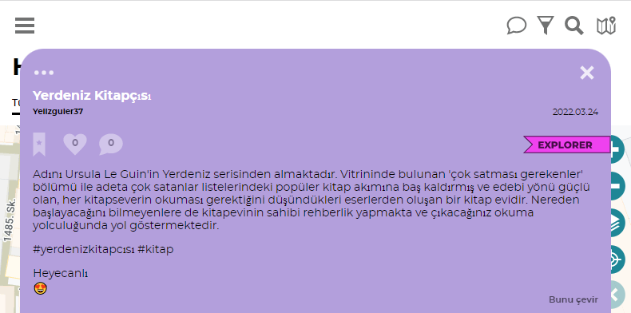
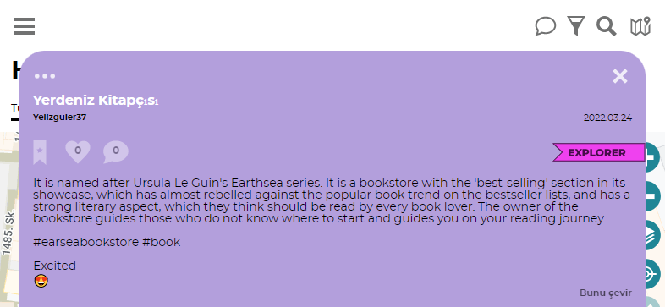

Slide 38
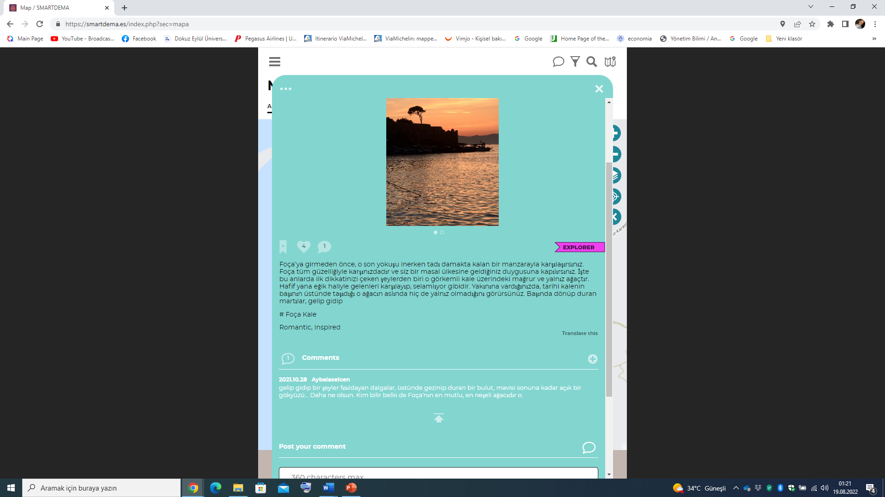

Slide 39
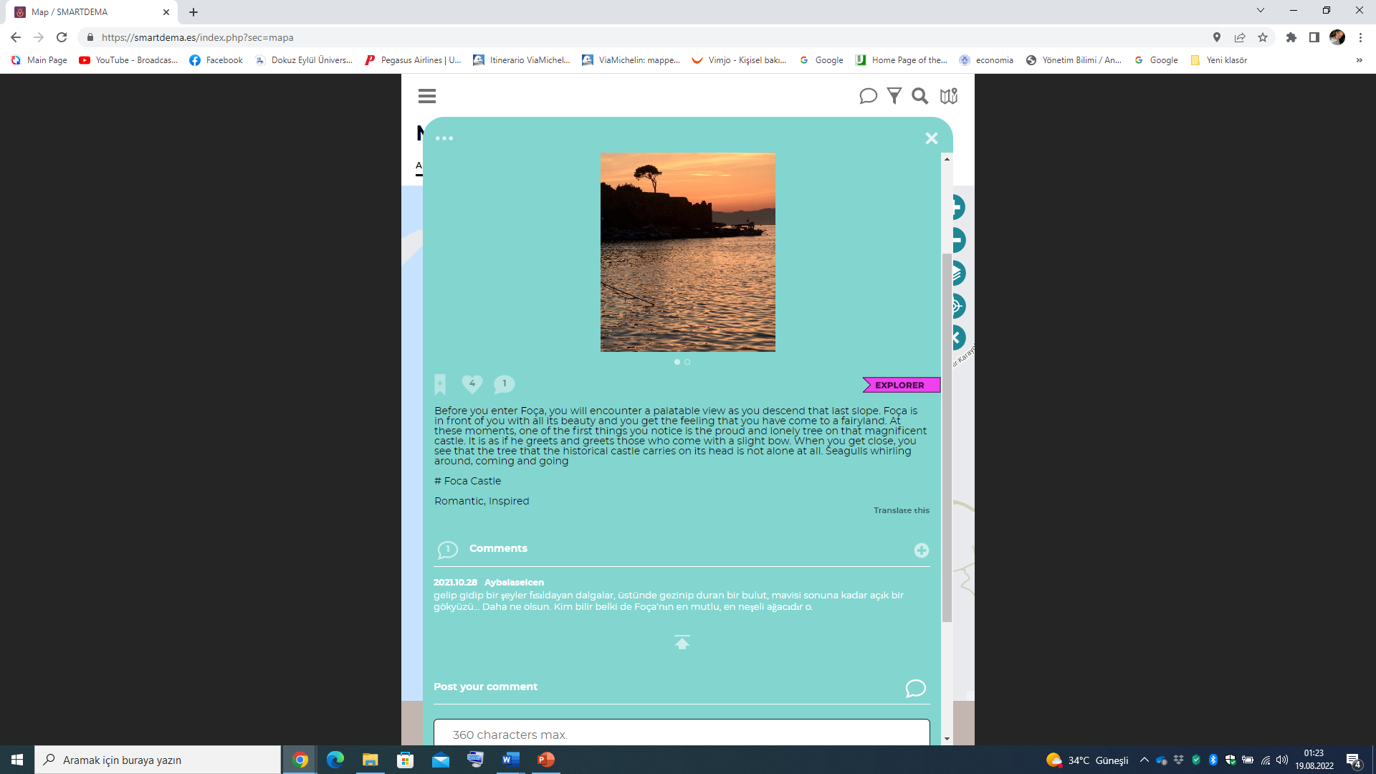

Slide 40
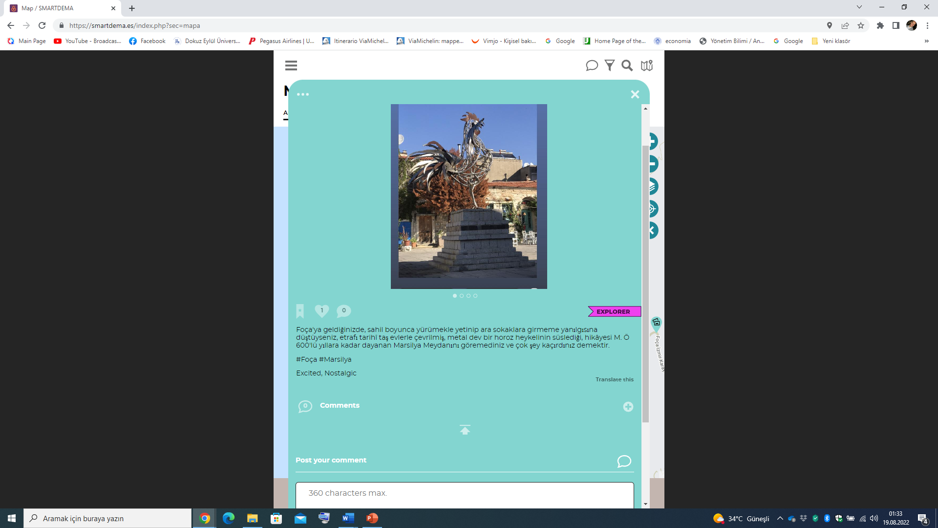

Slide 41


Slide 42
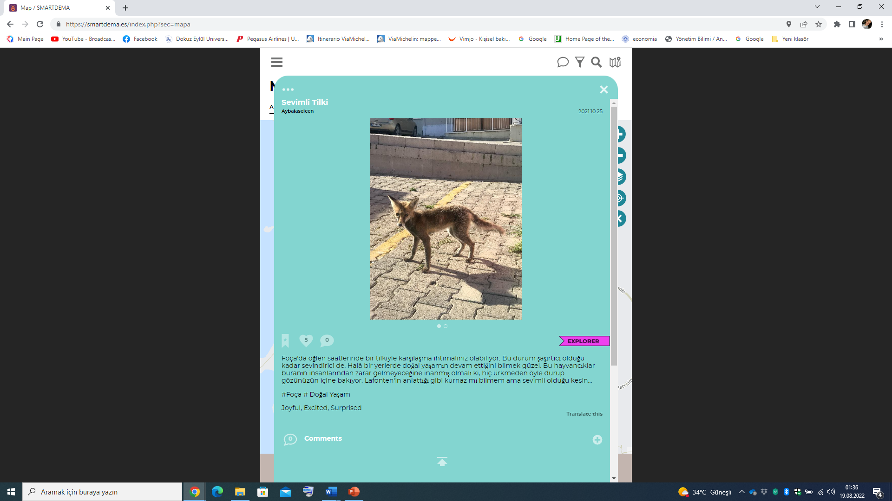

Slide 43


Slide 44
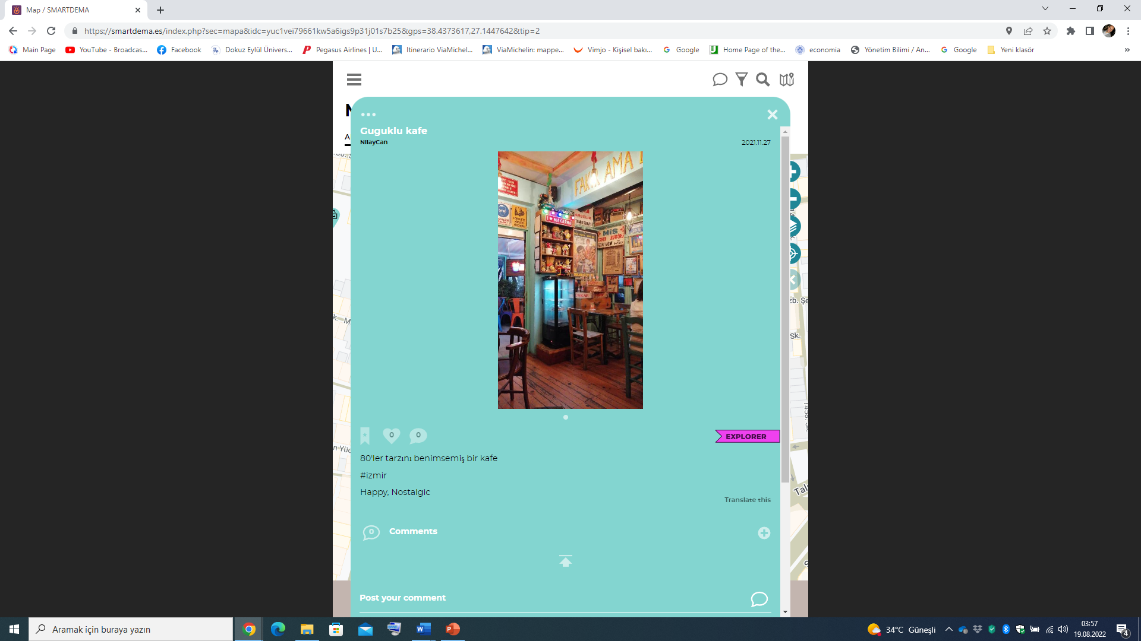

Slide 45


Slide 46
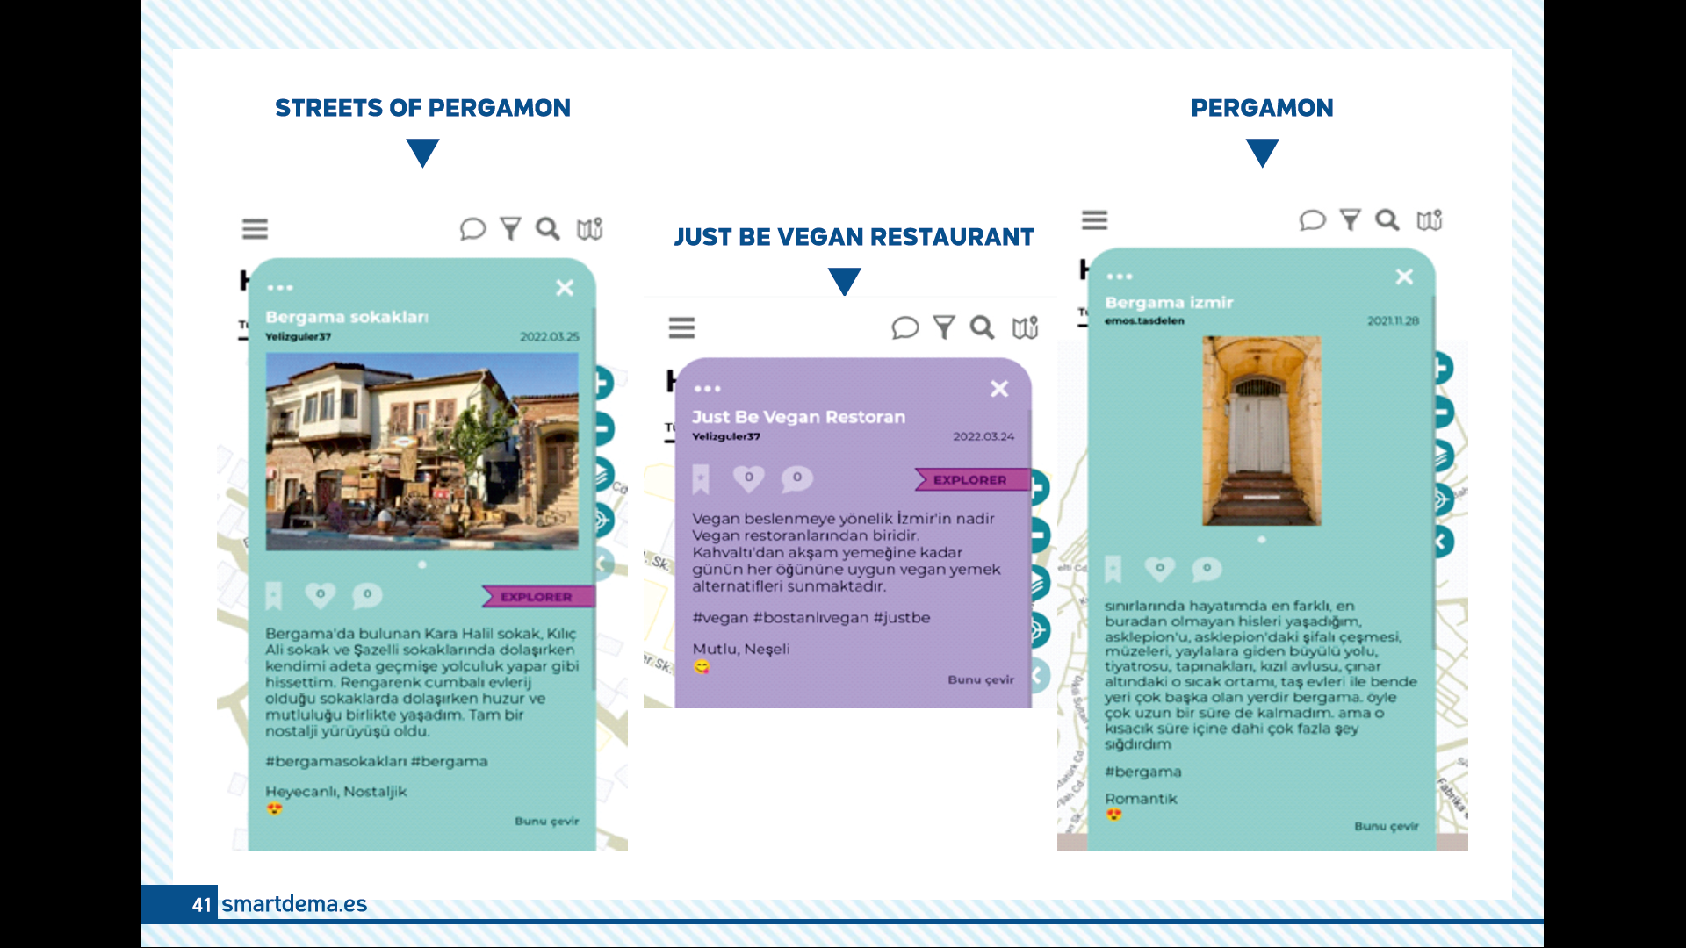

Slide 47
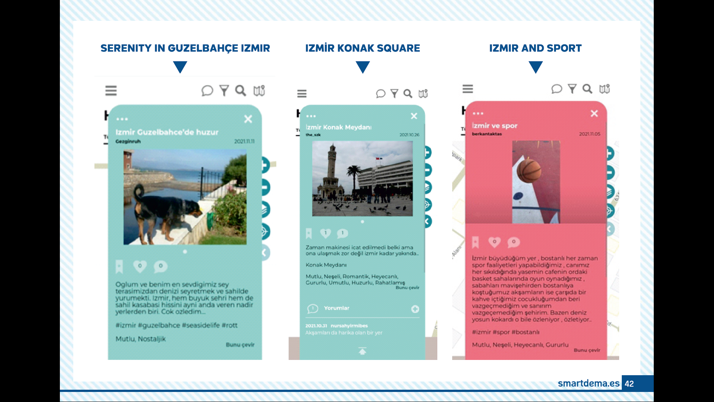

Slide 48
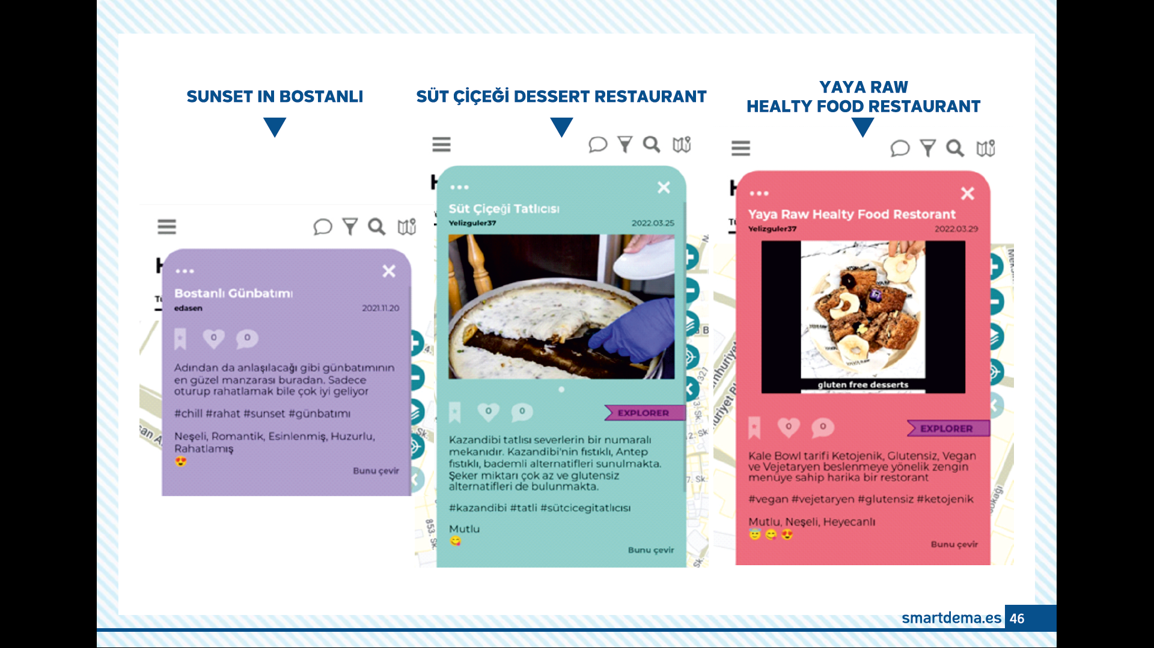

Slide 49
Stories from Ljubljana

Slide 50
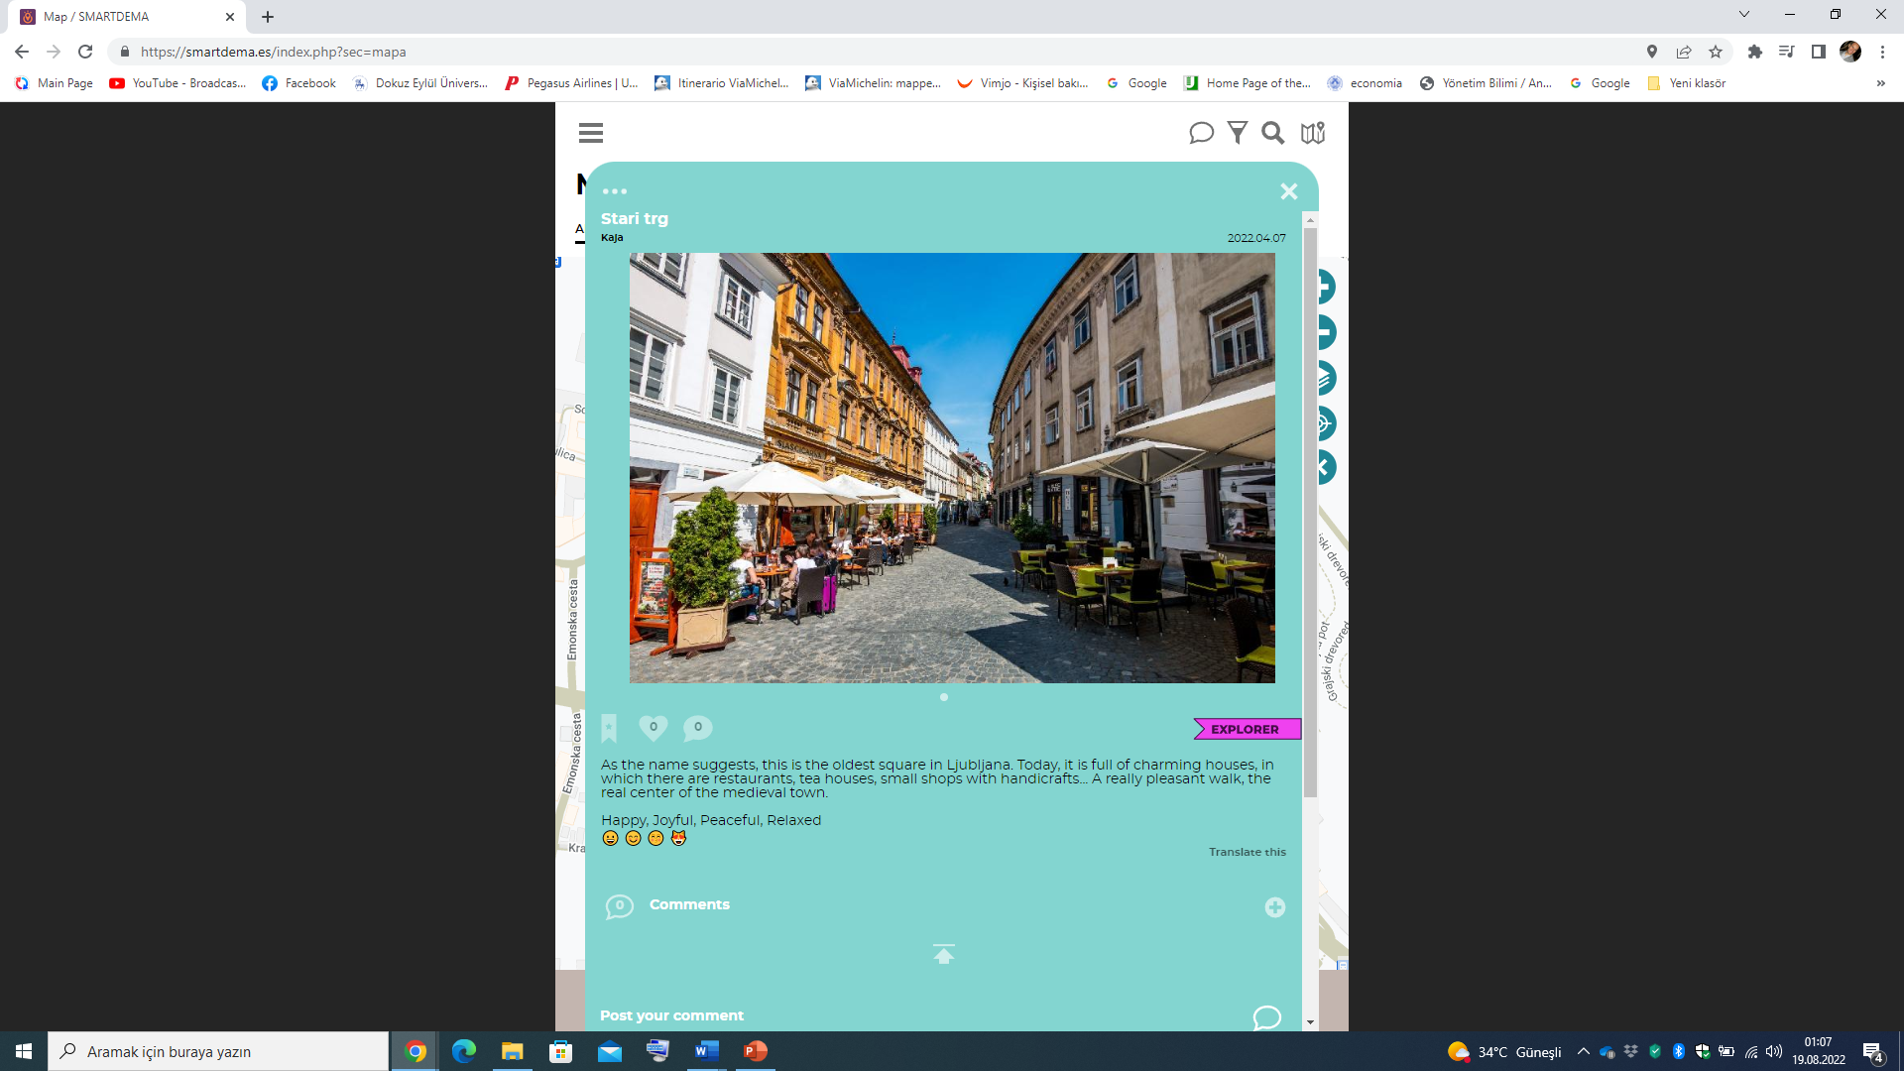

Slide 51
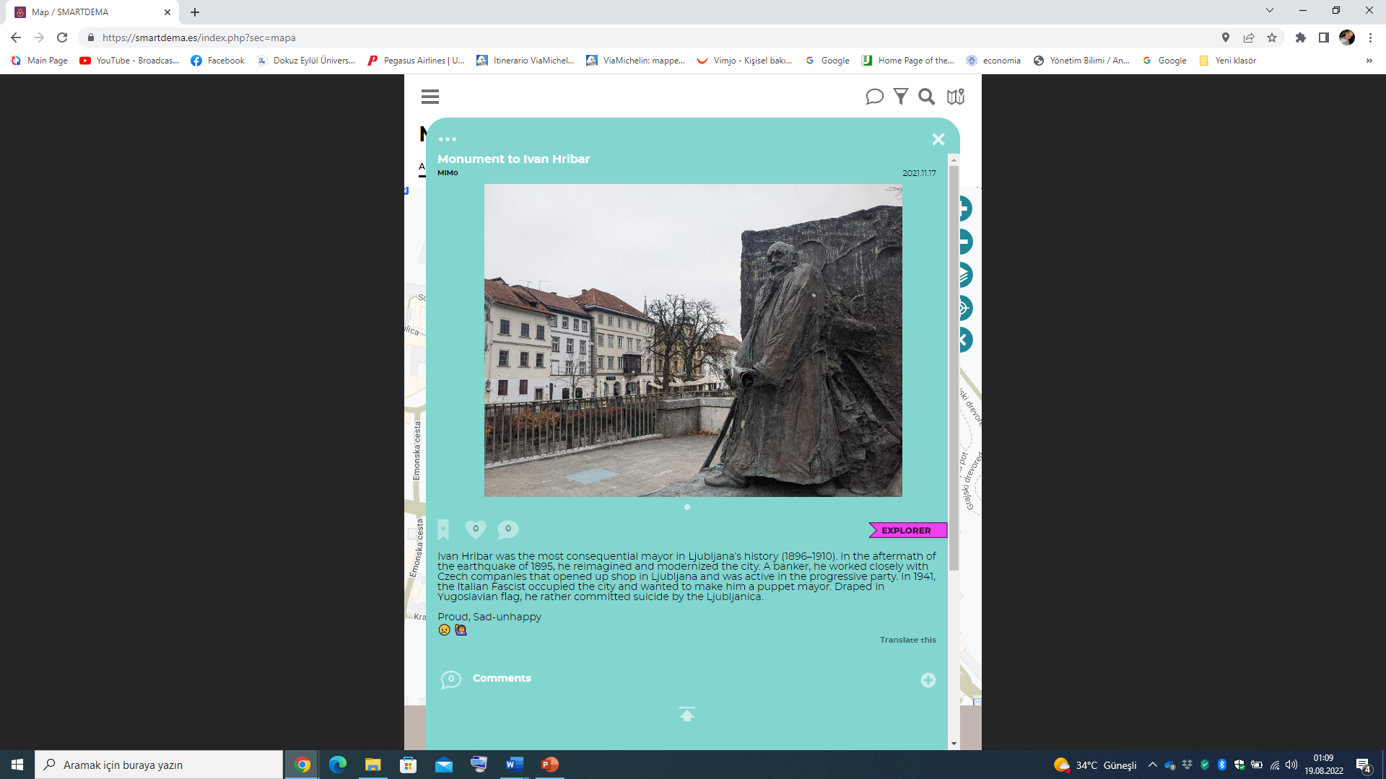
Not every stories are pleasant☹

Slide 52
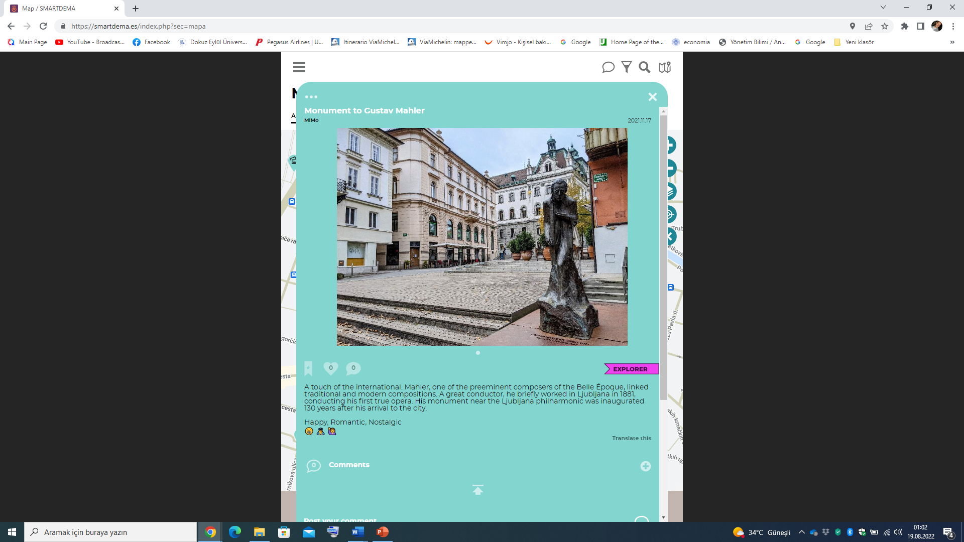

Slide 53
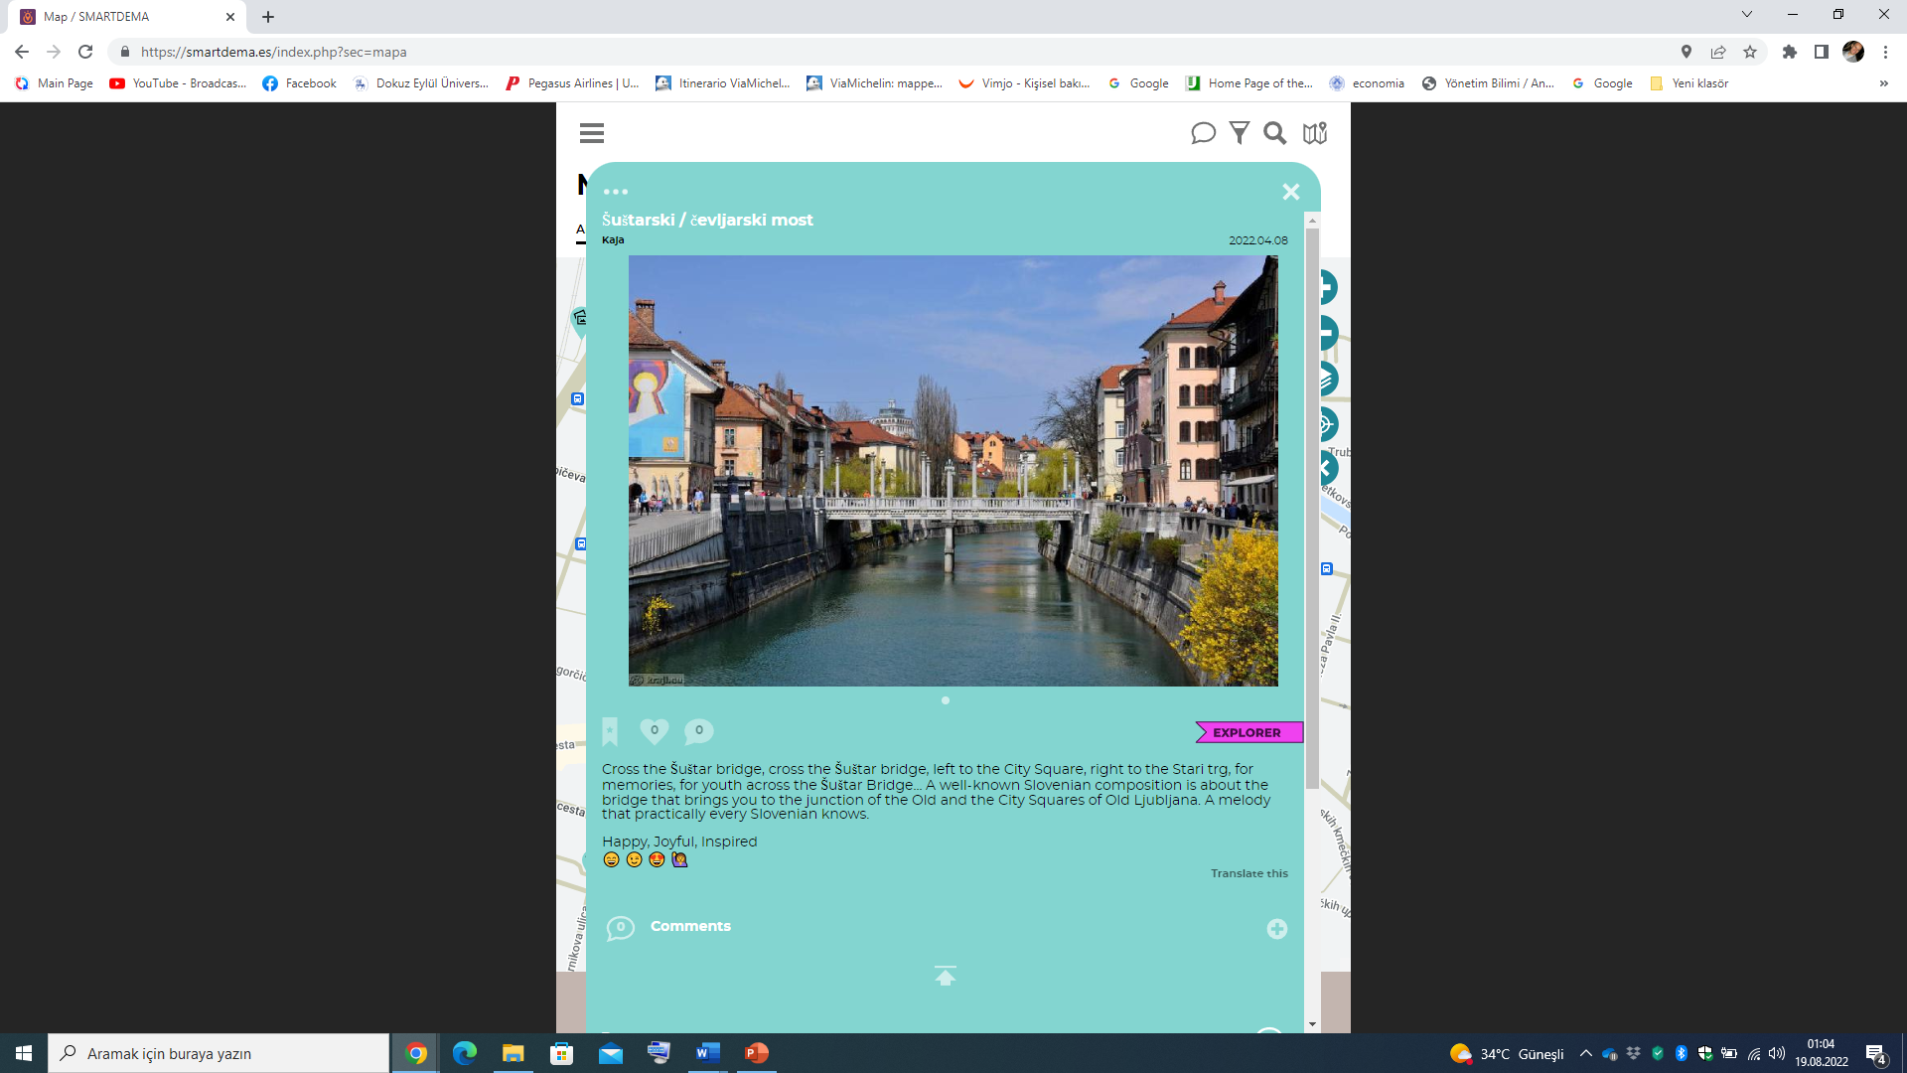

Slide 54
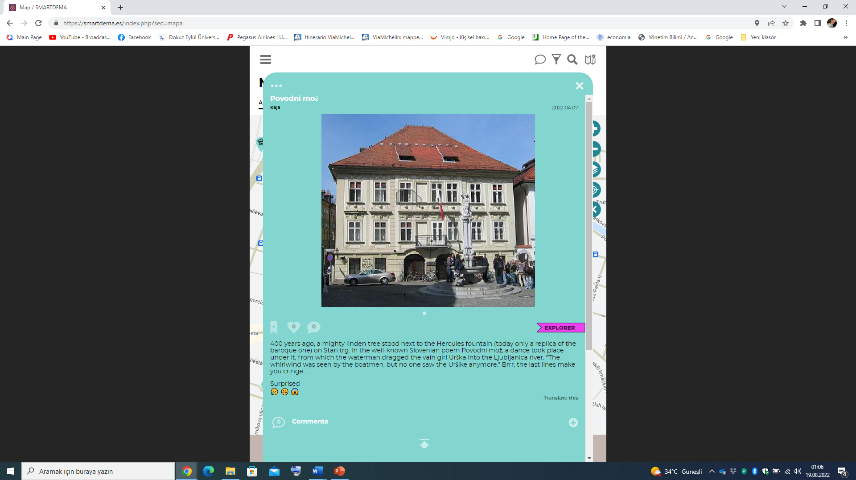

Slide 55
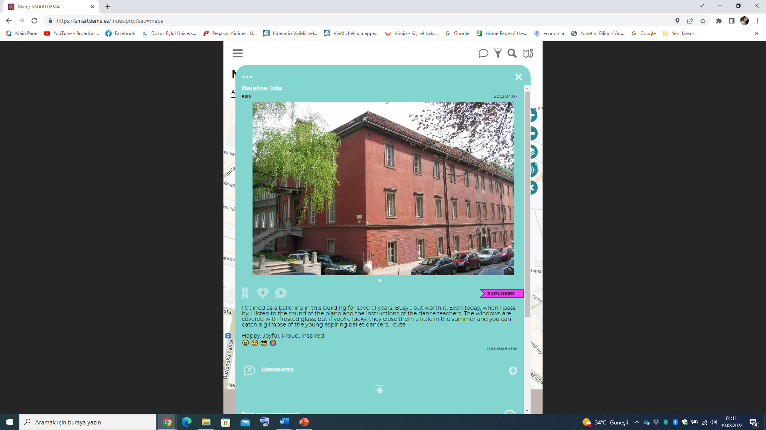

Slide 56
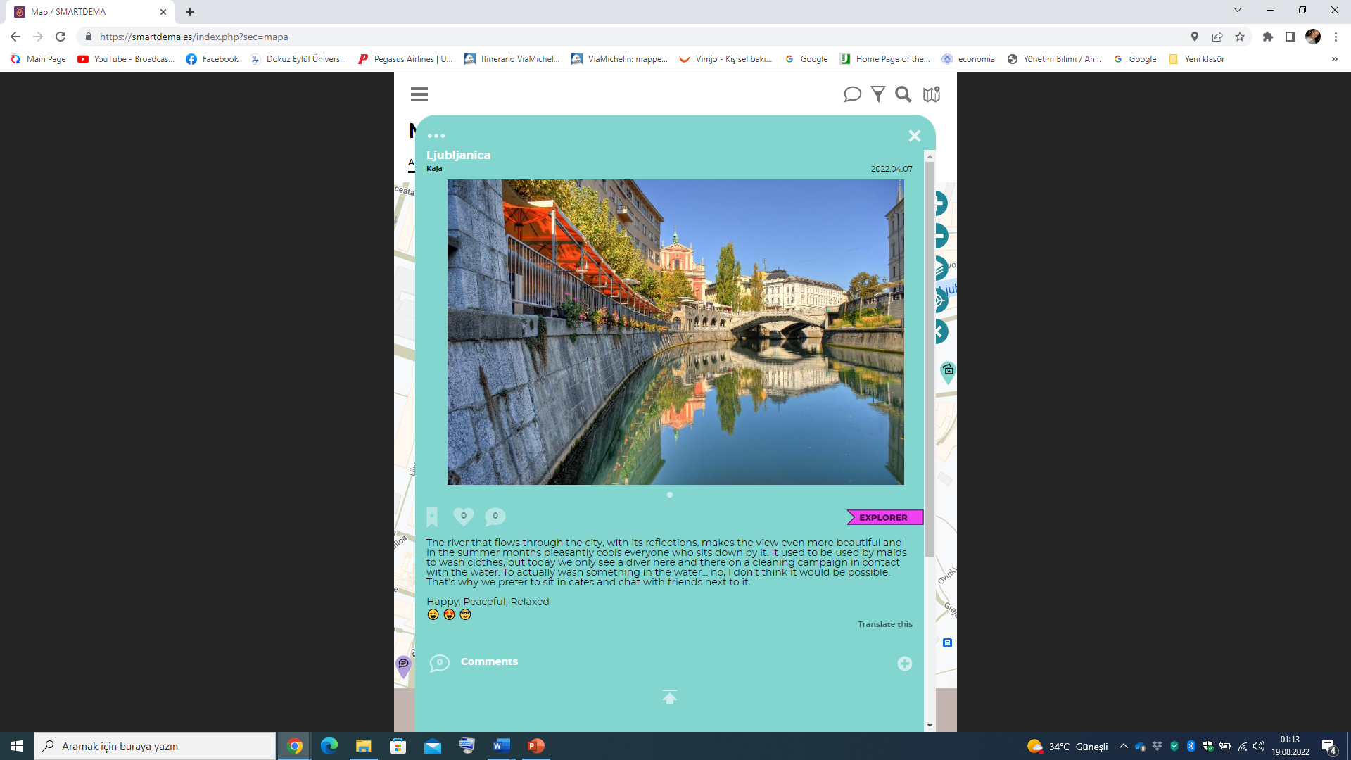

Slide 57
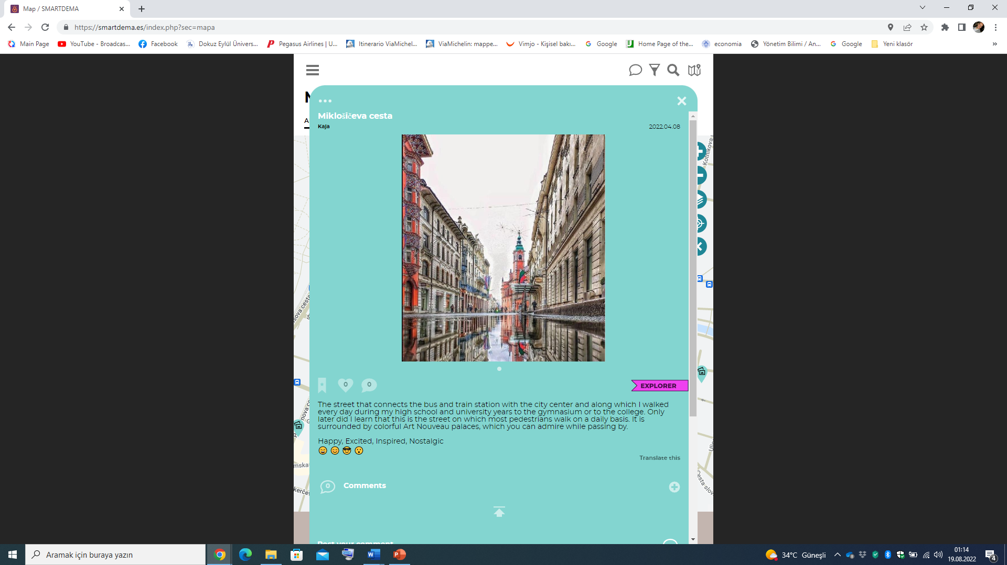

Slide 59
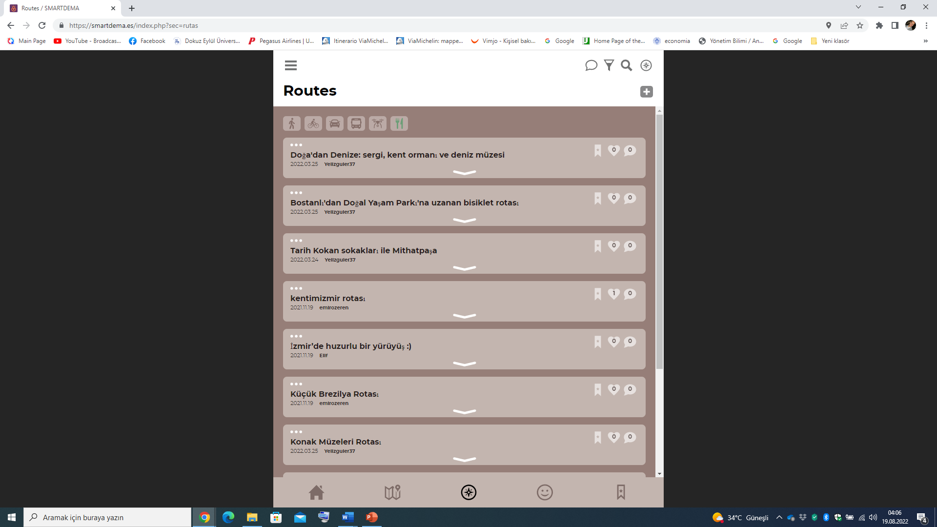

Slide 60
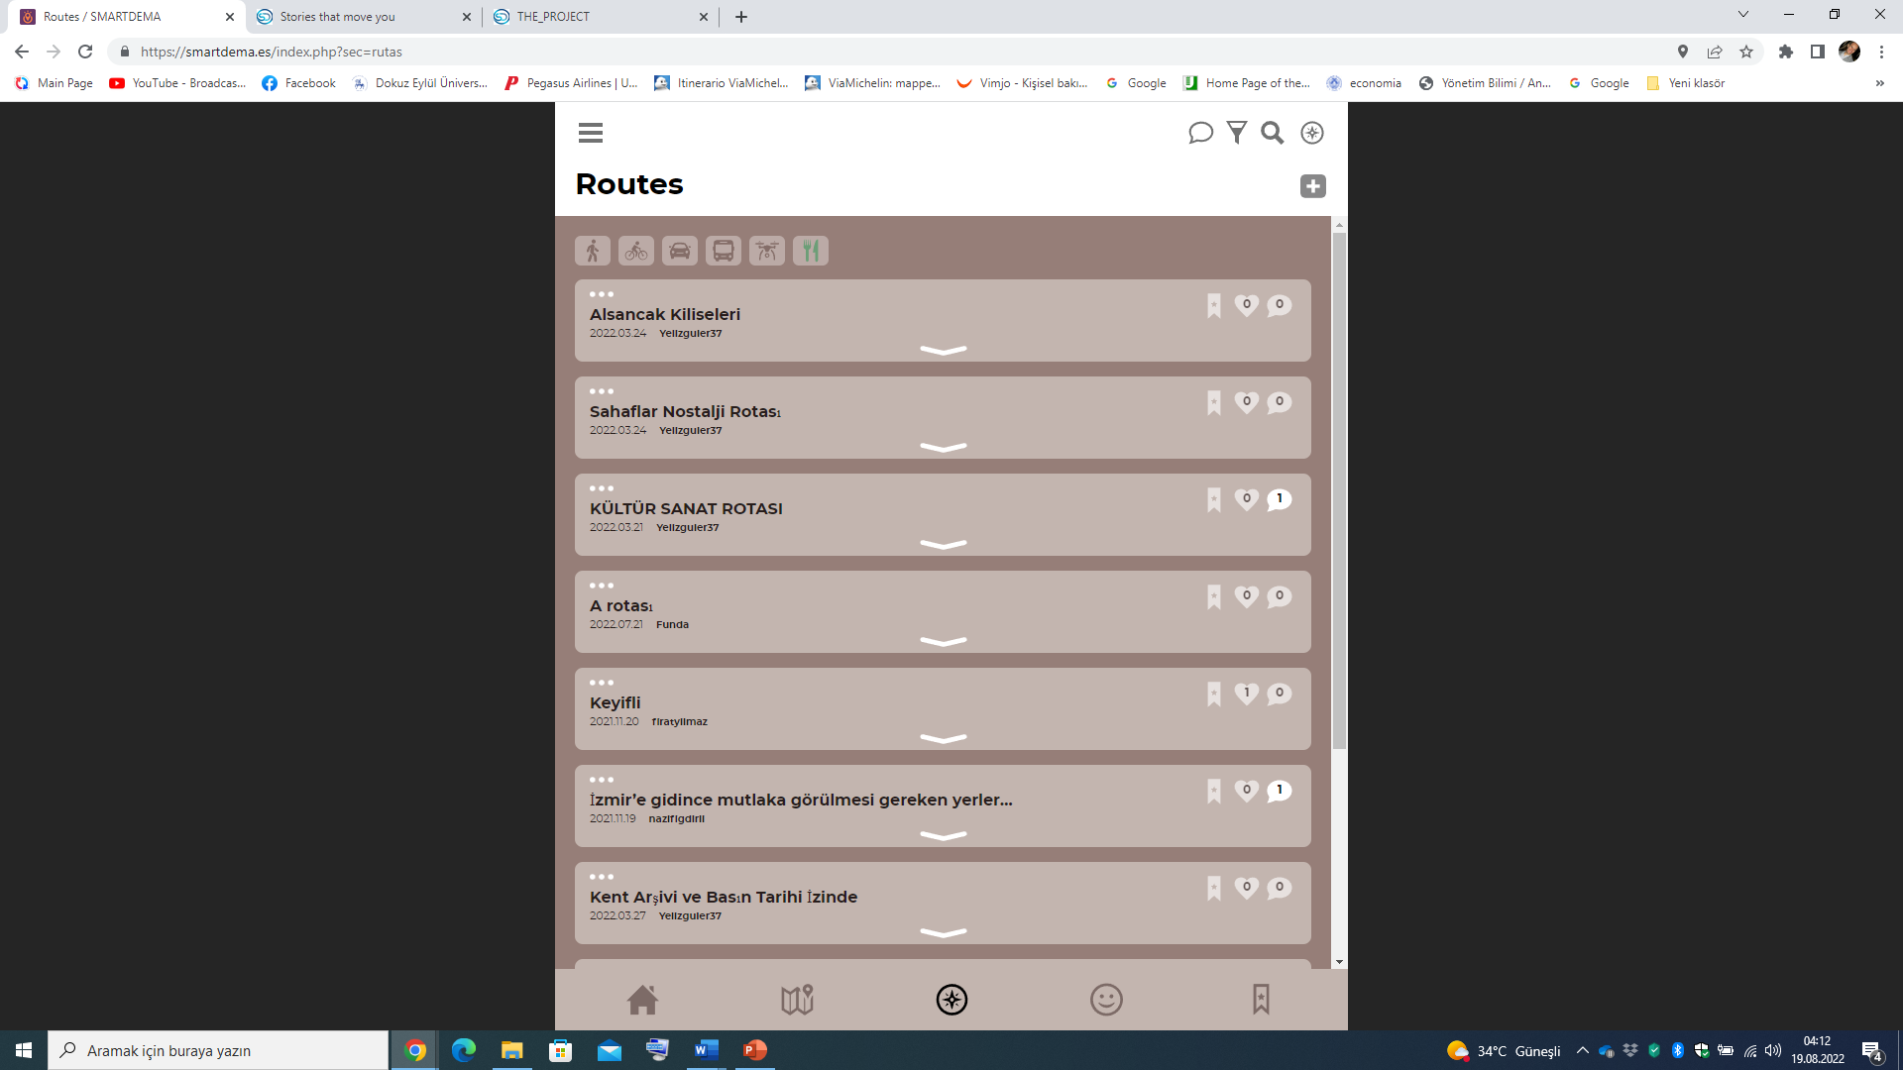
How to create your own route

Slide 61


Slide 62


Slide 63


Slide 64


Slide 65
  The users have created new, different routes to reflect the special, various type of interests of citizens in Izmir.
  Examples of these routes:
    The Jewish heritage route
    The Vegan route by Ferry
    Urla vineyards route by bike
    Zübeyde Hanım route with her memories
    city's culture and art route
    The churches route of Alsancak
    second-hand booksellers’ nostalgia route
    İzmir Clock tower and the ancient city of Agora
    Museums of Izmir
    The city archive and press history route

Slide 66

Second-hand Booksellers’ Nostalgia Route
(nostalgia route to old books)
At Ege Kitap ve Plak, the first stop of the route, you will go to the past among the forgotten 45 records and comics. The second stop on the route is Palto Sahaf which is a second-hand bookseller, you can find rare old books. At Guguklu Cafe, which is the resting point of the route, you can make your choice among rare sodas from every region of Turkey and cool off. At our last stop, Yerdeniz Bookstore, you can meet the best-selling books. This is a journey for book lovers, from the dusty pages of the past to the works of art of today.

Slide 67


VEGAN ROUTE WITH FERRY

Slide 68


Slide 69


Slide 70


Slide 71


Slide 72

Thank you for listening & patience…
Please do not hesitate to communicate with me directly for any question, ideas or potential collaboration.
Assoc.Prof.Dr.Emir Ozeren
Coordinator
SmartDEMA Eramus+ KA2 Project
emirozeren@yahoo.com
emir.ozeren@deu.edu.tr

