Slide 1
Data Analysis
Joumana Boustany

Slide 2
SMALL DATA vs BIG DATA
Data is small enough for human comprehension | Data is too large to be analyzed by humans
Data is made up of small elements that are make them: readable accessible understandable usable | Data is specific to machines. It is generally characterized by 3V: Volume Variety Velocity (speed)
Data generally provides information that answers a specific question or addresses a particular problem | Invented by the web giants, Big Data is a solution designed to allow everyone to access giant databases in real time
Data concerns the end user. These data provide information on what he needs, on his reactions and feelings | Collecting and processing data on a large scale can be time consuming, as can feedback

Slide 3
Qualitative method vs. Quantitative method
The qualitative method is a search for meaning | The quantitative method is a data collection technique associated with concrete data
It focuses on opinions and motivations | It allows us to analyze behaviors, opinions, or even expectations in measurable quantities
It tends to focus on "how?" and "why?" questions | She tends to favor questions like "how many?" and "how often?"

Slide 4
Which software to analyse the data?
NVivo will be used to analyze Smartdema data. It is a qualitative data analysis software
Other software exist
ATLAS.ti, Provalis Research Text Analytics Software, Quirkos, MAXQDA, Dedoose, etc.
Open source software exist also:
R project + specific extensions
The interface is designed for statistics specialists.

Slide 5
NVivo
Software designed by QSR International
Allows you to organize, code and manage your data as well as to facilitate its analysis with visualization, memorization and reporting functions.
WARNING, the (difficult) work of sorting the data still rests on your shoulders.
It helps you analyze text, audio, video, email, images, spreadsheets, online surveys, web content and social media from various sources.
Through a browser extension "Ncapture", it allows to collect data directly from the web
Even if it is essentially a qualitative analysis software, it also allows to make quantitative analyses

Slide 7
Data Quality is an Important Criterion
Before you can process the data, it is important to clean it:
Make sure that the columns and rows have been exported correctly. Some characters may cause problems
Delete irrelevant data (sometimes people write irrelevant content not related to the context)
etc.

Slide 8
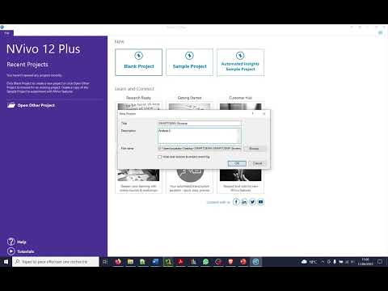
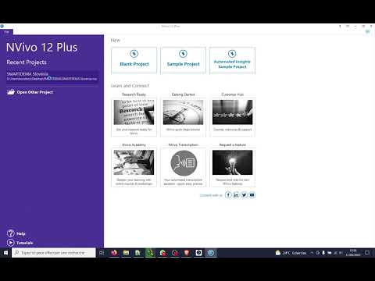
Create a new project
Open an existing project

Slide 9
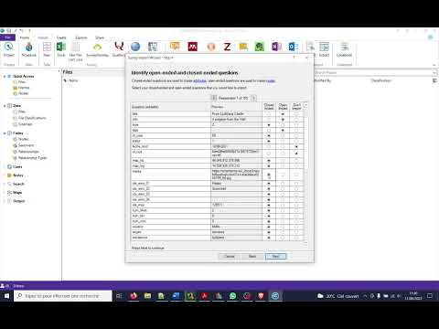
Import data
Cases
Units of analysis
In SMARTDEMA context each story = a case
Close-ended questions => Attributes
question formats that provoke a simple response from a respondent. e.g.: smiley
attributes are the values that these fields can contain. e.g.
Open-ended questions => nodes
an open-ended question is a question that cannot be answered with a "yes" or "no" response, or with a static response. e.g. title, info, tags
the contents of these fields will be grouped into nodes or themes

Slide 10
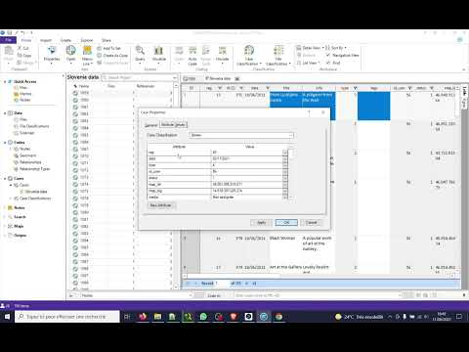
Where to find cases?
These cases can be used for future cross-referencing and analysis

Slide 11
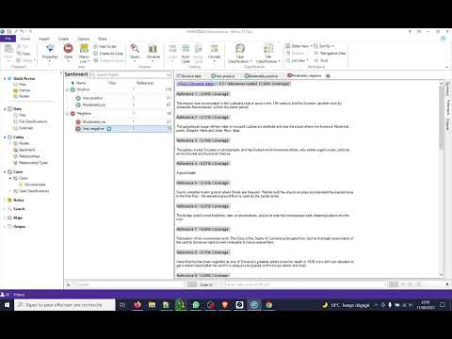
Access Sentiment Analysis
In the import process, we asked NVivo to code sentiment.
The result is divided into 2 classes :
Positive
Moderately positive
Very positive
Negative
Moderately negative
Very negative
Beware that the results are not always reliable. Is should be corrected manually

Slide 12
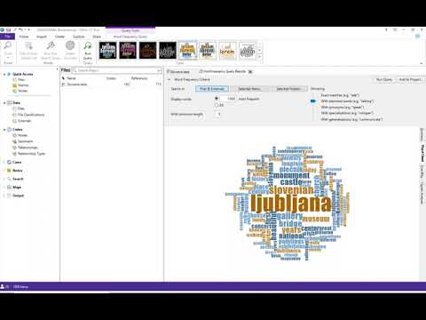
Word Frequency
NVivo allows to highlight the vocabulary used in a certain context
It presents the most frequent words in different ways:
List
Word cloud (The word cloud will list all the words used by the story writers, and highlight the most used)
Tree map

Slide 13
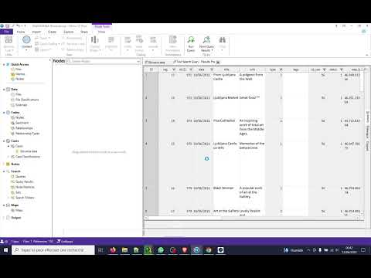
Explore and Create Node Manually
This procedure brings together the different themes addressed in the stories
NVivo uses Nodes for a collection of all the sections of qualitative data (references) that have been coded as belonging to a project theme.
For example, all the segments of text/audio/video/picture in SMARTDEMA corpus which refers to Castle will be coded to a node called “Castle”.

Slide 14
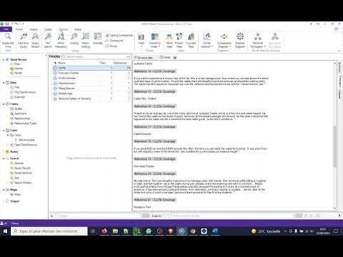
Explore Corpus and Create Nodes by Queries
When you have explored at least 10% of your corpus, you can have an idea about the content
At this level, you can use queries to code the text

Slide 15
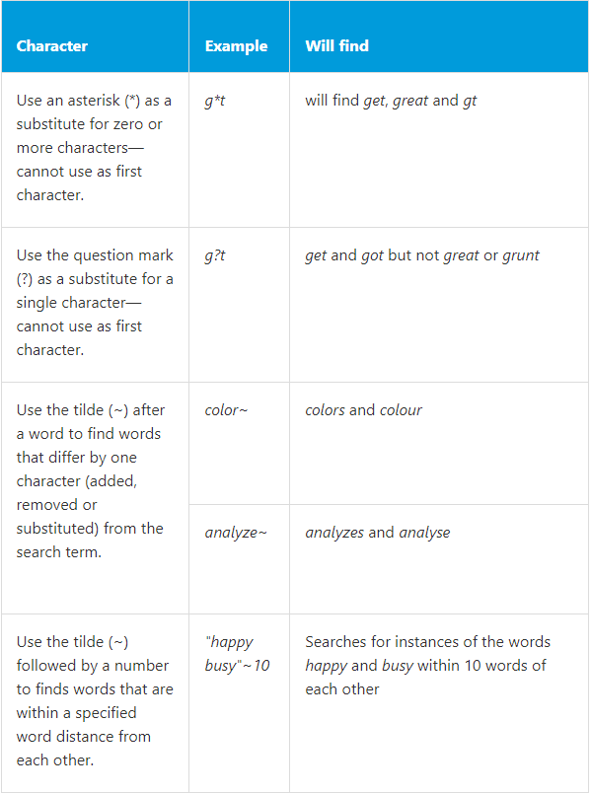
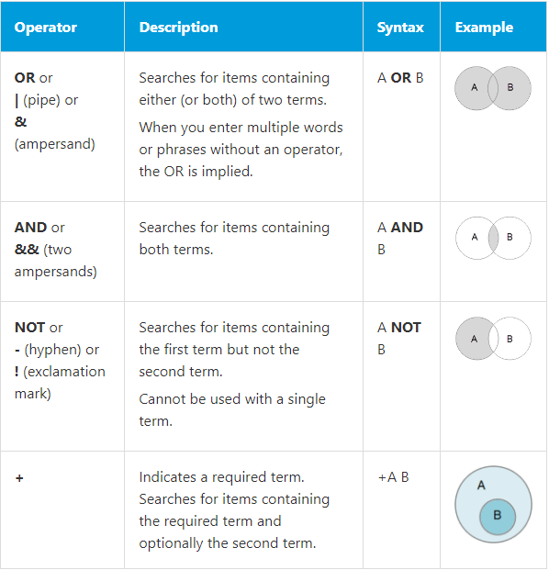
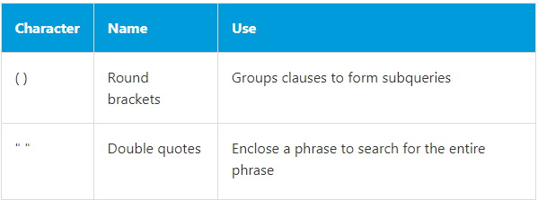
Wildcard and proximity characters
Boolean operators
Other special characters

Slide 16
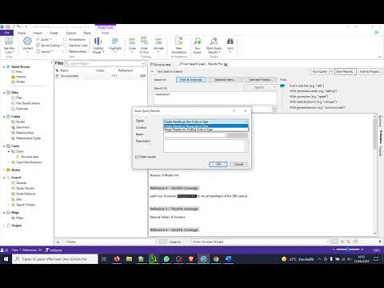
Explore Corpus and Create Nodes by Queries Using Advanced Operators
As shown in the previous slide, NVivo offers advanced search options.
In this video, we explain how to create a code using bartering.
impression* = impressionist, impressionism

Slide 17
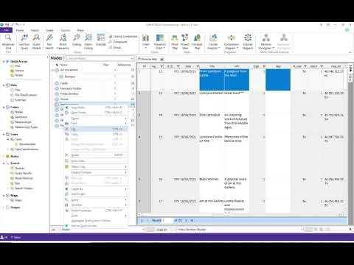
Classify nodes
When coding your corpus, you may have to reorder your nodes as you discover the content
This procedure is easy to do with NVivo

Slide 18
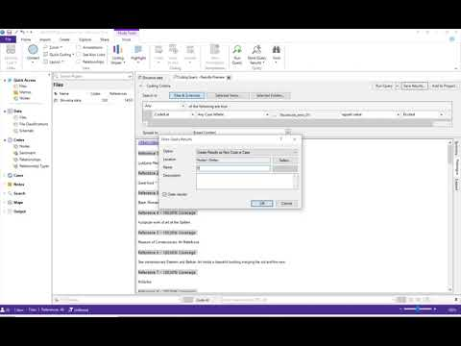
Code Closed-Ended Question
In our corpus, we used smileys to classify the content into nodes
This choice will allow to create a matrix Coding cross the different nodes

Slide 19
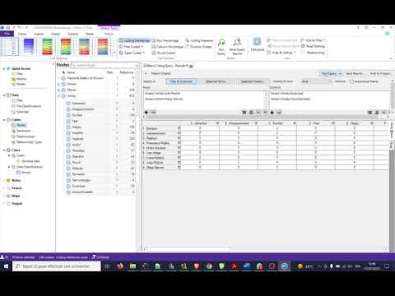
Matrix Coding Analysis
In order to understand if certain places, artists, etc. provoke certain emotions in the users, we crossed the data related to these variables with the emotions.

